Slide 1
Welcome to Project ECHO COVID and Communicable Diseases Network
Series 11: Session 1
“Beyond the COVID-19 Pandemic: Revisiting our role in Infection prevention and control in primary care”

Slide 2
Acknowledgement of Countries
I’d like to begin by acknowledging the Traditional Owners and custodians of the lands and waterways from which we are all zooming in from today.
the Wadda Wurrung, Gulidjan, Gadubanud, Keeray Wurrung, Peek Wurrung, Gunditjmara, Djab Wurrung, Wotjobaluk, Dja Dja Wurrung, Jadawadjarli, Wergaia, Jaadwa and Jupagalk peoples
We recognise their diversity, resilience, and the ongoing place that First Peoples hold in our communities.
We pay our respects to the Elders, both past and present and commit to working together in the spirit of mutual understanding, respect and reconciliation.
We support self-determination for First Nations Peoples and organisations and will work together on Closing the Gap.
Ask the question. Do you identify as Aboriginal or Torres Strait Islander?

Slide 3
Etiquette/Zoom use
Chat
Introduce yourself / Role / Region / Organisation in “chat”
Use chat to ask questions
Please remain on ‘mute’ except when speaking
Please turn video on
In-session Evaluation at the end
These sessions will be recorded for ongoing training and quality improvement purposes.
The didactic presentations ONLY will be disseminated on our learning channel.
Discussions will be de-identified where used for QI or research purposes.
Please let us know if you would not like your comments recorded.
RACGP and ACCRM accredited, certificates PD

Slide 4
Learning outcomes
Series
Opportunity to review and discuss policy and guidelines in practice
Discuss emerging models of primary care with a focus on:
Communicable disease prevention
Communicable disease screening, assessment and management
evaluation of respiratory symptoms and fevers
Continuing care provision
Consider real-world experiences of implementing new care models in different settings
Build knowledge about current resources, supports & referral pathways
Engage in a community of practice and rapid learning network
Session 1 Learning outcomes
Differentiate the roles of the Department of Health and the regional Public Health units in communicable diseases reporting and surveillance activities
Describe the communicable diseases of high priority in Victoria and the Western Vic region at this time
Discuss the role of primary care clinicians in data collection and reporting
Discuss the role of the public health units and department of health in communicating with primary care to enact public health responses relevant to primary care
Describe Victorian key initiatives in communicable diseases prevention and control at this time.

Slide 5
Agenda for COVID and Communicable Diseases Network Series 11: Session 1 “Beyond the COVID-19 Pandemic: Revisiting our role in Infection prevention and control in primary care”
Naomi White, Covid Operations Manager, Western Victoria PHN
New announcements
Associate Professor Deb Friedman, Deputy Chief Health Officer (Communicable Disease), Victorian Department of Health
Communicable Diseases policy and key priorities
Communicable Diseases public health knowledge framework
Panel for discussion:
Dr Akhtar Hussain, Public Health Physician, Public Health Unit, Barwon Health

Slide 6
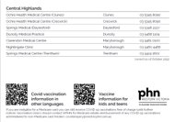
COVID update
Antiviral prescribing – 290,000 prescriptions since feb on PBS
Vaccines
New bivalent Moderna is replacing original Moderna
Automatic enrollment to Pfizer for Moderna clinics
Notify PHN if wishing to withdraw
Vaccinations for Non-medicare card holders – for free – PHN will reimburse
Notes:
https://westvic.communityhealthpathways.org/1015115.htm

Slide 7
COVID update cont..
Isolation for positive case now – recommended
October 1st changes -
GoShare- COVID bundles now live
Post-pandemic?
Notes:
Novavax vaccine for adolescents aged 12-17 years | Australian Government Department of Health and Aged Care

Slide 8
Project Echo October 13, 2022
Deb Friedman
Deputy Chief Health Officer
Communicable Diseases
Victorian Department of Health

Slide 9
Domains of public health
Health Services
Health Promotion
Healthcare Workforce
Access to healthcare
Evaluation of healthcare
Informing & empowering community to improve health
Health Protection
Enforce regulations
Monitor, investigate and respond to immediate problems
Notes:
One way of looking at public health is by splitting it into health protection, health promotion and health services.
Health protection focuses on hazards (can be biological, chemical, physical, radiation)
Exposures
Impacts
Health protection is often split into Communicable disease and Environmental health

Slide 10
What is meant by “Health Protection” in Victoria?
COMMUNICABLE DISEASE CONTROL
ENVIRONMENTAL HEALTH
Agent
Environment
Host
Notes:
Communicable disease public health medicine looks at communicable hazards, exposures and impacts
Uses agent, host, environment paradigm

Slide 11
What is communicable disease control?
The reduction in incidence of preventable disease by protecting the community against hazards resulting from or associated with communicable disease
Eradicate
Control
Eliminate

Slide 12
Example: Polio elimination and smallpox eradication via vaccination

Slide 13
The pillars of communicable disease control
Prevention
Surveillance
hazards, exposures, impacts
Control (Investigation & Response)
Risk Assessment
Risk Management
Risk Communication

Slide 14
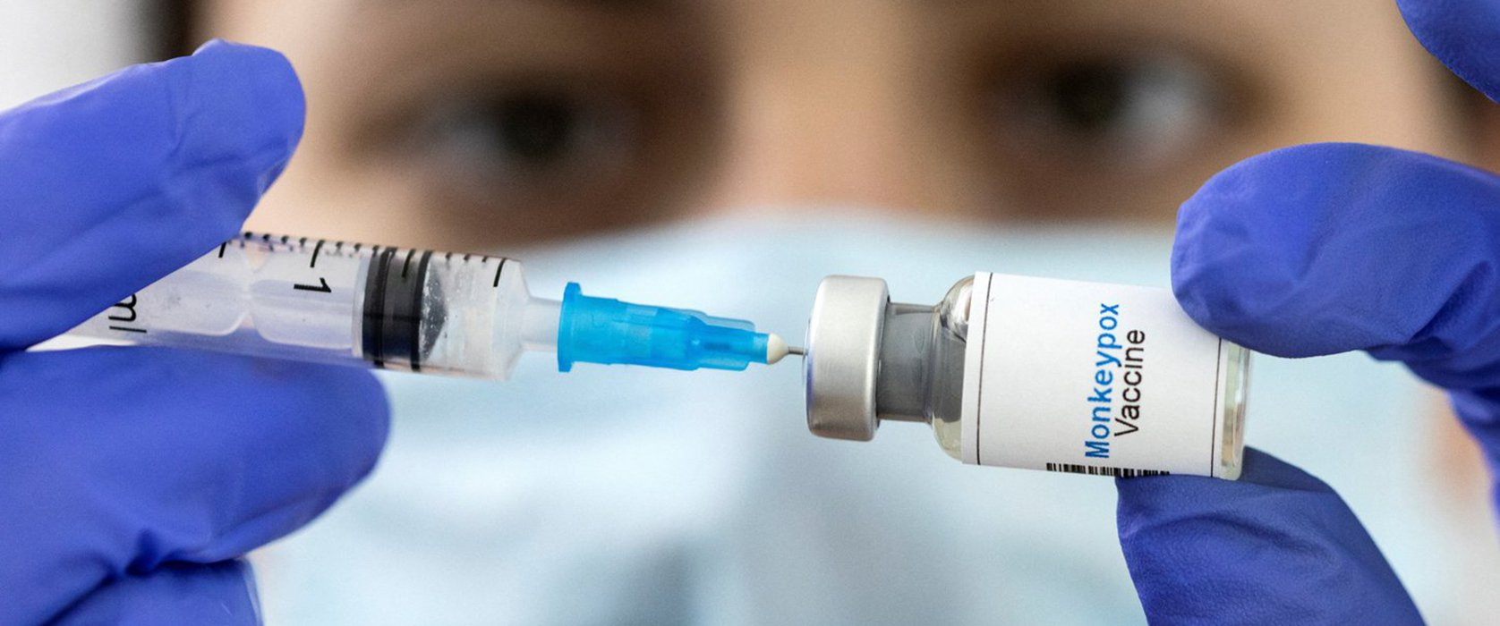
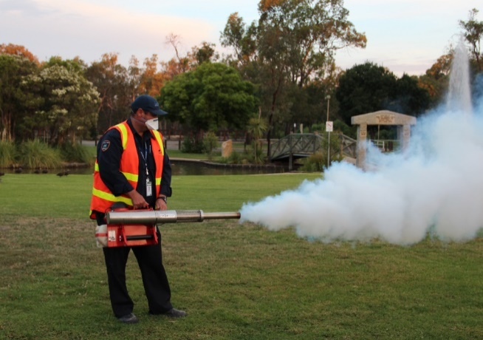
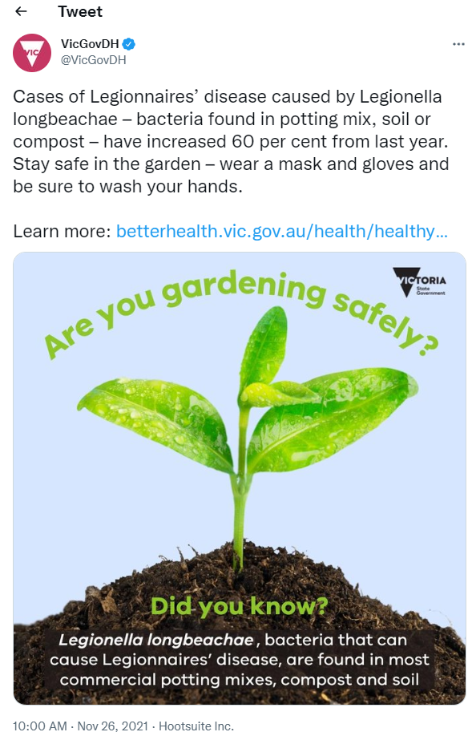
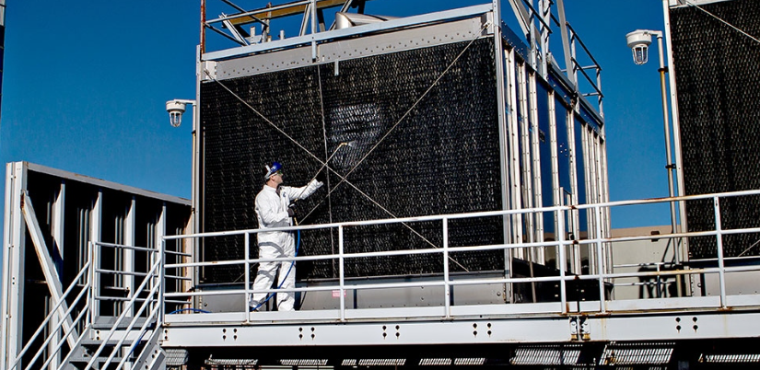
Prevention Examples of communicable disease prevention activities
https://thorneharbour.org/sexual-health/monkeypox/
https://twitter.com/vicgovdh/status/1464006064748339205
Notes:
Examples of prevention activities against communicable diseases:
Vaccination
Vector/Mosquito control (both prevention and control activity)
Cooling tower inspection and pre-emptive cleaning for legionella
Public communications/raising awareness (e.g., around wearing a mask and gloves when handling potting mix)

Slide 15
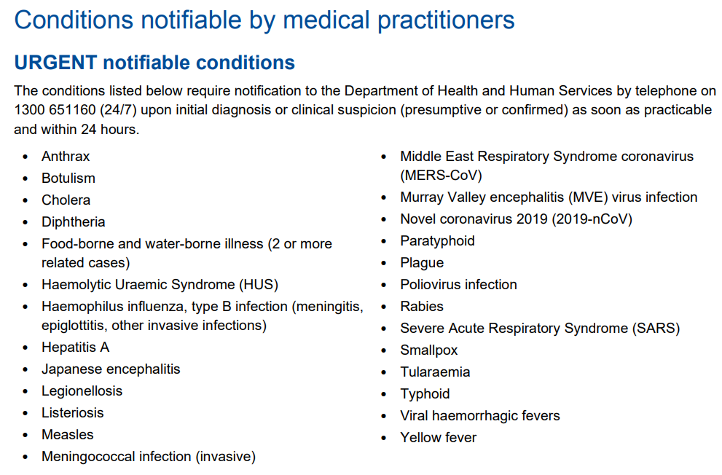
Surveillance How we find out about things – Urgent notifiable conditions
Notes:
Brainstorm ways of finding out about infectious disease.
In Victoria, notification forms the bedrock of information gathering about communicable disease for the department.
Discuss advantages and disadvantages of notifications
Discuss some urgent notifiable diseases and get students to say what can be done if we find out promptly

Slide 16
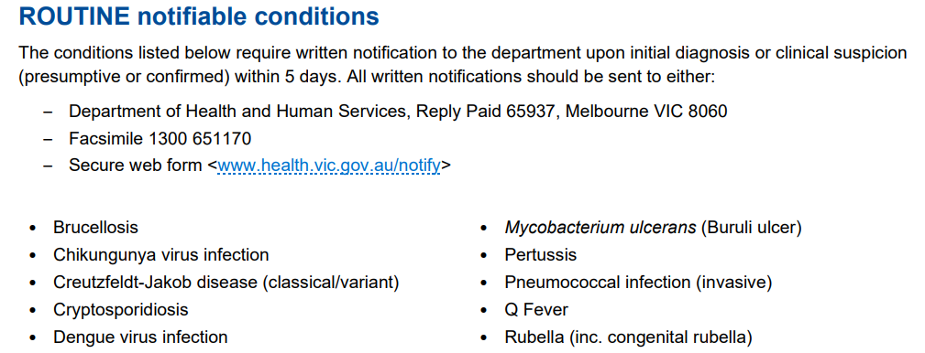
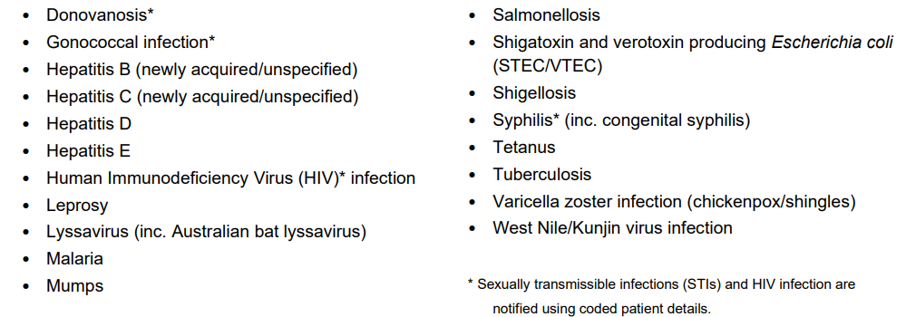
Surveillance How we find out about things – routine notifiable conditions
Notes:
Brainstorm ways of finding out about infectious disease.
In Victoria, notification forms the bedrock of information gathering about communicable disease for the department.
Discuss advantages and disadvantages of notifications
Discuss some urgent notifiable diseases and get students to say what can be done if we find out promptly

Slide 17
Timeline for training and integration into LPHUs
Integration order | Condition | 1. DRC review date | 2. Training dates | 3. Provisional integration date
1 | Influenza | 17 June | 6 July 2022 | 18 July 2022
1 | RSV | 17 June | 8 July 2022 | 18 July 2022
1 | Pertussis | 17 June | 13 July 2022 | 18 July 2022
2 | Mycobacterium ulcerans | 7 July | 20 July 2022 | 25 July 2022
2 | Varicella | 28 July | 3 August 2022 | 15 August 2022
2 | Invasive Pneumococcal Disease | 7 July | 10 August 2022 | 22 August 2022
3 | Hepatitis B | 11 August | 17 August 2022 | 29 August 2022
3 | Hepatitis C | 11 August | 24 August 2022 | 5 September 2022
 | Review of disease transition and pause | N/A | N/A | Commencing 31 August 2022 and for month of September
4 | Shigella | 6 October | 12 October 2022 | 24 October 2022
4 | Ross River/Barmah forest | 6 October | 19 October 2022 | 31 October 2022
5 | Chlamydia | 20 October | 2 November 2022 | 14 November 2022
5 | Q fever | 20 October | 16 November 2022 | 28 November 2022
6 | STEC | December | TBD | 12 December 2022
6 | Gonorrhoea | January | TBD | TBD
- | Rotavirus | February | TBD | TBD
- | Rabies/Lyssavirus | February | TBD | TBD

Slide 18
Role of doctors in notifiable disease
Clinical suspicion and appropriate investigation
Notification of suspected and confirmed cases
Initial management and risk minimising advice
Follow up of investigation results
Inform individual(s) of diagnosis
Arrange clinical follow up and referral
Assist Department of Health with additional information or investigation as required

Slide 19
Evolving threat of infectious diseases

Slide 20
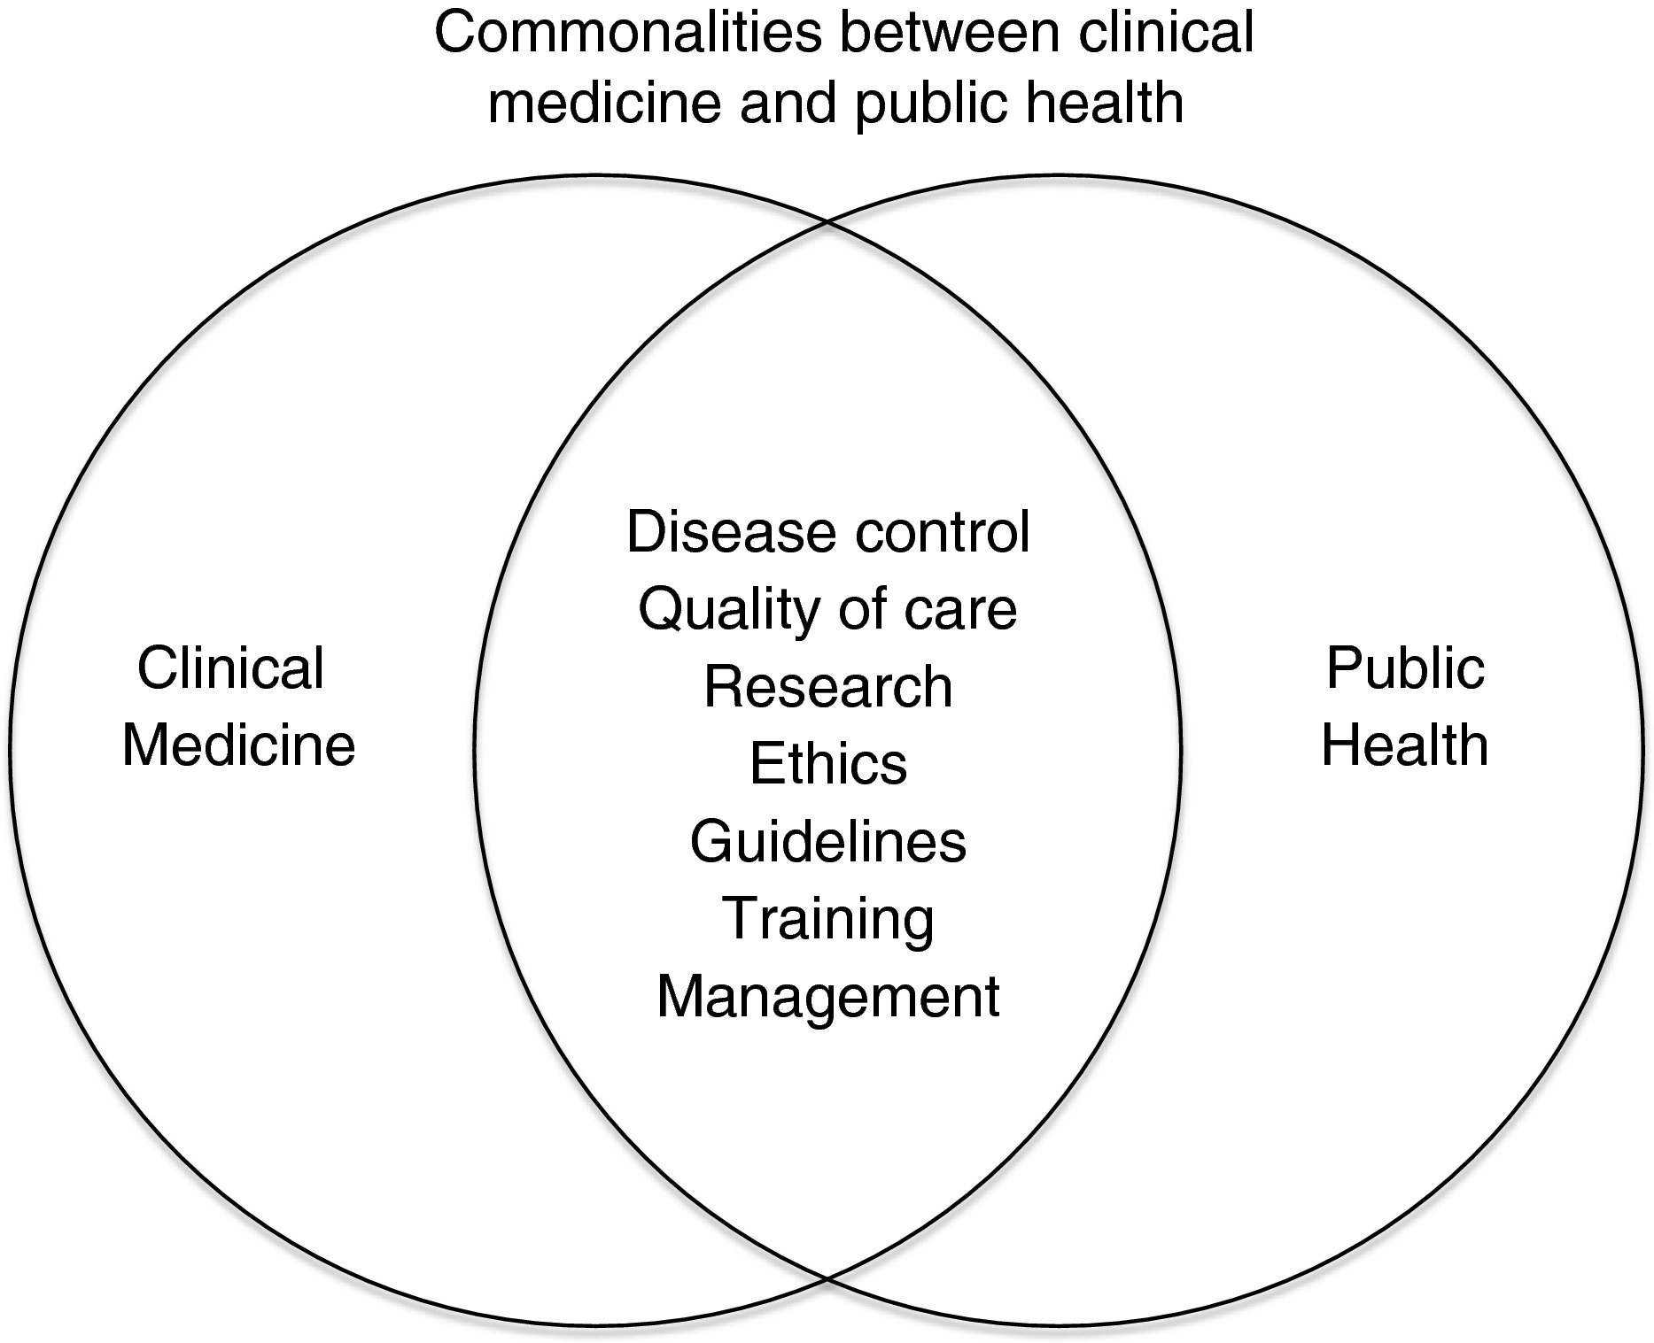
Health Promotion

Slide 21
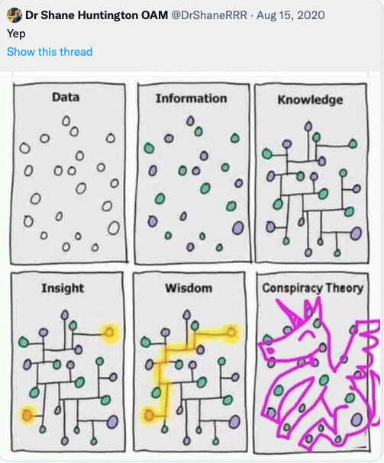
Where we started….a learning loop to mobilise knowledge Find missing knowledge, transfer it to where it is needed and organise it for future use
K2P
Knowledge to Practice
P2D
Practice to Data
D2K
Data to Knowledge
March 2020 an agile MVP
Knowledge Management
-People
-Process
-Tools/technology
-iterative content
Notes:
So, our story begins in March 2020 and to use hip agile thinking, inspired by our CHO,
-it all started with a minimum viable product- an Adaptive learning platform
- a learning loop to find knowledge, move it to where it is needed and codify it for future use
Recipe is fairly simple:
people,
tools and tech and
a process…
content
Learn and refine as you go.
Wherever possible, apply the appropriate amount of rigour to avoid this happening…

Slide 22
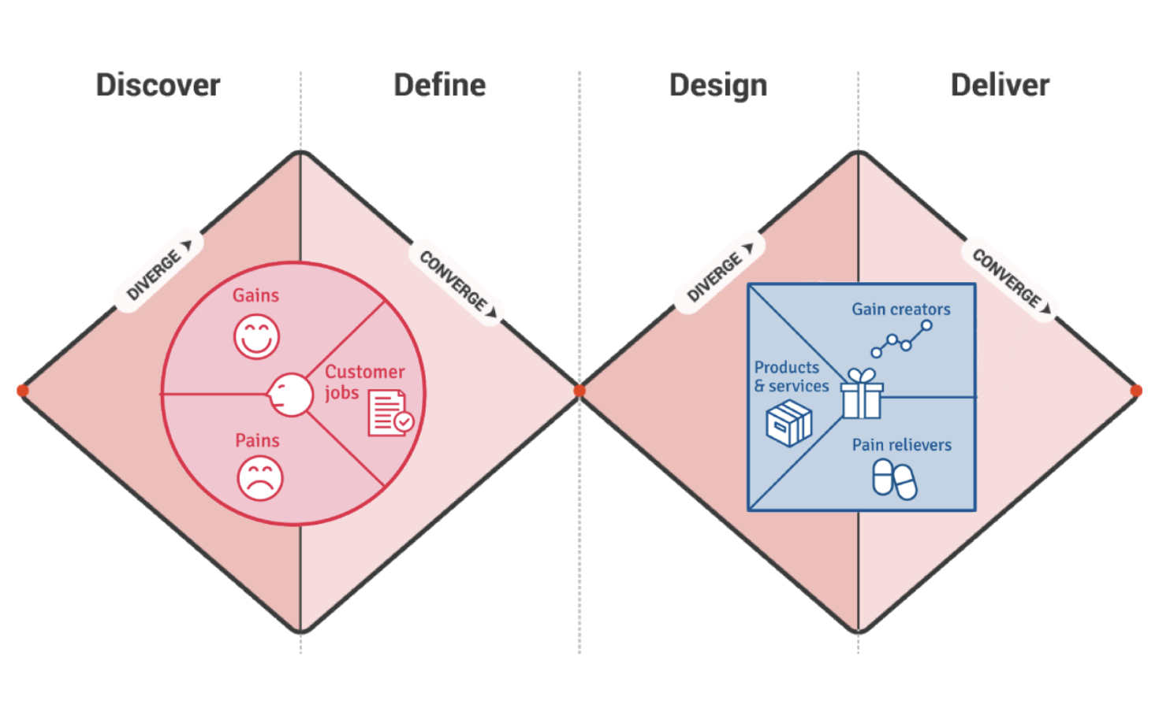
K2P
P2D
Practice to Data
D2K
Where we are heading- A Learning Health system?
ECHO
S03
ECHO
S04
ECHO
S05
ECHO
S01
ECHO
S02
Data to Knowledge
Epidemiology
Demand analysis
Service utilization
Gap analysis
Cost
Policy
Step 1- Define the Problem
-create a vision and shared goal
Notes:
Both making

Slide 23
Communicable Diseases “Sprint”
Experts in content
Policy- A/Prof Deb Friedman (DoH)
D2K- Dr Amanda Wade (BSW PHU)
K2P- Dr Kate Graham (WVPHN)
K2P- TBC
P2D-TBC
Tune in for each weeks reveal!
Experts in context
What is the problem?
What could we accomplish?
How will we know that we have made an improvement?
-as clinicians, an organisation, as a system

Slide 24
Case Presentation- SBAR tool
This is how easy it is
S-Situation (a concise statement of the problem)
40 something year old woman lesion on elbow for 2/7
B-Background (pertinent and brief information related to the situation)
Lives on Bellarine peninsula, loves gardening.
A-Assessment (analysis and considerations of options — what you found/think)
R/Q-Recommendations/Question (action requested/recommended — what you want)
It’s only been 2/7 so I think she’s being a hypochrondriac.
What is the likelihood that this could be a communicable disease? What data can you access?
what would the appropriate testing be in her region? Where can you access this advice?
Noticing the possums and lorikeets are eating all the fruit buds and the mozzies are back out with a vengeance!
Nil co-morbidities. She runs and eats lots of veggies. Totally virtuous.
Lesions doesn’t look like much more than a scratch
but I should give her some advice about when to return for review/testing
https://www.ihi.org/resources/Pages/Tools/SBARToolkit.aspx

Slide 25
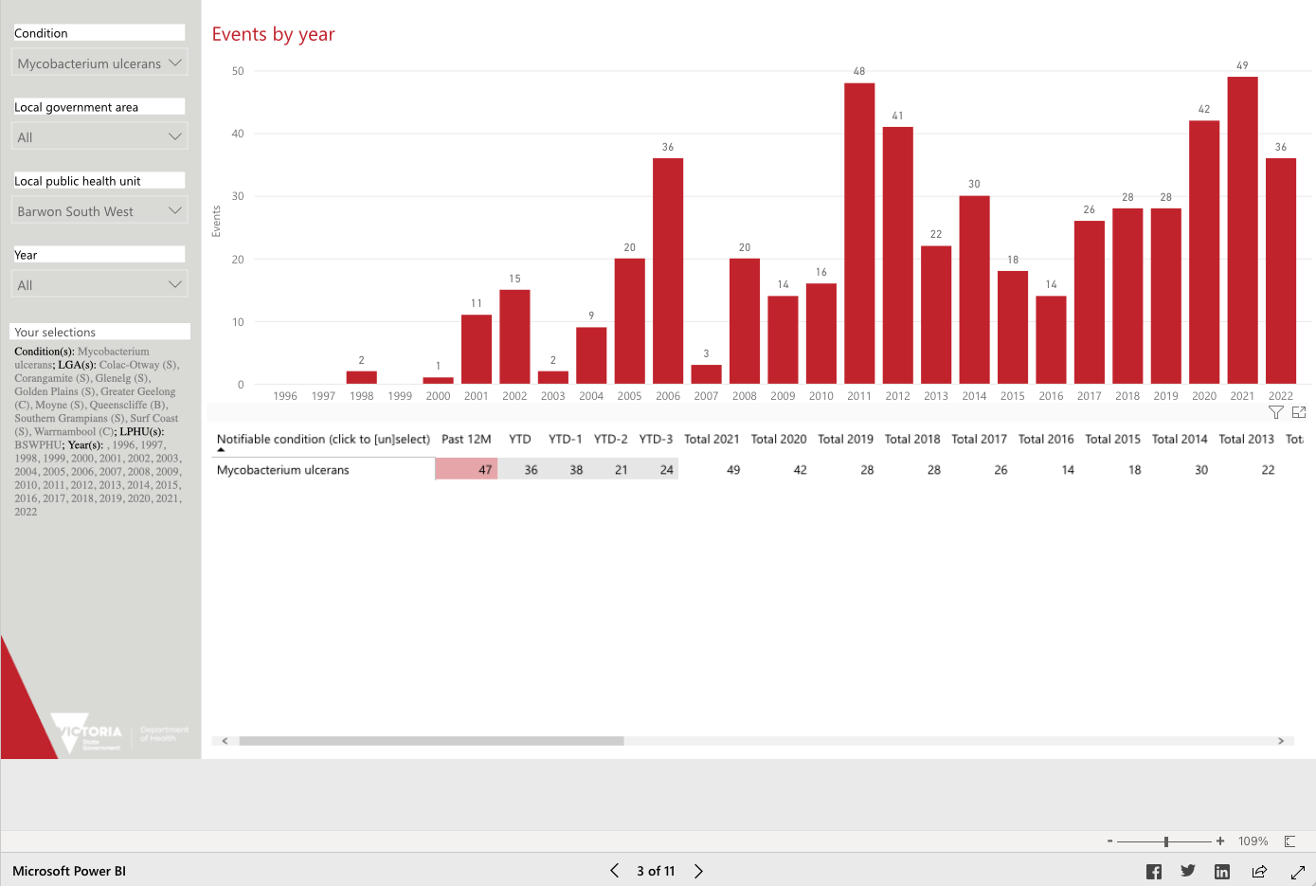
Accessing the data
Local epidemiology
https://app.powerbi.com/view?r=eyJrIjoiMjQ0OWI3ZTAtNjMwOS00ODk4LTlmMjAtZDc5MjZiMzA2YWNiIiwidCI6ImMwZTA2MDFmLTBmYWMtNDQ5Yy05Yzg4LWExMDRjNGViOWYyOCJ9

Slide 26
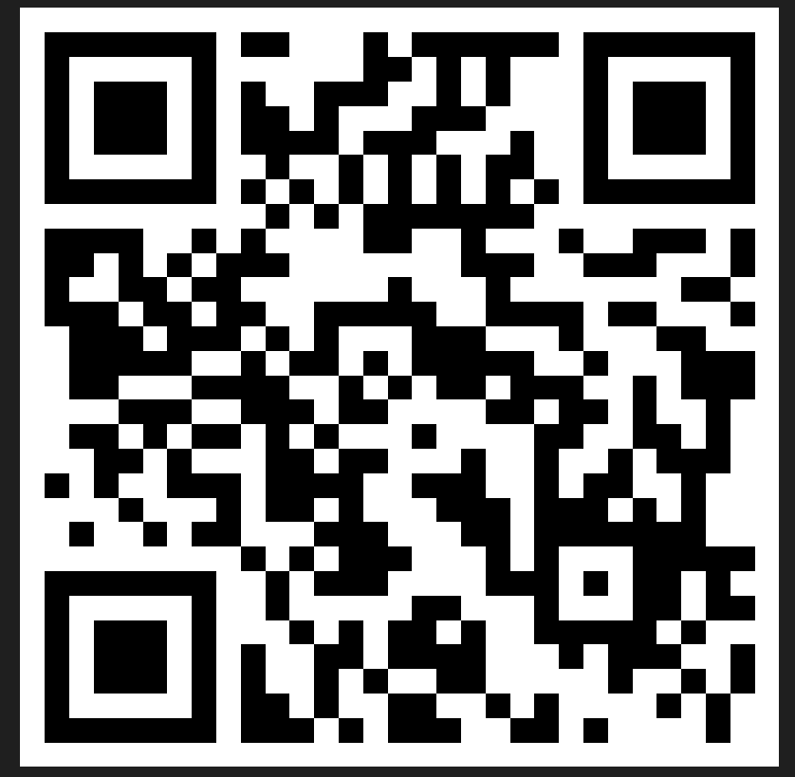
Evaluation
Session evaluation
Please take the time to evaluate this session
Link pasted into the chat
Session evaluation
Upcoming Sessions
27 October
10 November
24 November
8 December
If you have a case you would like to discuss with the group:
New case template here
Email projectechocovid19@westvicphn.com.au
Use the comment box in the evaluation form
Notes:
Session evaluation link https://forms.office.com/r/fb8b5Jv61J
Case template link https://forms.office.com/r/xFPCCRSkzc

Slide 27
Be a part of an International study
Participate in an International Project ECHO study!
This study aims to:
Understand how implementations of Project ECHO compare across international and sectoral contexts
Understand where implementations of Project ECHO can be improved across international and sectoral contexts
Your de-identified aggregate data will be submitted to The University of Queensland and Children's Health Queensland Hospital and used to examine the various implementations of Project ECHO within organisations worldwide from across multiple sectors to determine the current state of play using an implementation success framework.
It’s the first of it’s kind. Please support Project ECHO.
This study has ethics approval through the HREC committee at Children’s Health Queensland Hospital and Health Service, and The University of Queensland (HREC approvals no: HREC/22/QCHQ/86967, 2022/HE001044 and SSA-2022-QCHQ-86967).
Notes:
International Project ECHO Study https://forms.office.com/r/vUDwHruTi0

Slide 28
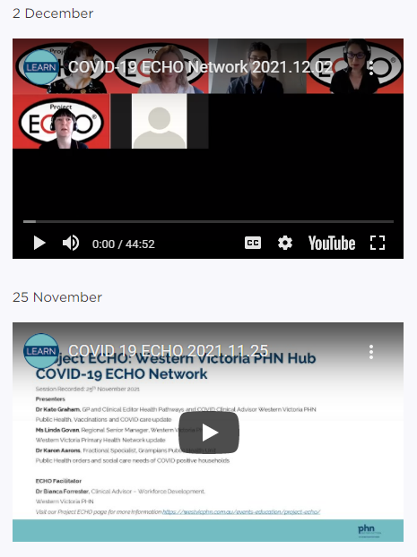
Listen and watch back previous sessions
Content is available on the WVPHN website
Listen back to all the series through Project ECHO: WVPHN Hub
COVID-19 ECHO network on Whooshkaa
https://westvicphn.com.au/events-education/project-echo/project-echo-covid19/
Notes:
https://player.whooshkaa.com/shows/project-echowvphn-hub-covid-19-echo-network
https://www.youtube.com/watch?v=nB5N57z9zG8&t=1s
Townhall 13th January 2022 https://www.youtube.com/watch?v=sr3uHtknLWs
Weekly emails,
Interactive discussions
To watch to view – Youtube
To listen - Whooshkaa
To listen to read – newsletter, resource pack, Zac’s notes
to participate – ECHO
To get in touch with us, email, healthpathways,

