Slide 1

Welcome to Project ECHO
COVID and Communicable Diseases Network
Series 11: Session 2
“Communicable diseases part 2: Analysing data and building knowledge- a case example of Hepatitis elimination in the West Vic Region”

Slide 2


Acknowledgement of Countries
I’d like to begin by acknowledging the Traditional Owners and custodians of the lands and waterways from which we are all zooming in from today.
the Wadda Wurrung, Gulidjan, Gadubanud, Keeray Wurrung, Peek Wurrung, Gunditjmara, Djab Wurrung, Wotjobaluk, Dja Dja Wurrung, Jadawadjarli, Wergaia, Jaadwa and Jupagalk peoples
We recognise their diversity, resilience, and the ongoing place that First Peoples hold in our communities.
We pay our respects to the Elders, both past and present and commit to working together in the spirit of mutual understanding, respect and reconciliation.
We support self-determination for First Nations Peoples and organisations and will work together on Closing the Gap.
Ask the question. Do you identify as Aboriginal or Torres Strait Islander?

Slide 3


Etiquette/Zoom use
Chat
Introduce yourself / Role / Region / Organisation in “chat”
Use chat to ask questions
Please remain on ‘mute’ except when speaking
Please turn video on
In-session Evaluation at the end
These sessions will be recorded for ongoing training and quality improvement purposes.
The didactic presentations ONLY will be disseminated on our learning channel.
Discussions will be de-identified where used for QI or research purposes.
Please let us know if you would not like your comments recorded.
RACGP and ACCRM accredited, certificates PD

Slide 4
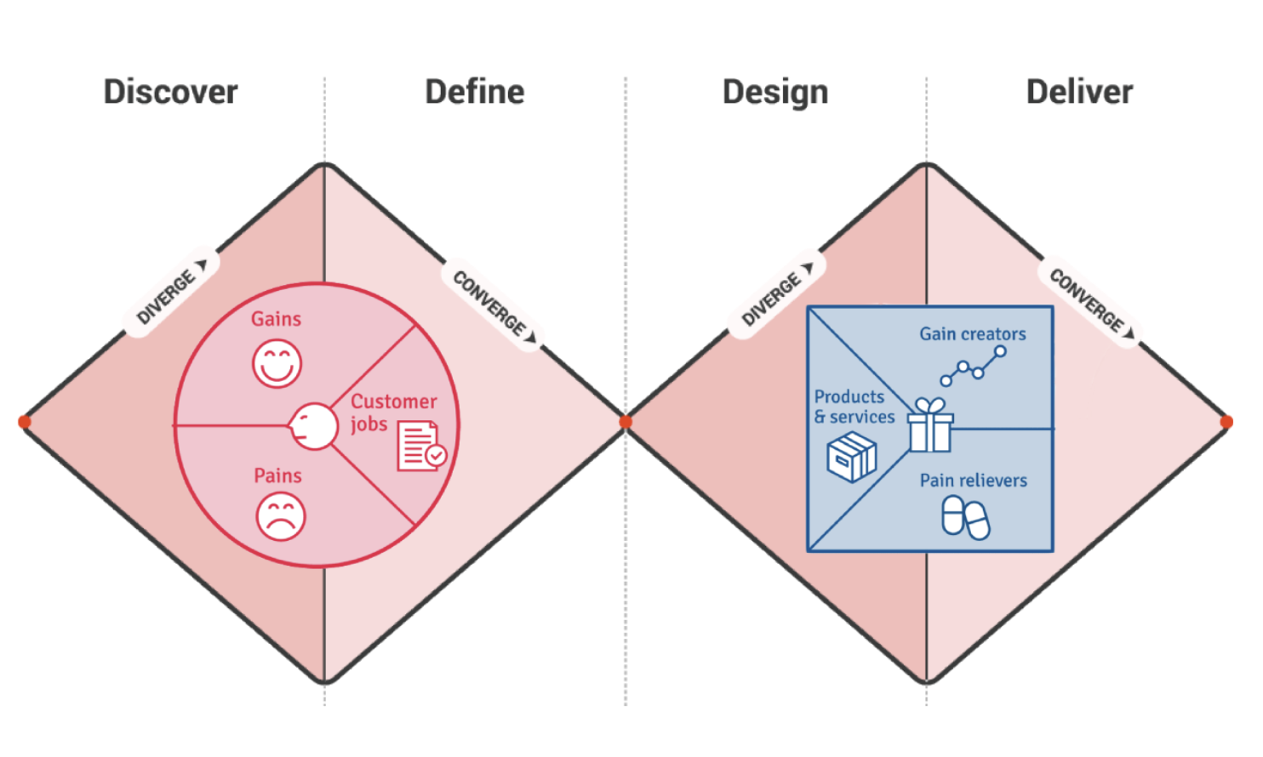
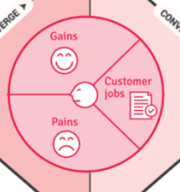
Learning labs- focus on process
Deliver, Discover, Define, Design, Deliver
K2P-Solution design-
Guidance, decision tools
models of care (MOC)
D2K
Data to Knowledge
K2P
Knowledge to Practice
D2K-Diagnostic- Evidence- gaps/needs
ECHO
SE3
ECHO
SE4
ECHO
SE5
ECHO
SE1
ECHO
SE2
K2P-Implementation
Quality Improvement
PDSA
P2D-Case for change- Policy to Practice
P2D
Practice to Data
K2P-Sustainability
Transform healthcare
Scale up MoC
The problem: People with Communicable diseases not receiving testing, care or management
Notes:
Both making

Slide 5
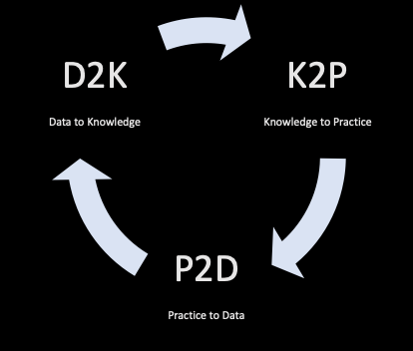
Define the problem- D2K- understand the root cause
Start with a problem statement
People living with communicable diseases need to access prevention, testing, care and treatment but they cannot do it or face a challenge [describe the challenge].
  (let's narrow this down!)
The problem is happening because [explain the cause of the problem that you identified from a needs analysis].
Based on [qualitative or quantitative data collected], I think that [your insights and solution design] can solve the problem.
  (let's get to it!)

Slide 6

Learning outcomes
Session 2 Learning outcomes
Describe the different types of data collection in relation to communicable diseases
Discuss the value of local prevalence data, care engagement and treatment data in practice in public health strategy
Describe the gaps needs of people living with Hepatitis B in relation to access to testing, care and treatment and the relevant gaps in care
Discuss how to interpret data represented visually
Describe how to use local population health and surveillance data to consider improvement to care at the local practice level
Series
Opportunity to review and discuss policy and guidelines in practice
Discuss emerging models of primary care with a focus on:
  Communicable disease prevention
  Communicable disease testing, assessment and management
  Continuing care provision in primary care and in partnership with specialist services
Consider real-world experiences of implementing new care models in different settings
Build knowledge about current resources, supports & referral pathways
Engage in a community of practice and rapid learning network

Slide 7
Agenda for COVID and Communicable Diseases Network Series 11: Session 1
“Communicable diseases part 2: Analysing data and building knowledge- a case example of Hepatitis elimination in the West Vic Region”
Naomi White, Covid Operations Manager, Western Victoria PHN
  New announcements in Commonwealth and state Policy and regional services
Dr Amanda Wade, Blood Borne Viruses Medical Lead, Barwon Health
  Accessing, extracting, mapping and interpreting data and health information for analysis
  Using data and insights to inform public health intervention planning
Panel for discussion:
Dr Kate Graham, GP and Clinical Editor – HealthPathways and COVID Clinical Advisor, Western Victoria PHN

Slide 8


Victorian Sexual and Reproductive Health Strategy 2022-2030
Goes live 24th October
The Victorian sexual and reproductive health and viral hepatitis strategy 2022–30 is designed to support people to achieve the best possible sexual and reproductive health outcomes and reducing the impact of blood borne viruses (BBV) and sexually transmissible infections (STI) on all Victorians
This strategy comprises seven plans - six of these are tailored to specific diseases and population groups and one focuses on the system enablers contributing to better outcomes across our sexual and reproductive health and viral hepatitis response.
https://www.health.vic.gov.au/victorian-sexual-reproductive-health-viral-hepatitis-strategy-2022-30
Notes:
https://www.health.vic.gov.au/victorian-sexual-reproductive-health-viral-hepatitis-strategy-2022-30

Slide 9
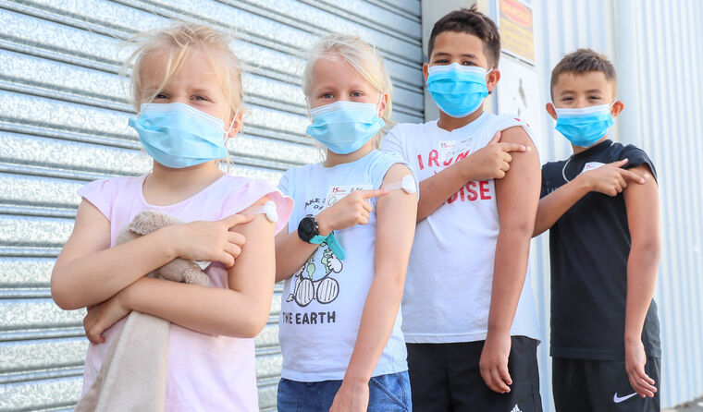
Commonwealth/State Policy announcement
ATAGI advise update on Boosters for 5-11 yo kids
  Severely immunocompromised
  Disability with complex health needs
  Complex and/or multiple health issues that increase risk of severe COVID-19

Slide 10

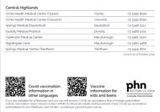

Local Regional COVID updates
Post Pandemic Declaration - Victoria
  Review your infection prevention and control policies
  Provide visible information on how patients can protect themselves
    I'm a COVID case/contact | Coronavirus Victoria
  Provide resources to staff to keep themselves as safe as possible
  Discuss with your insurance provider and Work Safe Victoria
    https://www.worksafe.vic.gov.au/managing-covid-19-risks-workplaces
  ASK us your questions and we will help answer them at next session
Vaccinations for Non-medicare card holders – for free – PHN will reimburse
Notes:
https://westvic.communityhealthpathways.org/1015115.htm
I'm a COVID case/contact | Coronavirus Victoria
https://www.worksafe.vic.gov.au/managing-covid-19-risks-workplaces

Slide 11
Barwon Virtual Emergency care service
Soft launch next week
Secondary consult service (not for patient self-referral)
For Urgent care centres, RACFs, Ambulance and primary care
7/7 days 12pm til 9pm
ED based telehealth support to the region across Barwon SW region
Supporting better care at home across the region
Ward clerk and emergency consultant
Grampians region - VVED
Notes:
Bill Reynolds is the Project Manager for this
Soft launch from next Monday- gradually expanded service model

Slide 12
Priority Primary Care Centres (PPCC)
Ballarat
Opening VERY soon,
Hours: Monday- Friday 10am-8pm
Saturday- 10am- 2pm
Sunday- closed
PPCC's are for urgent care, not emergency care
Geelong/Bellarine
EOI's released, closing COB November 4th.
EOI's have been sent to practice managers within Geelong/Bellarine area
Additional communications/EOI's will be provided by Friday
Will provide link to market briefing session recording

Slide 13
Epidemiology for Project ECHO
Amanda Wade
  MBBS FRACP PhD
  Infectious Diseases Physician Barwon Health
  NHMRC Senior Research Fellow Burnet Institute
Why is data interesting?
  Data tells stories
  Data is currency
    To improve health care systems
    To save lives
  A demonstration using the medium of viral hepatitis

Slide 14
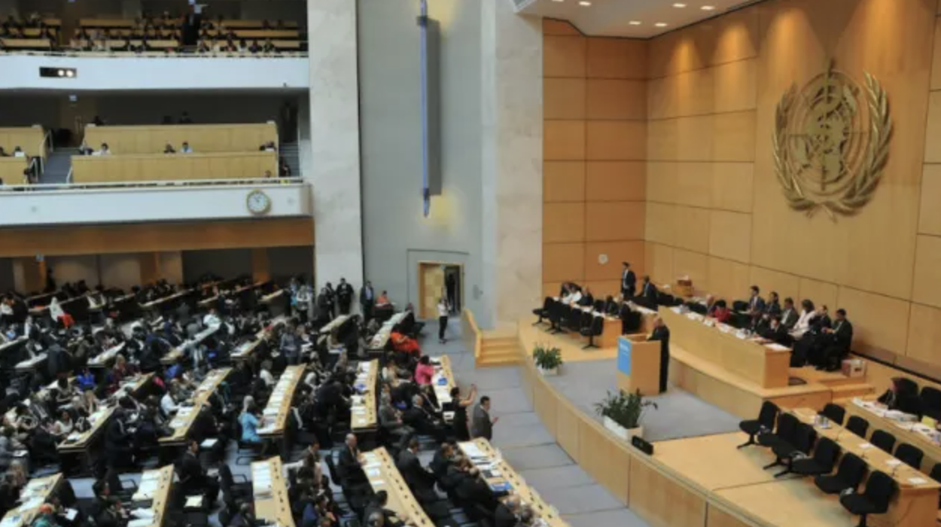
69th World Health Assembly, 2016
Notes:
The World Health Assembly is the decision-making body of WHO. It is attended by delegations from all WHO Member States and focuses on a specific health agenda prepared by the Executive Board. The main functions of the World Health Assembly are to determine the policies of the Organization, appoint the Director-General, supervise financial policies, and review and approve the proposed programme budget. The Health Assembly is held annually in Geneva, Switzerland.

Slide 15
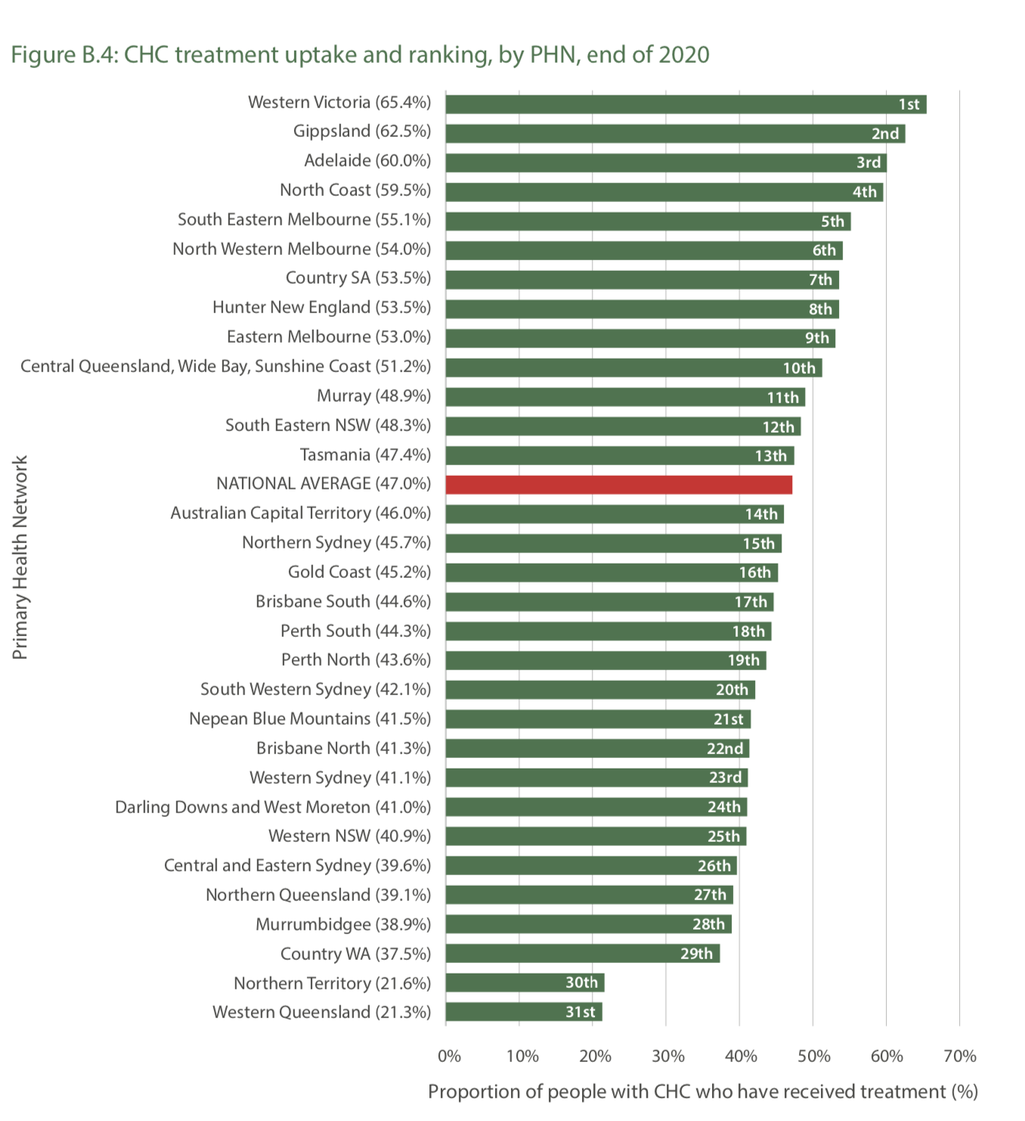
Hepatitis C Western Victoria
Viral Hepatitis Mapping report, Doherty Institute, 2020

Slide 16
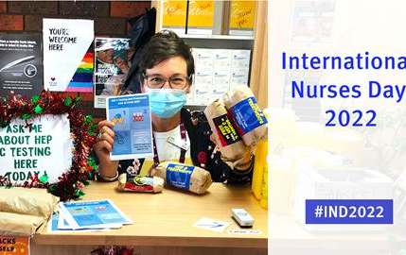

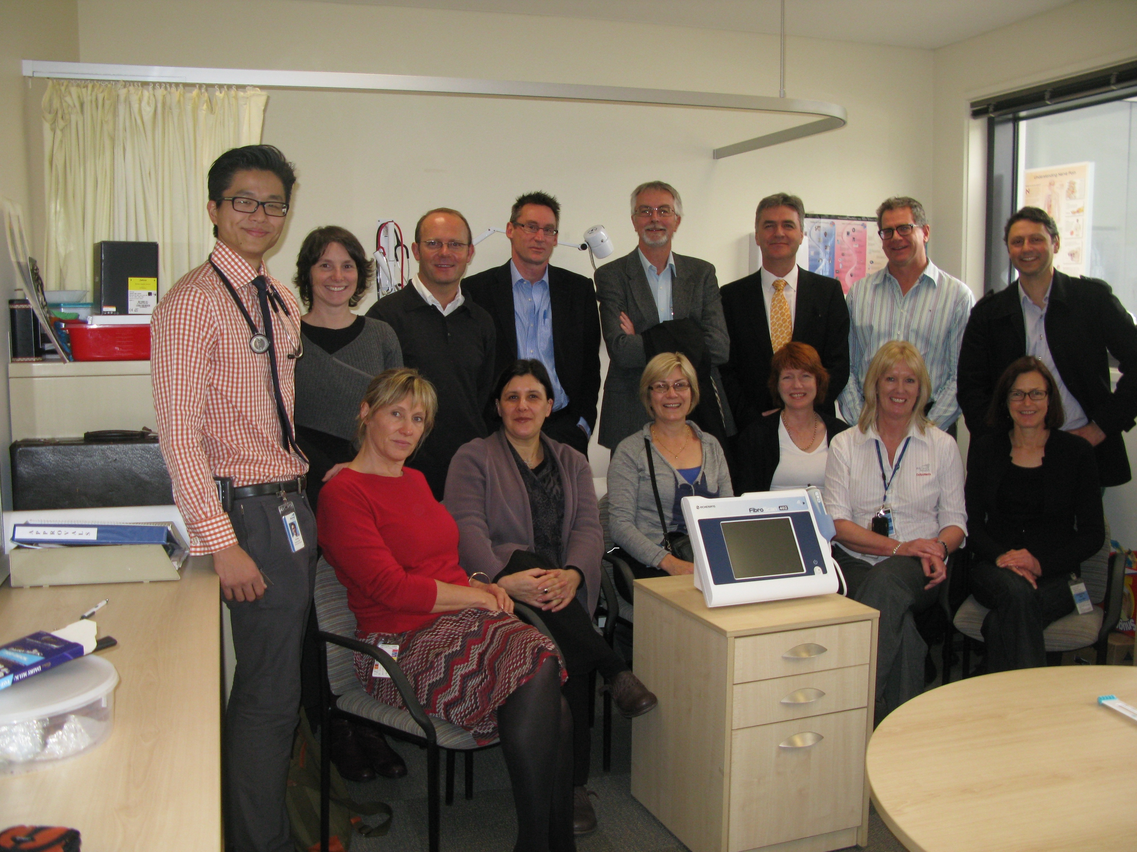

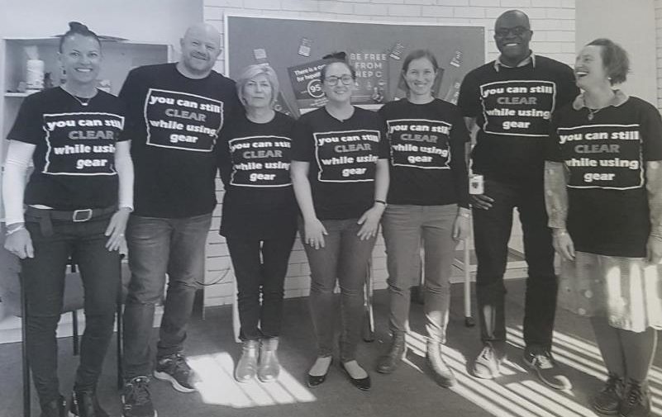
Western Victoria hepatitis C success story

Slide 17
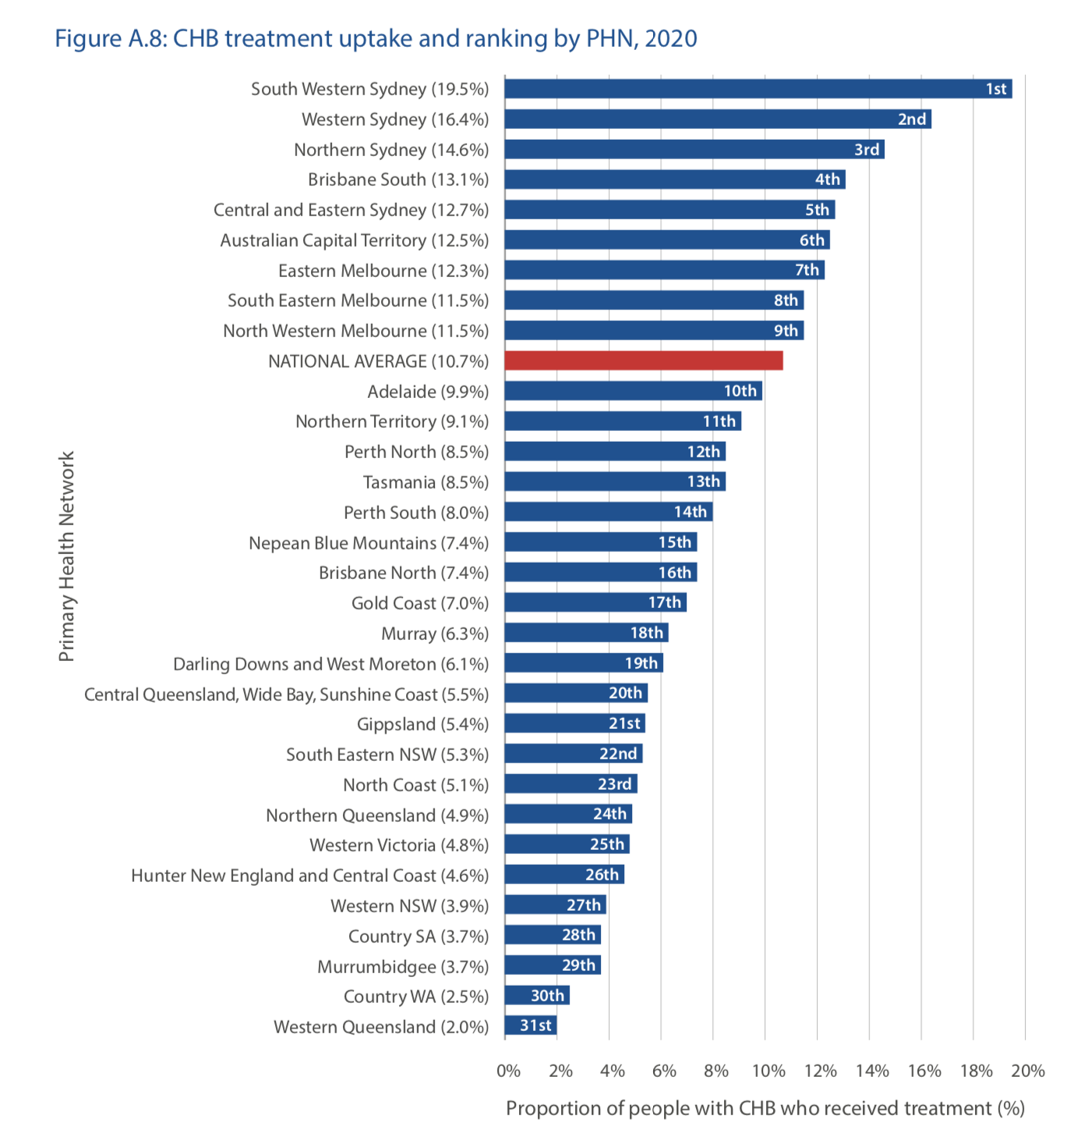
Hepatitis B in Western Victoria
Progress towards 2022 National target: of every 4 people living with hepatitis B in Western Victoria that need treatment, only 1 is treated
Viral Hepatitis Mapping report, Doherty Institute, 2020

Slide 18
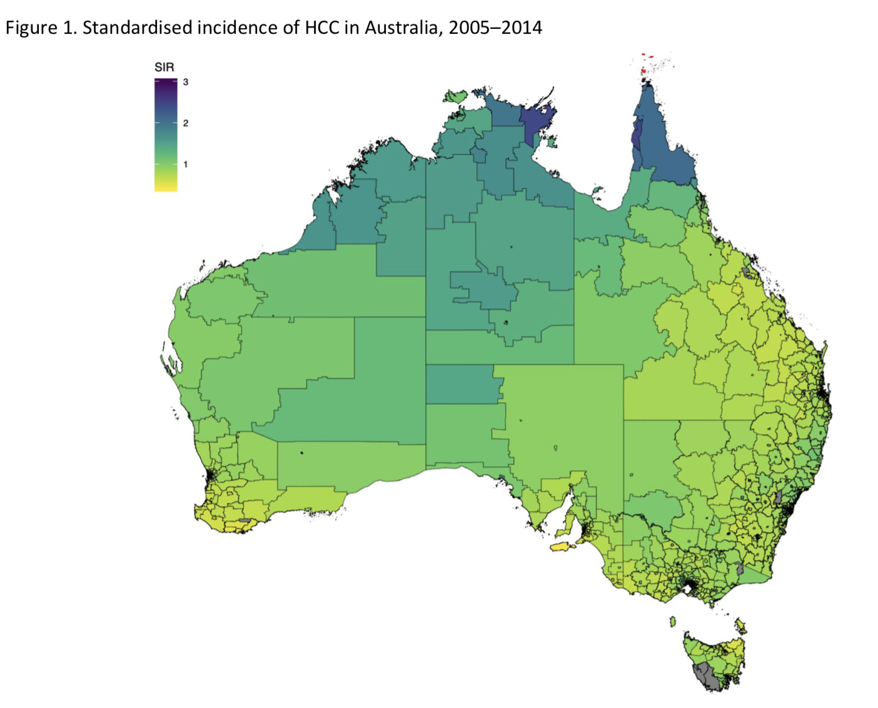
Why is this a problem?
2.1–6% of people living with hepatitis B develop cirrhosis annually
In Australia hepatocellular carcinoma (HCC) incidence has increased markedly
Annual incidence of HCC in people living with hepatitis B
  1% in non-cirrhotic
  2-3% in cirrhotic
Hepatitis B treatment prevents cirrhosis and significantly decreases risk of developing HCC
The overall 5-year survival with for HCC in Australia is 20%
GESA HCC consensus guidelines, 2020
GESA HBV consensus guidelines 2022

Slide 19
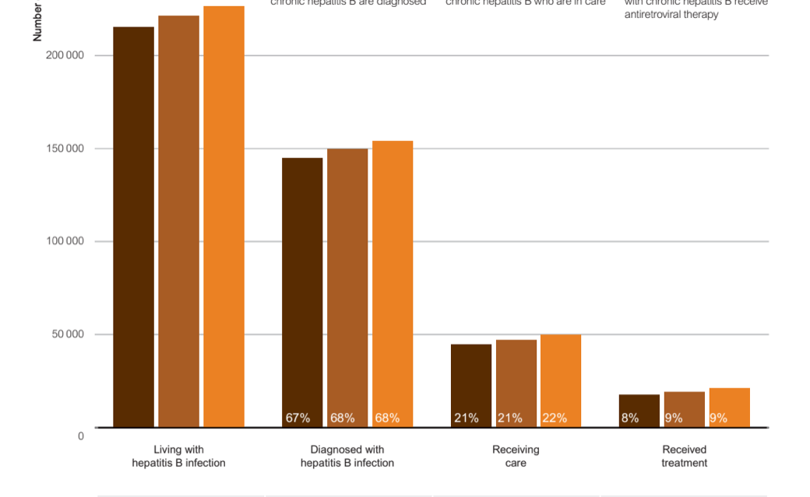
What is the story of this hepatitis B data?
Blue brackets indicate 2022 National Strategy test and treat targets
Green brackets indicate 2030 WHO Strategy programmatic test and treat targets
National update on HIV, viral hepatitis and STI in Australia 2009 – 2018, Kirby Institute
Notes:
Australian hepatitis B care cascade 2016 – 2018
Transmission
Testing
Management

Slide 20
The data story is
Not enough people are having hepatitis B tests
  Why and how do we increase testing uptake in a cost effective and impactful way?
Not enough people receive hepatitis B care and treatment
  Why and how do we increase engagement in hepatitis B care and treatment in a cost effective and impactful way?

Slide 21
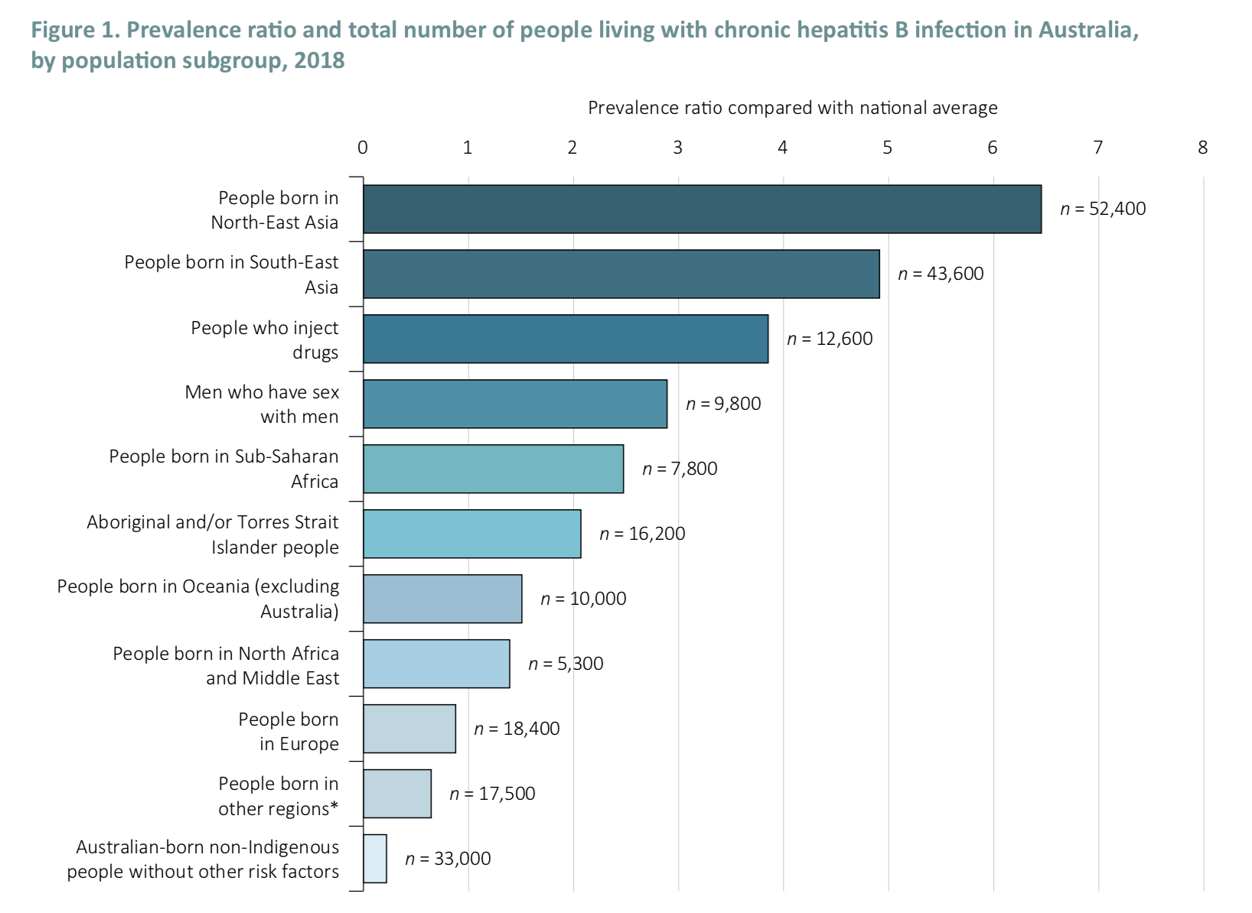
Demographics of people living with hepatitis B in Australia
GESA HBV Consensus Guidelines 2022

Slide 22
WVPHN Health Analytics Data
Percentage of the Population Born Overseas
LGA Name | Percent Population Born Overseas
Ararat | 11.3%
Ballarat | 11.3%
Central Goldfields | 9.2%
Colac-Otway | 10.3%
Corangamite | 7.4%
Glenelg | 8.7%
Golden Plains | 9.2%
Greater Geelong | 17.7%
Hepburn | 14.0%
Hindmarsh | 10.5%
Horsham | 7.1%
Moorabool | 14.3%
Moyne | 7.4%
Northern Grampians | 9.2%
Pyrenees | 9.6%
Queenscliffe | 10.7%
Southern Grampians | 7.7%
Surf Coast | 11.8%
Warrnambool | 9.6%
West Wimmera | 6.7%
Yarriambiack | 6.7%
WVPHN | 13.1%
VIC | 30.0%
AUS | 27.7%
Source: 2021 Census data

Slide 23
Top Countries of birth by LGA
LGA Name | Country | Number | Rank
Ararat | India | 127 | 3
Ballarat | India | 1,846 | 2
Central Goldfields | Philippines | 84 | 3
Colac-Otway | China | 181 | 3
Corangamite | Netherlands | 85 | 3
Glenelg | Philippines | 126 | 3
Golden Plains | Netherlands | 120 | 3
Greater Geelong | New Zealand | 2,863 | 3
Hepburn | Netherlands | 107 | 3
Hindmarsh | Myanmar | 107 | 2
Hindmarsh | Thailand | 80 | 3
Horsham | India | 183 | 2
Horsham | Philippines | 144 | 3
Moorabool | India | 729 | 2
Moyne | Philippines | 107 | 3
Northern Grampians | Philippines | 134 | 2
Northern Grampians | India | 80 | 3
Pyrenees | Netherlands | 35 | 3
Queenscliffe | Scotland | 23 | 3
Southern Grampians | India | 84 | 3
Surf Coast | South Africa | 207 | 3
Warrnambool | China | 236 | 3
West Wimmera | Philippines | 23 | 3
Yarriambiack | India | 39 | 3
VIC | India | 258,193 | 1
VIC | England | 174,552 | 2
VIC | China | 171,447 | 3
AUS | England | 927,490 | 1
AUS | India | 673,352 | 2
AUS | China | 549,618 | 3
Source: 2021 Census data

Slide 24
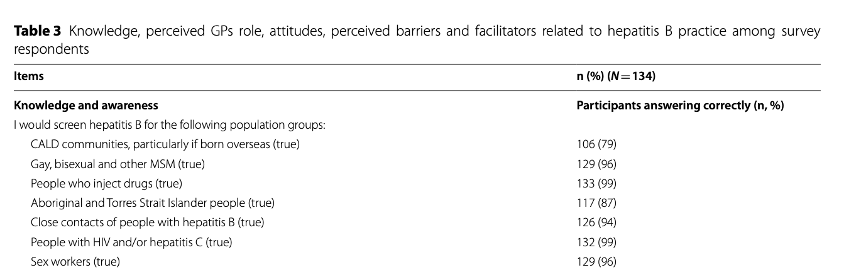
Is everyone at risk of hepatitis B offered a test?
Xiao, BMC Primary Care 2022
Notes:
1000 surveys sent out.

Slide 25

https://www.worldhepatitisalliance.org/wp-content/uploads/2021/11/WHA-Report-2021-Final.pdf
Notes:
https://www.worldhepatitisalliance.org/wp-content/uploads/2021/11/WHA-Report-2021-Final.pdf

Slide 26
Are HCW good at interpreting serology?
Accurate interpretation of
  HBV sAg positive
  HBV cAb positive
  HBV sAb negative
    Active hepatitis B infection (acute or chronic)
  110/134 (82%) GPs answered correctly
    Xiao, BMC Public Health 2022

Slide 27
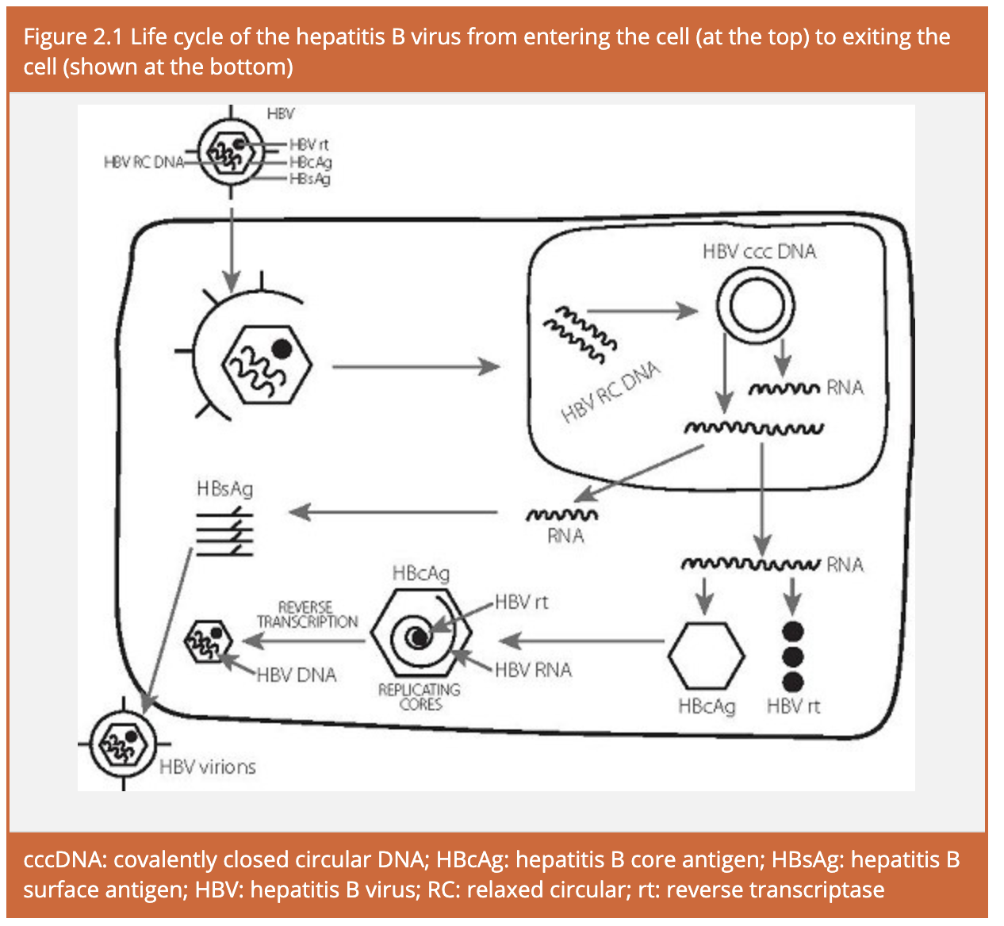
What does core antibody positive mean?
Body has seen hepatitis B
https://www.hepatitisb.org.au/virology-viral-replication-current-therapy-and-progress-to-a-cure/
Notes:
https://www.hepatitisb.org.au/virology-viral-replication-current-therapy-and-progress-to-a-cure/

Slide 28
Interpreting the test results
Test | Result | Interpretation
HBsAg Anti-HBc Anti-HBs | Negative Negative Negative | Susceptible (vaccinate)
HBsAg Anti-HBc Anti-HBs | Negative Negative Positive | Vaccinated
HBsAg Anti-HBc Anti-HBs | Negative Positive Positive | Resolved hepatitis B
HBsAg Anti-HBc Anti-HBs | Positive Positive Negative | Active hepatitis B
HBsAg Anti-HBc Anti-HBs | Negative Positive Negative | Distant resolved infection; or Recovering from acute infection; or False positive; or Occult hepatitis B.
Body has never seen HBV
Body has seen HBV

Slide 29

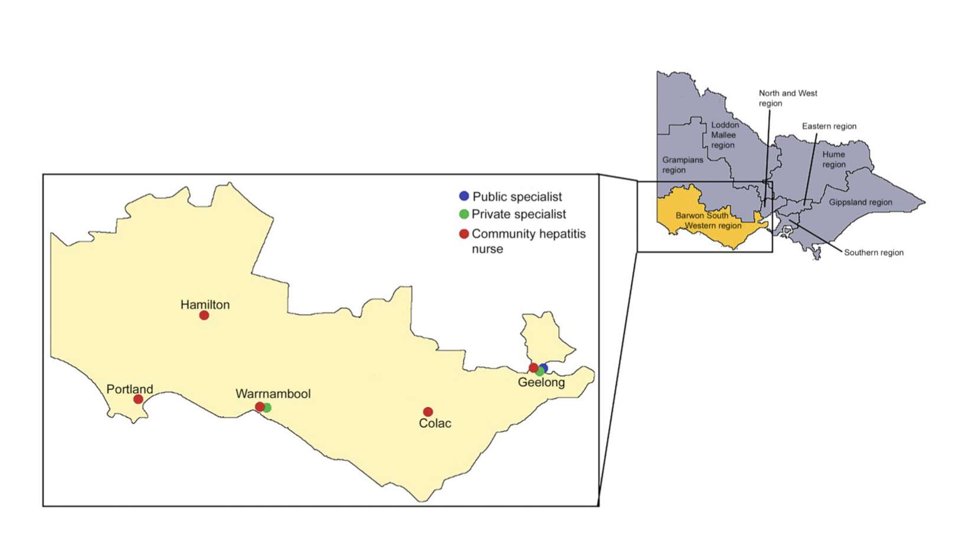
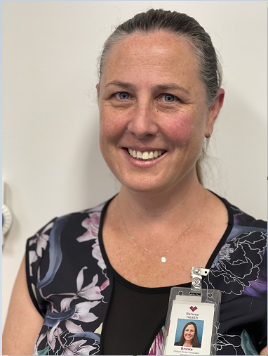

Referral for care and treatment
HBV S100 GP x 2
Inga
Brooke
Sue

Slide 30
Questions

Slide 31

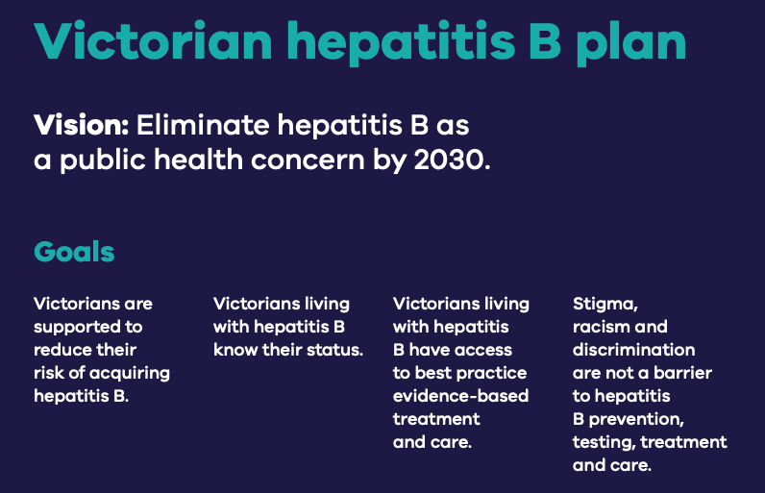
Discussion- Refining our problem statement
5 mins
People living with Hepatitis B need to access to diagnosis, care and treatment but they cannot do it or face a challenge [describe the challenge].
The problem is happening because [explain the cause of the problem that you identified from a needs analysis].
Based on [qualitative or quantitative data collected], I think that [your insights and solution design] can solve the problem.
D2K diagnostic:
Getting to the root cause of the problem
The Victorian Government is committed to eliminating HBV as a public health concern by 2030.
https://content.health.vic.gov.au/sites/default/files/2022-09/vic-hep-b-plan-2022-23-online-pdf.pdf
Tip: Use 5 whys if we get stuck…..(next slide)

Slide 32
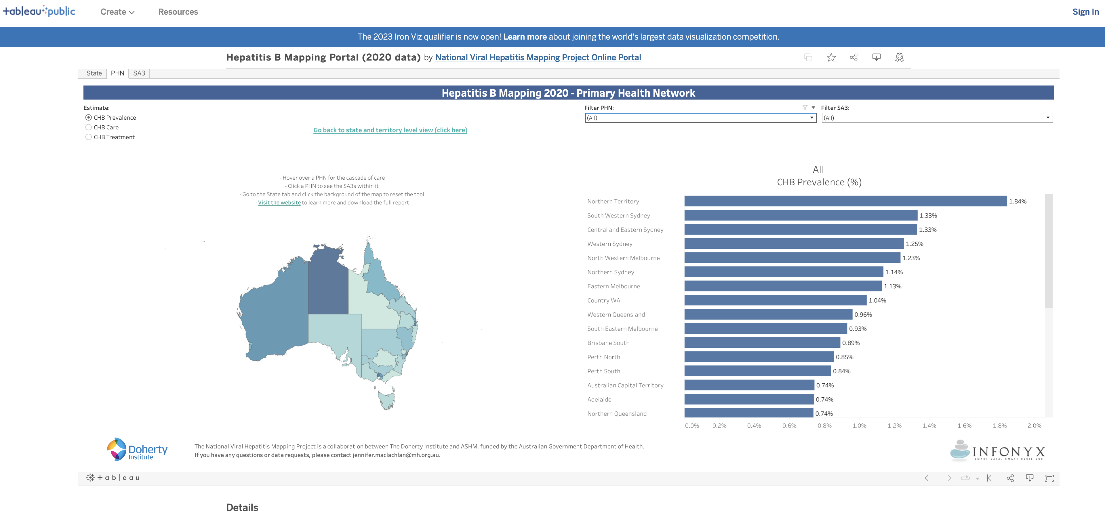
Needs analysis local region
We love
Pre-submitted Questions
Q-
How many people are living in Western Victoria with Hepatitis B? How and where do I find this data?
If only about 70% are diagnosed how might we identify higher risk groups? (Pop Health Needs analysis)
How can we identify clinics that see a higher rate of higer risk consumers?
https://public.tableau.com/app/profile/nationalhepmapping/viz/HepatitisBMappingPortal2020data_16355924109080/State

Slide 33
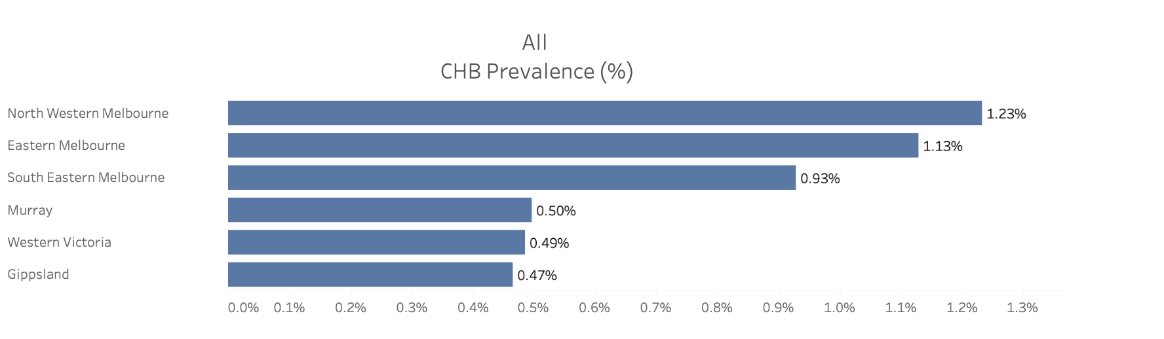

Hep B data-Prevalence in Western Victoria

Slide 34
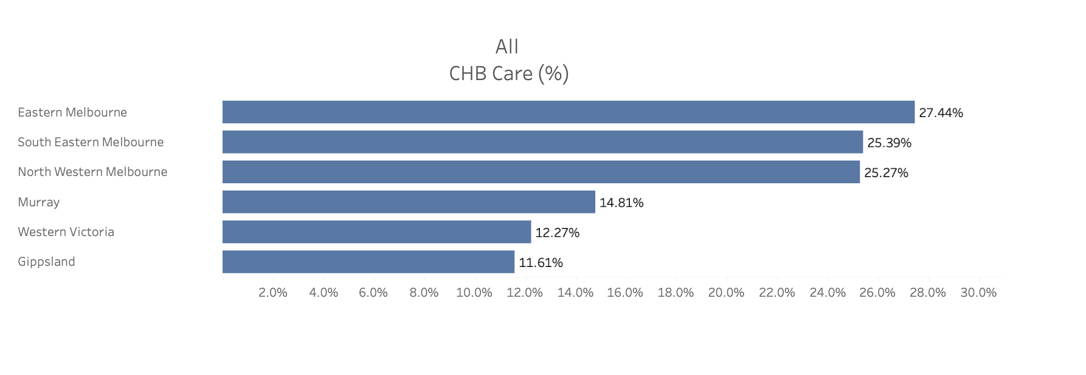
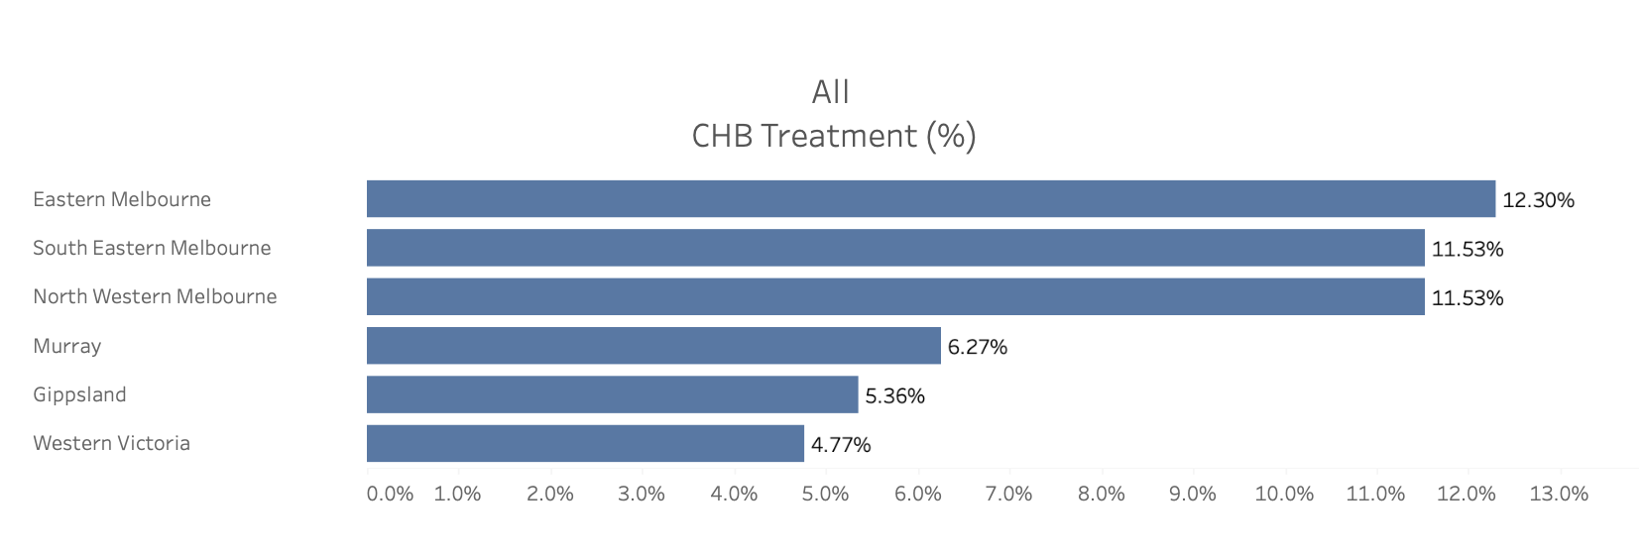


Hep B data- in care and treatment
Vic Strategy Target 55%
Vic Strategy Target 21%
Notes:
For the purposes of this sessions, treatment is never completed. That is to say, the overwhelming majority of people that start of hepatitis B treatment will be advised to continue treatment for a prolonged, undetermined period. A discussion about who treatment can be stoped in when and how would in itself take 20 mins, and only specialists should really do that probably.

Slide 35
Identifying the root cause of the problem- The 5 whys
5 mins
People living with Hepatitis B need to access diagnosis, care and treatment but they cannot do it or face a challenge [describe the challenge].
The problem is happening because [explain the cause of the problem that you identified from a needs analysis].
D2K diagnostic:
Getting to the root cause of the problem

Slide 36
Discussion:
Opportunities for intervention: Brainstorming exercise
5 mins
Prevent Transmission
Goals:
Achieve and maintain childhood vaccination coverage of 95 per cent at birth, 12 and 24 months.
Achieve and maintain
100 per cent uptake
of HBIg and birth dose vaccine for all infants born to women with chronic hepatitis B, and access to antiviral therapy in the third trimester of pregnancy for women with high hepatitis B viral load
Reduce the number of newly acquired hepatitis B infections by 50 per cent, with a focus on priority populations.
Increase Testing
Goals
Increase the proportion of people living with chronic hepatitis B who are diagnosed to 75 per cent
Engage in care
Goals
Increase the total proportion of people living with chronic hepatitis B receiving care
to 55 per cent. (Currently at 12.7%)
Complete Treatment
Goals
For people living with chronic hepatitis B and eligible for treatment, increase the proportion receiving antiviral treatment to 21 per cent. (Currently at 4.8%)
Victorian Public Health strategy- Victorian hepatitis B plan 2022–30
https://content.health.vic.gov.au/sites/default/files/2022-09/vic-hep-b-plan-2022-23-online-pdf.pdf

Slide 37
Childhood immunisations
SA3_Name | Age Group | % DTP | % Polio | % HIB | % HEP | % MMR | % Pneumo | % MenC | % Varicella | % Fully
Ballarat | 24-<27 Months | 95.49 | 97.24 | 95.78 | 97.24 | 95.64 | 96.88 | 97.31 | 95.57 | 94.69
Creswick - Daylesford - Ballan | 24-<27 Months | 93.77 | 96.11 | 94.94 | 96.11 | 94.55 | 95.33 | 96.89 | 94.94 | 92.61
Maryborough - Pyrenees | 24-<27 Months | 94.09 | 95.91 | 94.55 | 95.91 | 94.55 | 95.00 | 95.45 | 94.55 | 93.64
Barwon - West | 24-<27 Months | 94.36 | 96.99 | 95.49 | 96.99 | 94.36 | 95.49 | 95.49 | 94.36 | 94.36
Geelong | 24-<27 Months | 95.82 | 98.05 | 96.11 | 98.05 | 95.90 | 97.28 | 97.28 | 95.99 | 95.46
Surf Coast - Bellarine Peninsula | 24-<27 Months | 94.21 | 96.70 | 94.61 | 96.70 | 93.91 | 95.80 | 95.80 | 94.01 | 93.51
Grampians | 24-<27 Months | 95.33 | 97.42 | 95.81 | 97.42 | 95.65 | 96.78 | 97.10 | 95.49 | 94.69
Glenelg - Southern Grampians | 24-<27 Months | 93.99 | 95.63 | 93.99 | 95.63 | 93.72 | 95.36 | 95.08 | 93.72 | 93.44
Warrnambool - Otway Ranges | 24-<27 Months | 94.54 | 97.16 | 95.22 | 97.16 | 94.20 | 96.02 | 96.13 | 94.43 | 93.97
2022 data. Childhood immunisations.
Source:
Immunisation coverage data, surveys and reports | Australian Government Department of Health and Aged Care

Slide 38

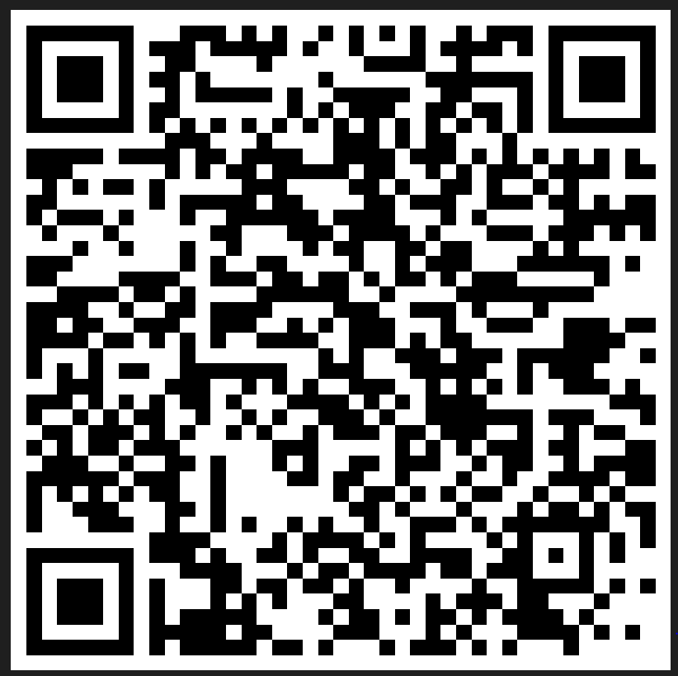

Evaluation
Session evaluation
Please take the time to evaluate this session
  Link pasted into the chat
Session evaluation
Upcoming Sessions
10 November
24 November
1 December
If you have a case you would like to discuss with the group:
New case template here
Email projectechocovid19@westvicphn.com.au
Use the comment box in the evaluation form
Notes:
Session evaluation link https://forms.office.com/r/sCdXhEQQ6p
Case template link https://forms.office.com/r/xFPCCRSkzc

Slide 39


Listen and watch back previous sessions
Content is available on the WVPHN website
Listen back to all the series through Project ECHO: WVPHN Hub
COVID-19 ECHO network on Whooshkaa
https://westvicphn.com.au/events-education/project-echo/project-echo-covid19/
Notes:
https://player.whooshkaa.com/shows/project-echowvphn-hub-covid-19-echo-network
https://www.youtube.com/watch?v=nB5N57z9zG8&t=1s
Townhall 13th January 2022 https://www.youtube.com/watch?v=sr3uHtknLWs
Weekly emails,
Interactive discussions
To watch to view – Youtube
To listen - Whooshkaa
To listen to read – newsletter, resource pack, Zac’s notes
to participate – ECHO
To get in touch with us, email, healthpathways,

