Slide 1
Welcome to Project ECHO COVID and Communicable Diseases Network
Series 11: Session 3
Beat the Bite: mosquito borne viruses and Buruli ulcer- translating public health and local knowledge into practice in primary care

Slide 2
Acknowledgement of Countries
I’d like to begin by acknowledging the Traditional Owners and custodians of the lands and waterways from which we are all zooming in from today.
the Wadda Wurrung, Gulidjan, Gadubanud, Keeray Wurrung, Peek Wurrung, Gunditjmara, Djab Wurrung, Wotjobaluk, Dja Dja Wurrung, Jadawadjarli, Wergaia, Jaadwa and Jupagalk peoples
We recognise their diversity, resilience, and the ongoing place that First Peoples hold in our communities.
We pay our respects to the Elders, both past and present and commit to working together in the spirit of mutual understanding, respect and reconciliation.
We support self-determination for First Nations Peoples and organisations and will work together on Closing the Gap.
Ask the question. Do you identify as Aboriginal or Torres Strait Islander?

Slide 3
Etiquette/Zoom use
Chat
Introduce yourself / Role / Region / Organisation in “chat”
Use chat to ask questions
Please remain on ‘mute’ except when speaking
Please turn video on
In-session Evaluation at the end
These sessions will be recorded for ongoing training and quality improvement purposes.
The didactic presentations ONLY will be disseminated on our learning channel.
Discussions will be de-identified where used for QI or research purposes.
Please let us know if you would not like your comments recorded.
RACGP and ACCRM accredited, certificates PD

Slide 4
Learning outcomes
Series
Opportunity to review and discuss policy and guidelines in practice
Discuss emerging models of primary care with a focus on:
Communicable disease prevention
Communicable disease testing, assessment and management
Continuing care provision in primary care and in partnership with specialist services
Consider real-world experiences of implementing new care models in different settings
Build knowledge about current resources, supports & referral pathways
Engage in a community of practice and rapid learning network
Session 3 Learning outcomes
Describe public health priorities in relation to mosquito borne viruses
Locate accessible standards of care for mosquito borne viruses
Describe clinician responsibilities in notification and communication with LPHU
Evaluate guidelines, tools and resources for use in primary care
Identify care gaps and equity issues

Slide 5
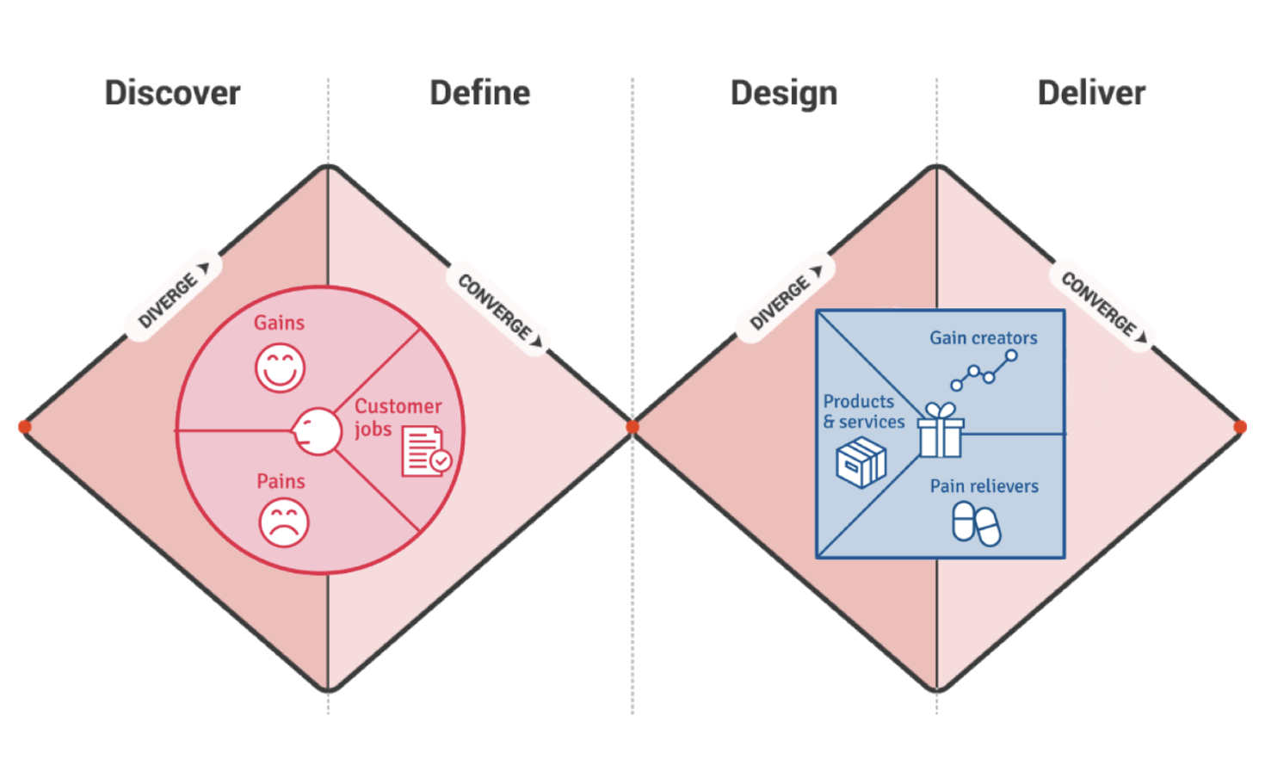
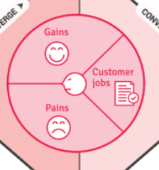
Learning labs- focus on process Deliver, Discover, Define, Design, Deliver
K2P-Solution design-
Guidance, decision tools
models of care (MOC)
D2K
Data to Knowledge
K2P
Knowledge to Practice
ECHO
SE3
ECHO
SE4
ECHO
SE5
ECHO
SE1
ECHO
SE2
K2P-Implementation
Quality Improvement
PDSA
D2K-Diagnostic-
Evidence- gaps/needs
P2D
Practice to Data
K2P-Sustainability
Transform healthcare
Scale up MoC
P2D-Case for change-
Policy to Practice
The problem: People with Communicable diseases not receiving testing, care or management
Notes:
Both making

Slide 6
Learning Health System approach
Identify the problem:
Synthesise the evidence
Design Intervention
P2D
Practice to Data
D2K
Data to knowledge
K2P
Knowledge to Practice
-1
K2P
Knowledge to Practice
-2
P2D
Practice to Data
People with communicable diseases unable to access testing, care or management
Access, extract, map and represent health information for analysis
Make knowledge actionable and sharable, generate tailored messages for decision making

Slide 7
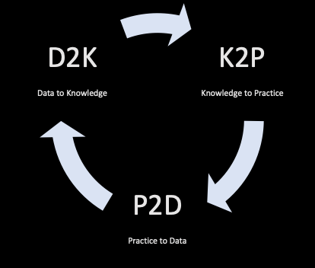
Identify and Clarify the problem- K2P Map solution components Make knowledge actionable and sharable Generate tailored messages for decision making
Refine problem statement
People living with communicable diseases need to access prevention, testing, care and treatment but they cannot do it or face a challenge [describe the challenge].
The problem is happening because [explain the cause of the problem that you identified from a needs analysis].
Based on [qualitative or quantitative data collected], we think that [ECHO working group insights and solution design] can solve the problem.
(let's get to it!)
Notes:
W+ECHO working groupswe

Slide 8
Agenda for COVID and Communicable Diseases Network Series 11: Session 3 Beat the Bite: mosquito borne viruses and Buruli ulcer- translating public health and local knowledge into practice in primary care
Naomi White, Covid Operations Manager, Western Victoria PHN
New announcements in Commonwealth and state Policy and regional services
Dr Naomi Clarke, Public Health Registrar, Barwon South West Public Health Unit
Buruli Ulcer epidemiology
Dr Jessica O’Keeffe, Infectious diseases Registrar, Barwon Health
Clinical diagnosis and management of Buruli Ulcer
Dr Kate Graham, GP and Clinical Editor – HealthPathways and COVID Clinical Advisor, Western Victoria PHN
Translating knowledge to practice in primary care
Discussion

Slide 9
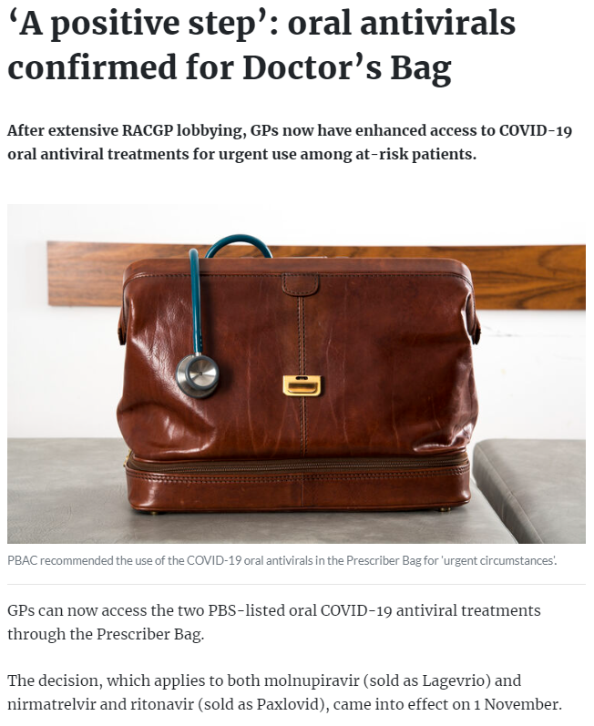
Commonwealth/State Policy announcement
Anti-viral Medications
Updated anti-viral eligibility:
Aboriginal or Torres Strait Islander, 30 years of age or older and with 1 additional risk factors.
Updated eligibility for oral COVID-19 treatments | Australian Government Department of Health and Aged Care
GPs and NPs can now order covid anti virals into their "doctors bag" 2 units of Paxlovid or Lagevrio
Pharmaceutical Benefits Scheme (PBS) | Prescriber Bag Supplies has been updated.
RACGP - ‘A positive step’: oral antivirals confirmed for Doctor’s Bag
Those over 70 yrs prescribed are 55% less likely to die

Slide 10
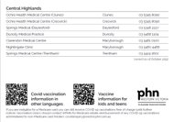
Local Regional COVID updates
34% increase in reported COVID-19 cases over last week in Victoria. 24% increase in hospitalisations
*6.4% of doses delivered in primary care
4th dose coverage 39.5% of Vic population
Only 19 children under 5 have received COVID vaccination
NEW WAVE
New subvariants – BQ1 and XBB continue to grow, likely to become dominant, immune evasion.
Notes:
There were 10,226 COVID-19 cases reported in Victoria this week, an increase of 20.1 per cent on the previous week. The average daily number of new cases this week was 1,461, up from 1,220 last week.
The number of active cases in Victoria is 9,607 up from 7,851 at the same time last week.
The seven-day rolling average of patients with COVID-19 in Victorian hospitals is 231, a 34.3 per cent increase when compared to the same time last week.
There are currently 256 COVID-19 patients in hospital in Victoria. 8 patients and 1 cleared care are in intensive care. There are 3 COVID-19 patients on a ventilator. The seven-day rolling average of patients in intensive care in Victorian hospitals is 7.
https://westvic.communityhealthpathways.org/1015115.htm
I'm a COVID case/contact | Coronavirus Victoria
https://www.worksafe.vic.gov.au/managing-covid-19-risks-workplaces

Slide 11
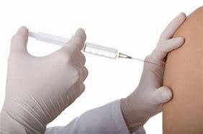
Monkey pox update
An increased supply of MPX vaccines is now available in Victoria.
Increased eligibility
People who are immunocompromised
People who have received a 1st dose 28 days ago or more can receive a 2nd dose
MPX vaccine is available free-of-charge for eligible people through Local Public Health Units and certain sexual health clinics and health services.
GPHU has partnerships with
Lister House in Horsham, UFS Medical and Ballarat Community Health in Ballarat, Springs Medical in central highlands
Notes:
Health update on monkeypox (MPX) vaccination
Monkeypox | health.vic.gov.au

Slide 12
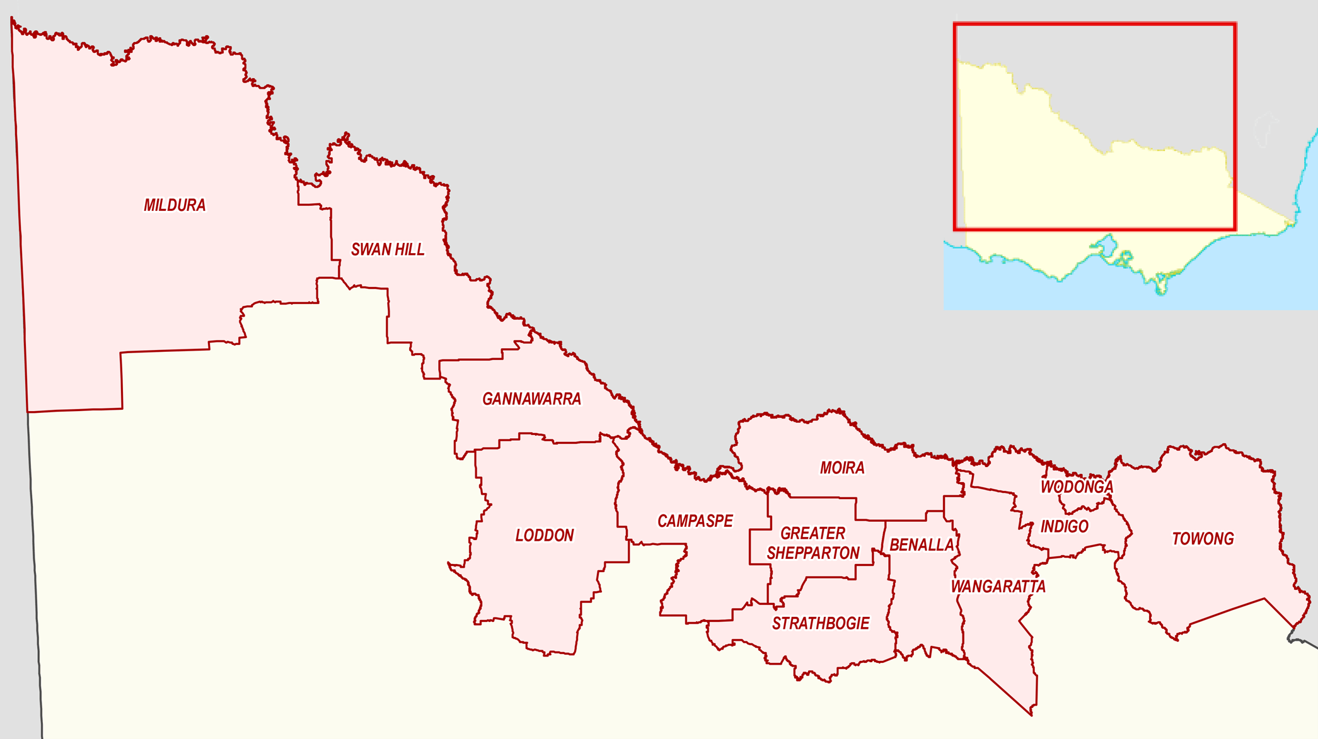
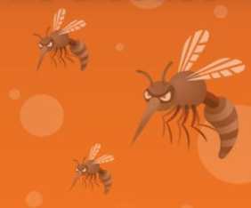
JEV Update
There have been no confirmed cases of JE and no detections of JE virus in mosquitoes this season.
Eligibility criteria for JE vaccine have now been expanded in northern Victorian LGAs – those over the age of 2 months who spend 4 or more hours outside per day or living in temporary housing.
The simplest and best way to prevent JE virus infection and other mosquito-borne diseases is to avoid mosquito bites.
Those that are engaged in the prolonged outdoor recovery efforts (clean up) of stagnant waters following floods*
*Vaccination can be administered after arrival in flood affected areas to those from other regions deployed for prolonged recovery efforts
Japanese encephalitis virus (health.vic.gov.au)
Notes:
Japanese encephalitis virus (health.vic.gov.au)
Read the full advisory: Japanese encephalitis vaccination update
Protect yourself from mosquito-borne disease - Better Health Channel

Slide 13
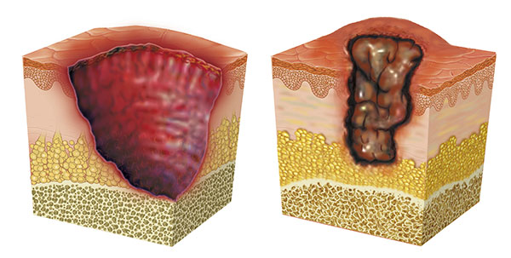
Buruli ulcer
Health Alert - Increase in spread of locations for detection. Not just in coastal areas. Geelong area of note.
Buruli ulcer (health.vic.gov.au)
Beating Buruli in Victoria (health.vic.gov.au)
Buruli ulcer (who.int)

Slide 14
An update on Buruli ulcer epidemiology
Naomi Clarke · Public health registrar · Barwon South West LPHU
9th November 2022
Notes:
Acknowledge country

Slide 15
BURULI ULCER IN AUSTRALIA
Buruli ulcer (“Bairnsdale ulcer”) first described in Bairnsdale, Victoria in 1930s
Mycobacterium ulcerans identified as causative organism in Melbourne in 1940s
In Victoria: epidemiology has evolved over time
Gradually moving from East to West along mainly coastal areas
East Gippsland → Mornington Peninsula → Bellarine Peninsula → Surf Coast / inner Melbourne
Outside Victoria: found in northern Queensland; not present in other States and Territories
Globally: 33 endemic countries worldwide, almost all tropical/subtropical and low-to-middle income countries
Notes:
East Gippsland 1930s to 1990s
1990s Phillip Island cluster for a few years, then sustained reduction
Very few cases 1995-2000
From 2000 onwards, large new outbreaks on Mornington Peninsula and Bellarine Peninsula
More recently, cases in Surf Coast and Aireys Inlet, Bayside suburbs of Melbourne and several inner Melbourne suburbs, as well as the Geelong suburb of Belmont.
QLD: far north of the state, from Mossman to the Daintree River in the Douglas Shire. Endemic area has been static, unlike Victoria. Known locally as "Daintree ulcer" or "Mossman ulcer"

Slide 16
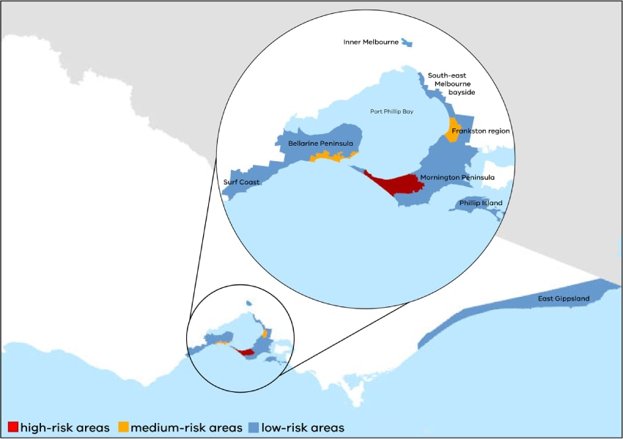
EPIDEMIOLOGY IN VICTORIA
Current endemic and emerging areas (Department of Health):
Mornington Peninsula
Bellarine Peninsula
Frankston and Seaford
South Eastern Bayside suburbs
East Gippsland
Phillip Island
Surf Coast and Aireys Inlet
Inner Melbourne (Essendon, Moonee Ponds, Brunswick West, Pascoe Vale South, Strathmore)
Geelong suburb of Belmont

Slide 17
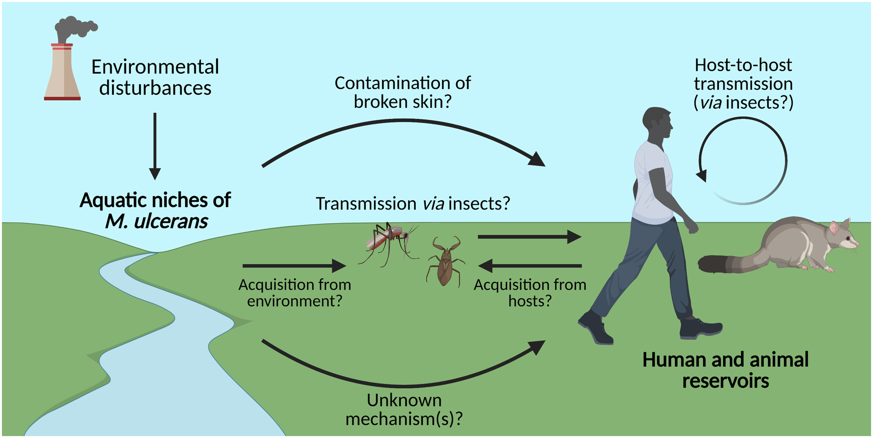
TRANSMISSION
Incubation period: 4.5 months (range 1-9 months)
Environmental acquisition but exact mechanisms unknown
Possums implicated as potential primary reservoir
Mosquitoes possible mechanical vector
Insect repellent, wearing long clothing, washing of minor skin wounds protective in case-control studies; mosquito bites associated with increased risk¹
Muleta AJ, Lappan R, Stinear TP, Greening C (2021) Understanding the transmission of Mycobacterium ulcerans: A step towards controlling Buruli ulcer. PLoS Negl Trop Dis 15(8): e0009678.
1. Quek TY, Athan E, Henry MJ, Pasco JA, Redden-Hoare J, Hughes A et al (2007) Risk factors for Mycobacterium ulcerans infection, southeastern Australia. Emerg Infect Dis 13(11):1661–1666.
Notes:
No person to person transmission
Positive PCR for M ulcerans detected from both possum faeces and from possums themselves with clinical BU lesions
Possums without lesions also found to be excreting M ulcerans in faeces
--> Point Lonsdale, Sorrento and Blairgowrie
--> Working hypothesis is that BU is a zoonosis with humans as spillover/dead end hosts connected directly to possums, or connected indirectly via mosquitoes
Some evidence of mosquitoes PCR positive for M ulcerans --> potentially a mechanical vector. Because M. ulcerans is an environmental pathogen, PCR-positive mosquitoes may only be indicators of its presence in the environment and not linked to transmission. Findings more consistent with organisms being acquired on outer surfaces of mosquitoes when resting or feeding in storm water drains, rather than mosquitoes being a true productive reservoir and vector.

Slide 18
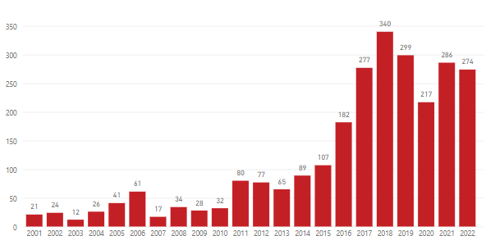
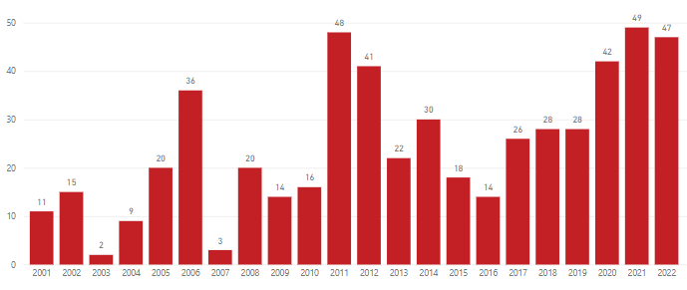
EPIDEMIOLOGY IN VICTORIA
350
300
250
Number of reported cases per year
in Victoria, 2001-2022 (YTD)
200
150
100
50
0
2001 2002 2003 2004 2005 2006 2007 2008 2009 2010 2011 2012 2013 2014 2015 2016 2017 2018 2019 2020 2021 2022
50
40
30
Number of reported cases per year
in Barwon South West region, 2001-2022 (YTD)
20
10
0
2001 2002 2003 2004 2005 2006 2007 2008 2009 2010 2011 2012 2013 2014 2015 2016 2017 2018 2019 2020 2021 2022

Slide 19
EMERGING AREAS OF TRANSMISSION
In the last 3-4 years, clear picture emerging of local transmission of Buruli ulcer in Greater Geelong
Particularly Belmont and Highton; also Newtown, Wandana Heights, Grovedale, Marshall
Significant increase in case numbers compared with previous years
Analysis of possum faeces from 2020-2022: positive M. ulcerans samples in Belmont and Highton, in close proximity to case locations
Numerous cases with no or minimal time spent in known endemic areas
https://www.health.vic.gov.au/health-advisories/buruli-ulcer-is-spreading

Slide 20
KEY MESSAGES
Epidemiology of Buruli ulcer continues to evolve in Victoria
Consider as a diagnosis for anyone in Barwon South West region with a clinically compatible illness
Key emerging area of transmission: 3216 postcode (particularly Belmont and Highton)
Important to consider more broadly in Greater Geelong, in addition to known endemic areas on Bellarine Peninsula and Surf Coast
Thanks to GP specialist colleagues for assisting Public Health Unit with surveillance data for Buruli ulcer cases in our region – helps to understand patterns of spread

Slide 21
THANK YOU!
Questions?

Slide 22
Approach to Mycobacterium Ulcerans
Jess O’Keeffe
Infectious Diseases Registrar
University Hospital Geelong

Slide 23
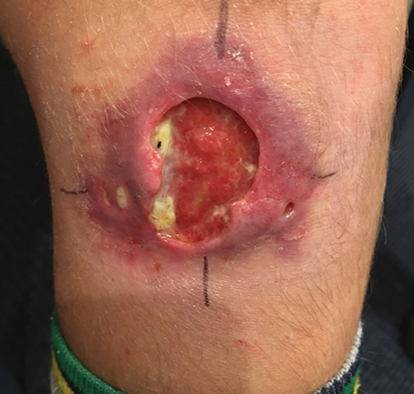
Diagnosis
M. ulcerans PCR (approaches 100% specificity and sensitivity)
PCR can essential detect a single bacterium
Testing can be performed on swab, aspirate or tissue
Culture
Smear positive for acid-fast bacilli
Slow growing, can take months to identify
Pitfalls of testing
Swabbing non-ulcerative lesions
Paediatric population
Failure to swab the entire undermined edge of the lesion and ensure clinical material is present on the swab
Sending a single swab only
Ross B C, Marino L, Oppedisano F, Edwards R, Robins-Browne R M, Johnson P D. Development of a PCR assay for rapid diagnosis of Mycobacterium ulcerans infection. J Clin Microbiol. 1997 Jul 1;35(7):1696–700.
O’Brien DP, Globan M, Fyfe JM et al. Diagnosis of Mycobacterium ulcerans disease: be alert to the possibility of negative initial PCR results. Med J Aust. 2019;210(9):416.

Slide 24
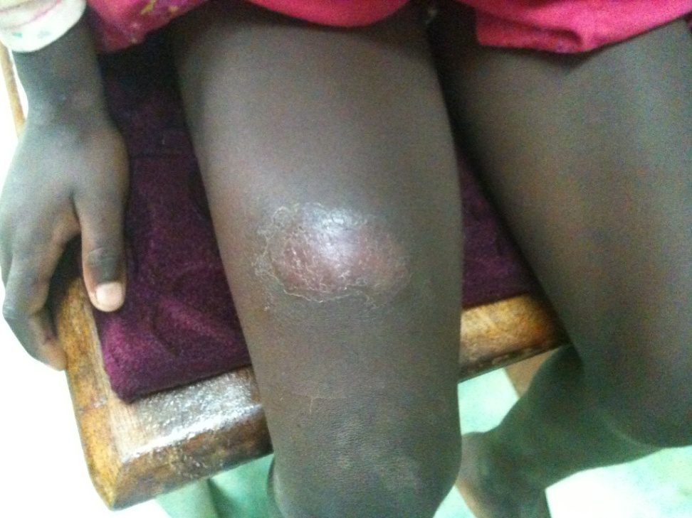
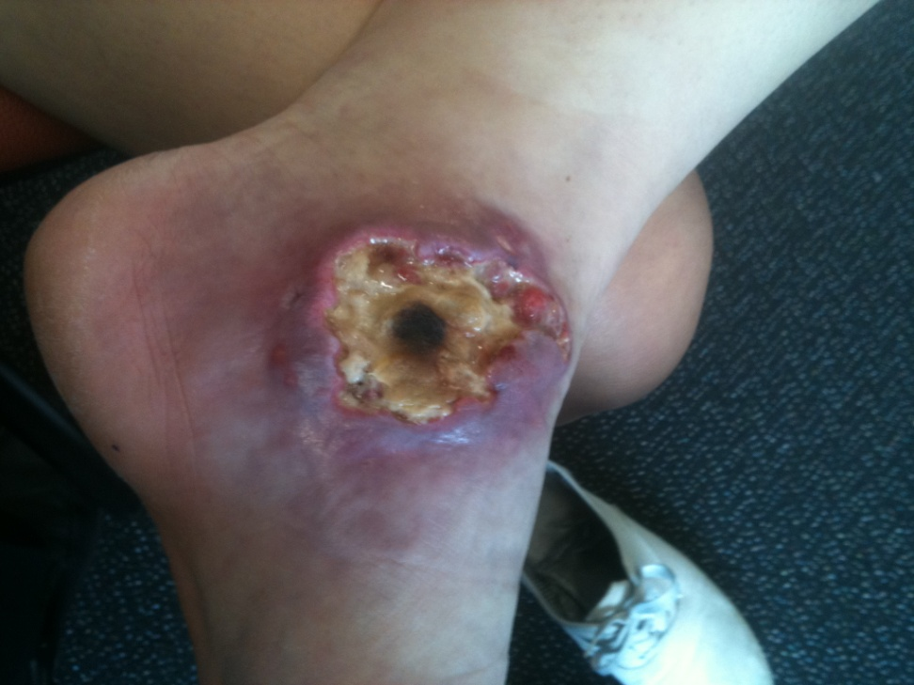
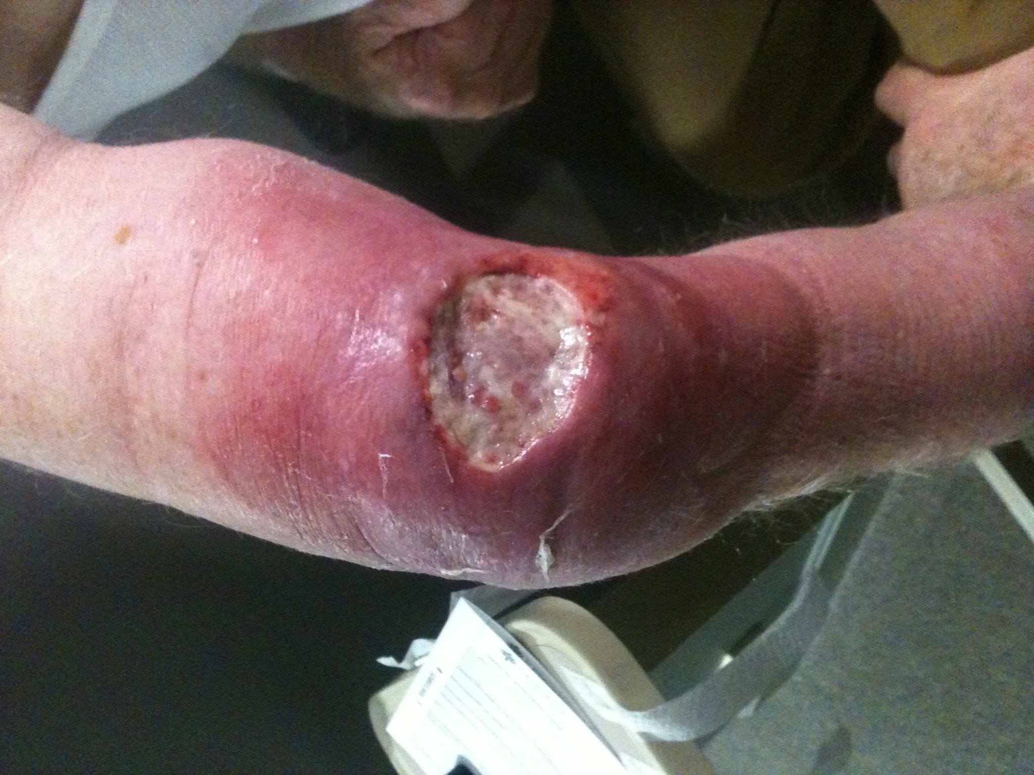
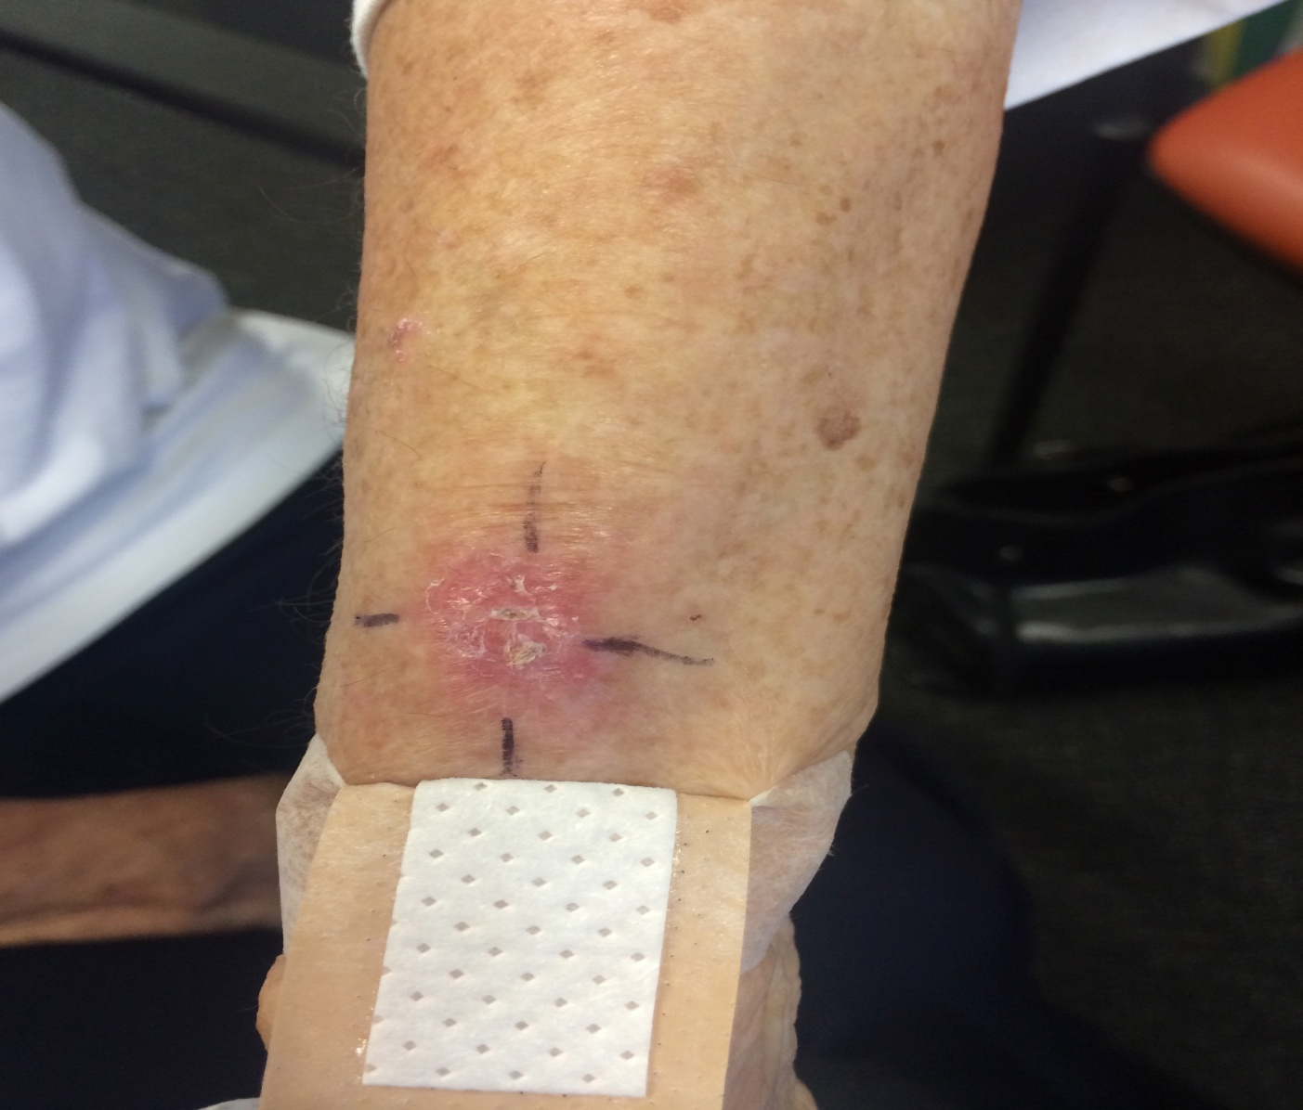
World Health Organization Categories
Ulcer
Plaque
WHO Category | Definition
I | Single lesion <5cm
II | Single lesion (non-ulcerative or ulcerative plaque with oedema) 5-15cm
III | Single lesion >15cm or multiple lesions, or disease affecting critical sites (eyes, genitalia, breast or bone)
Oedematous lesion
Nodule
World Health Organizaiton. Buruli Ulcer (Mycobacterium ulcerans infection) [Internet]. World Health Organization; 2022. Available from: https://www.who.int/news-room/fact-sheets/detail/buruli-ulcer-(mycobacterium-ulcerans-infection)#:~:text=The%20disease%20has%20been%20classified,and%20joint%20involvement%20(33%25).
Notes:
Buruli ulcer generally starts as a painless nodule, and develops into a larger painless area of induration
The disease usually progresses without pain or fever or other systemic signs of infection
Within 4 weeks, the initial lesion ulcerates
Bone is occasionally affected, and can cause significant deformities
WHO category II-III constitute severe disease

Slide 25
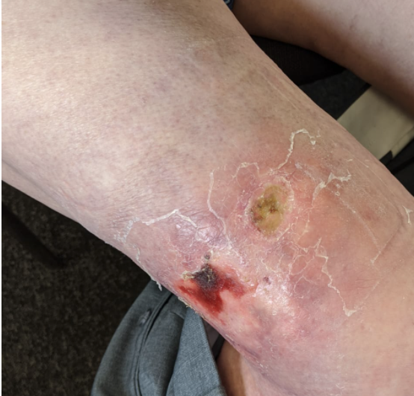
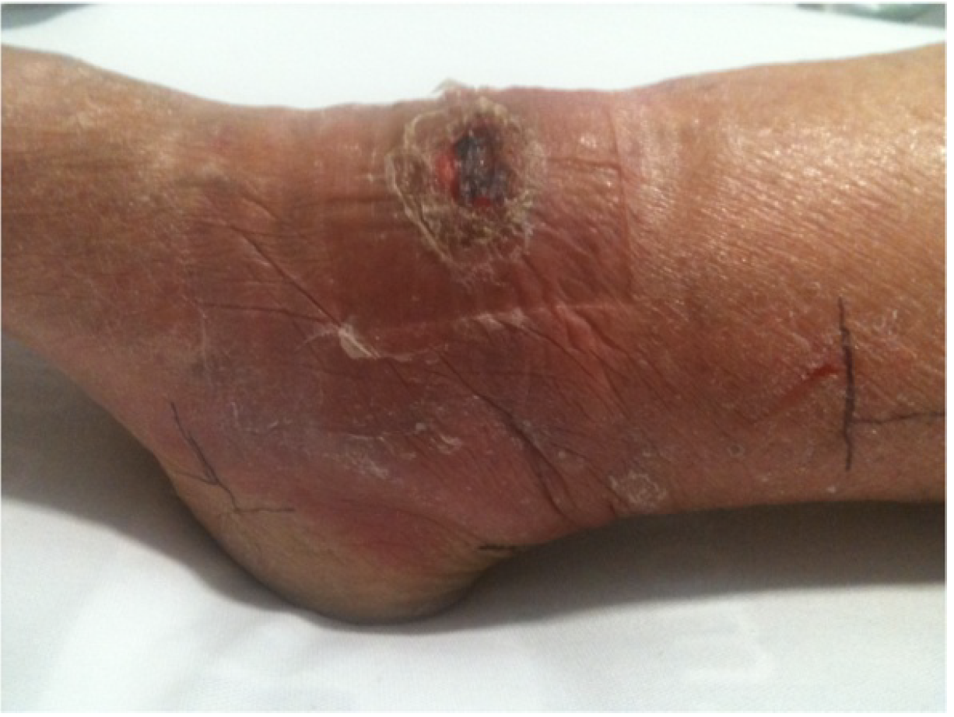
The Painful lesion
76% of oedematous lesion present as WHO II or III
Account for 7% of cases seen in the Bellarine Peninsula
Often rapidly progressive
Can lead to extensive ulceration within a few days
Painful
Associated with systemic signs of infection including fever
PCR initial non-ulcerated swab –
6.5% false negative

Slide 26
Treatment
eTG / WHO recommendation:
Rifampicin 10mg/kg max 600mg daily + Clarithromycin 7.5mg/kg max 500mg BD
Ciprofloxacin / Moxifloxacin can be used as alternatives to Clarithromycin
Treatment with antibiotics alone will lead to healing of BU lesions without recurrence – 98% cure rate
Surgery not routinely required but can be considered in certain circumstances
Median time to healing
WHO I: 119 days
WHO II: 169 days
WHO III: 175 days
1. Chauty A, Ardant MF, Marsollier L, et al. Oral treatment for Mycobacterium ulcerans infection: results from a pilot study in Benin. Clin Infect Dis 2011;52:94–6.
2. Etuaful S, Carbonnelle B, Grosset J, et al. Efficacy of the combination rifampinstreptomycin in preventing growth of Mycobacterium ulcerans in early lesions of Buruli ulcer in humans. Antimicrob Agents Chemother 2005; 49:3182–6.
3. Gordon CL, Buntine JA, Hayman JA, et al. All-oral antibiotic treatment for buruli ulcer: a report of four patients. PLoS Negl Trop Dis 2010; 4:e770.
4. Nienhuis WA, Stienstra Y, Thompson WA, et al. Antimicrobial treatment for early, limited Mycobacterium ulcerans infection: a randomised controlled trial. Lancet 2010; 375:664–72.
5. Phillips RO, Sarfo FS, Abass MK, et al. Clinical and bacteriological efficacy of rifampin-streptomycin combination for two weeks followed by rifampin and clarithromycin for six weeks for treatment of Mycobacterium ulcerans disease. Antimicrob Agents Chemother 2014; 58:1161–6.
6. O’Brien DP, Murrie A, Meggyesy P, Priestley J, Rajcoomar A, Athan E. Spontaneous healing of Mycobacterium ulcerans disease in Australian patients. PLoS Negl Trop Dis 2019; 13:e0007178.
Notes:
Now looking at role of reducing treatment duration
Most lesions are culture negative after 4-6 weeks of Rifampicin based regimen
Studies have also demonstrated that lesions can heal, even with live bacteria present at the end of treatment
Small lesions can heal spontaneously

Slide 27
Drug toxicity
In Australia, median age of patients with Buruli ulcer is 55-60 years
Significantly higher rates of adverse events
~40% of people >65 years develop an antibiotic complication severe enough to require cessation of at least 1 antibiotic
Up to 4% of people will be hospitalized due to antibiotic related complications
Drug interactions (CYP3A dependent drugs)
QTc prolongation (tachyarrhythmia)
AKI / renal impairment
Hepatotoxicity
Tendonitis
Photosensitivity

Slide 28
Paradoxical Reactions
Clinical Manifestation
Worsening of existing, or appearance of new lesions
Histological appearance of intense inflammation
Risk factors
Age >60 years (RR 2.84, 95% CI 1.12-7.17, p =0.03)
Children age <15 years (significance limited by low numbers, p = 0.16)
Oedematous lesion (RR 3.44, 95% CI 1.11-10.70,
p =0.03)
Management
Prednisolone 1mg/kg with a slow wean over 4-8 weeks
20% of reactions will occur after completion of antibiotics, and should NOT be assumed to be treatment failure
O’Brien, D.P., Robson, M., Friedman, N.D. et al. Incidence, clinical spectrum, diagnostic features, treatment and predictors of paradoxical reactions during antibiotic treatment of Mycobacterium ulceransinfections. BMC Infect Dis. 2013;13(416).
Notes:
Difference between failure and paradoxical reaction: Mycobacterail cultures negative 100% of the time after 2/52 of antibiotic treatment. However AFBs and PCR will be positive, likely due to non-viable bacteria present – not helpful
Clinical manifestation
Worsening of existing, or appearance of new lesions
Increased induration of the initial wound
Increased volume of wound discharge
Risk factors
T cell immunity appears to play a strong role in the immune response to M. ulcerans, and an aging immune system or immature immune response may be involved in the reasons behind age being a predisposing factor
Oedematous lesions, 3 times more likely to result in paradoxical reaction
Amikacin also resulted in a significant risk of PR – likely related to its intense bacteriocidal activity.

Slide 29
Risk to Household Members
A cohort study 1998-2016 included 324 patients with BU, median age 57 years
21 patients (6.5%) were part of a family cluster, all diagnosed after 2008
Incidence 5.69/1,000 person-years (General population 0.85-4.04/year/1,000 population)
Median time to diagnosis between family members = 2.8 months (IQR 1.1-20.6)
Risk of recurrence 2.81 case/year/1,000 population (median time 44 months [IQR 16-68 months])
O’Brien, D. P., Wynne, J. W., Buultjens, A. H., Michalski, W. P., Stinear, T. P., Friedman, N. D., Hughes, A., & Athan, E. Exposure Risk for Infection and Lack of Human-to-Human Transmission of Mycobacterium ulcerans Disease, Australia. Emerg Infect Dis. 2017;23(5).
Notes:
Short duration indicates that family members are exposed to the same source in the environment for a short period of time
Short duration also indicates that the condition is not transmitted between family members, as the median incubation is 4.5 months
Mention chem

Slide 30
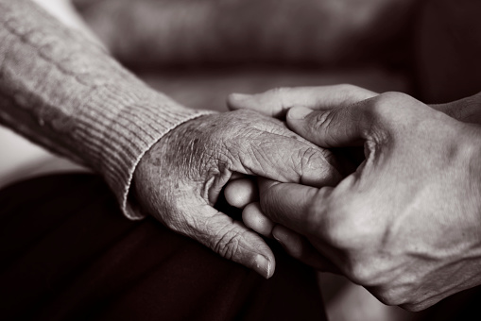
Infection in the Elderly
People >65 years significantly more likely to have a poor outcome
1.2% mortality rate
More likely to be immunosuppressed (p<0.001) or have diabetes (p<0.001)
More likely to present with multiple lesions (P <0.001)
More likely to present with WHO category III lesions (p<0.001)
40% risk of antibiotic related complications
O’Brien, D. P., Friedman, N. D., Cowan, R. et al. Mycobacterium ulcerans in the Elderly: More Severe Disease and Suboptimal Outcomes. PLoS Negl Trop Dis. 2015;9(12):e0004253.
Notes:
50 (26%) who had surgical management alone
Observational cohort study of 192 patients
20 recurrences in 16 patients
Incidence 41.8 per 100 person-years
Median time to recurrence 50 days (IQR 30-175 days)

Slide 31
What you can do to help
Diagnostic tests (sometimes multiple samples required)
Baseline FBE, CRP, UEC, LFTs
Baseline ECG
Complete list of medications and allergies attached to referral
Refer to Infectious Diseases Outpatient Clinic at Barwon Health
Inform the patient of the expected natural history: e.g. many months of wound healing, weeks of antibiotics, regular blood tests (fortnightly while on antibiotics), regular ID clinic review
Let the patient know that the referral will be triaged, and we will see them within 2-3 weeks
Can start antibiotics as per eTG (but not required)

Slide 32
Questions?

Slide 33
Data and infectious diseases in practice
Translating data into knowledge that's relevant to YOUR practice
Who to test?
Population data
Local data
Individual risk
What is the risk?
What tests?

Slide 34
COVID
Translating data into knowledge that's relevant to YOUR practice
Who to test?
Population data
Local data
Individual risk
Determined by govt advice but modified by local data
What is the risk?
What tests?
Determined by govt advice

Slide 35
Buruli Ulcer
Translating data into knowledge that's relevant to YOUR practice
Who to test?
Population data
Local data
Individual risk
What is the risk?
What tests?
Knowing the postcode data makes a difference to assessment of consistent presentations

Slide 36
Hepatitis B
Translating data into knowledge that's relevant to YOUR practice
Who to test?
What tests?
Population data
Local data
Individual risk
What is the risk?
Scientific
Systems
Patient centered

Slide 37
Hepatitis B
Translating data into knowledge that's relevant to YOUR practice
What tests?
Who to test?
Population data
Local data
Individual risk
What are the barriers?
What do you know about the patient?
What is the risk?
UNCERTAINTY
Where to source???
Scientific
Systems
Patient centered

Slide 38
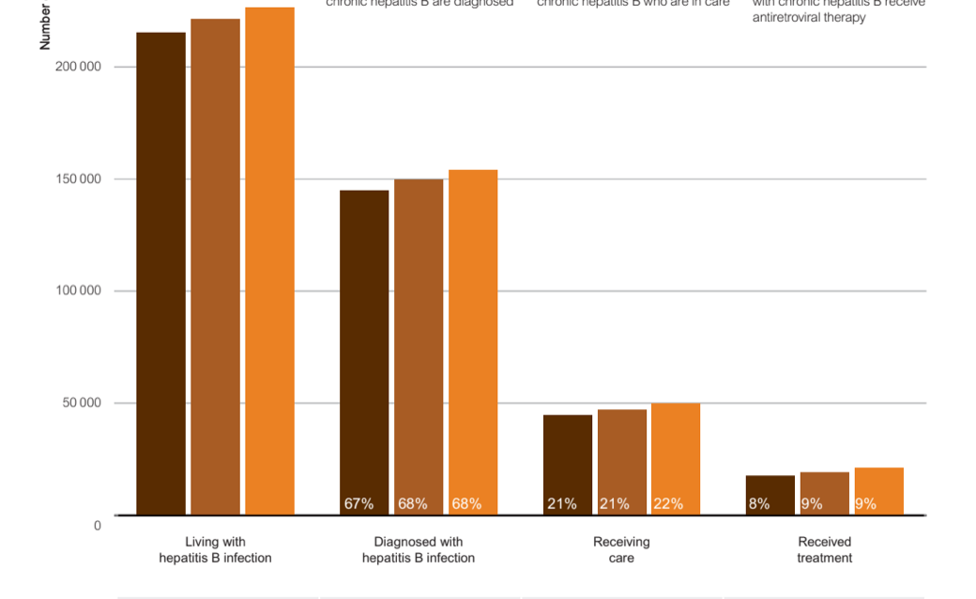
K2P staged along the patient journey “Cascade of care”- Hep B or Buruli Ulcer Understand the patient care journey and our role as primary care clinicians in this pathway
How do we prevent transmission?
How do we identify people at risk and assist them with testing? How do we interpret results correctly?
How do we link people to the right care?
?
What monitoring long term is needed?
Have the infection
Access testing and correct diagnosis
Access appropriate care
Complete appropriate treatment
Complete follow up as appropriate

Slide 39
In your practice:
After last ECHO – did you check what information is available on a patient record?
Do you know how to put in alerts e.g. for patients undergoing chemotherapy to prompt you to test?
Do you know how to do an audit of your patients using your software?

Slide 40
In your practice:
After last ECHO – did you check what information is available on a patient record?
Thinking about Hep B – common barriers to testing and treatment are:
Language / Cultural safety
Stigma
Socioeconomic / employment / visa
Location
Hepatitis-B-and-Immigration-v2.pdf (ashm.org.au)

Slide 41
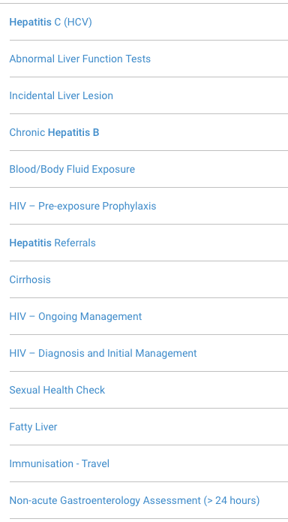
What resources can help you change your practice?
ASHM Hep B resources
Healthpathways referral and clinical guidelines
Hepatitis referral pathways were updated and
went live October 11th
Clinical Pathways
WVPHN leading the gastro pathways review
STI Clinical Guidelines pathways under review
Chlamydia, Gonorrhoea, Syphillis- Murray leading
Hepatitis Health Pathways
Health in Refugees
JEV, RRV – Mosquito borne diseases in Victoria
Buruli ulcer
Interpreter services

Slide 42
Make Knowledge actionable and shareable K2P- guidelines
FAIRness framework for human readable knowledge:
Findable
Accessible
Interoperable
Reusable
How do we make knowledge FAIR?
SHARE what you're doing to make things easier or what has worked in your setting

Slide 43
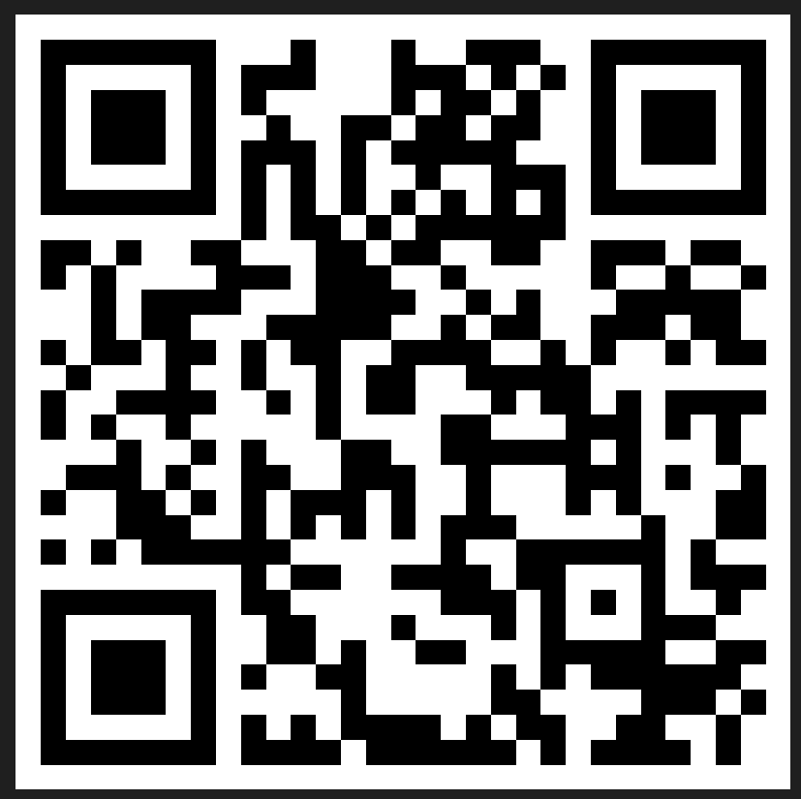
Evaluation
Session evaluation
Please take the time to evaluate this session
Link pasted into the chat
Session evaluation
Upcoming Sessions
24 November
1 December
If you have a case you would like to discuss with the group:
New case template here
Email projectechocovid19@westvicphn.com.au
Use the comment box in the evaluation form
Notes:
Session evaluation link https://forms.office.com/r/cZ9kC7nxpE
Case template link https://forms.office.com/r/xFPCCRSkzc

Slide 44
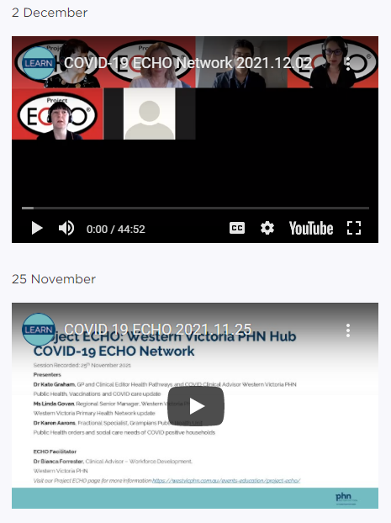
Listen and watch back previous sessions
Content is available on the WVPHN website
Listen back to all the series through Project ECHO: WVPHN Hub
COVID-19 ECHO network on Whooshkaa
https://westvicphn.com.au/events-education/project-echo/project-echo-covid19/
Notes:
https://player.whooshkaa.com/shows/project-echowvphn-hub-covid-19-echo-network
https://www.youtube.com/watch?v=nB5N57z9zG8&t=1s
Townhall 13th January 2022 https://www.youtube.com/watch?v=sr3uHtknLWs
Weekly emails,
Interactive discussions
To watch to view – Youtube
To listen - Whooshkaa
To listen to read – newsletter, resource pack, Zac’s notes
to participate – ECHO
To get in touch with us, email, healthpathways,

