Slide 1
Welcome to Project ECHO COVID and Communicable Diseases Network
Series 11: Session 4
Closing the care loop: Mapping care for communicable diseases across the patient journey
Hepatitis B case example

Slide 2
Acknowledgement of Countries
I’d like to begin by acknowledging the Traditional Owners and custodians of the lands and waterways from which we are all zooming in from today.
the Wadda Wurrung, Gulidjan, Gadubanud, Keeray Wurrung, Peek Wurrung, Gunditjmara, Djab Wurrung, Wotjobaluk, Dja Dja Wurrung, Jadawadjarli, Wergaia, Jaadwa and Jupagalk peoples
We recognise their diversity, resilience, and the ongoing place that First Peoples hold in our communities.
We pay our respects to the Elders, both past and present and commit to working together in the spirit of mutual understanding, respect and reconciliation.
We support self-determination for First Nations Peoples and organisations and will work together on Closing the Gap.
Ask the question. Do you identify as Aboriginal or Torres Strait Islander?

Slide 3
Etiquette/Zoom use
Chat
Introduce yourself / Role / Region / Organisation in “chat”
Use chat to ask questions
Please remain on ‘mute’ except when speaking
Please turn video on
In-session Evaluation at the end
These sessions will be recorded for ongoing training and quality improvement purposes.
The didactic presentations ONLY will be disseminated on our learning channel.
Discussions will be de-identified where used for QI or research purposes.
Please let us know if you would not like your comments recorded.
RACGP and ACCRM accredited, certificates PD

Slide 4
Learning outcomes
Series
Opportunity to review and discuss policy and guidelines in practice
Discuss emerging models of primary care with a focus on:
Communicable disease prevention
Communicable disease testing, assessment and management
Continuing care provision in primary care and in partnership with specialist services
Consider real-world experiences of implementing new care models in different settings
Build knowledge about current resources, supports & referral pathways
Engage in a community of practice and rapid learning network
Session 4 Learning outcomes
Discuss data collection, notification and use of data in practice
Discuss strategies to record and share data for communicable diseases surveillance and quality improvement
Translate the cascade of care to the western Victorian context
Discuss equity of access to monitoring, treatment and care in the Western Victorian context

Slide 5
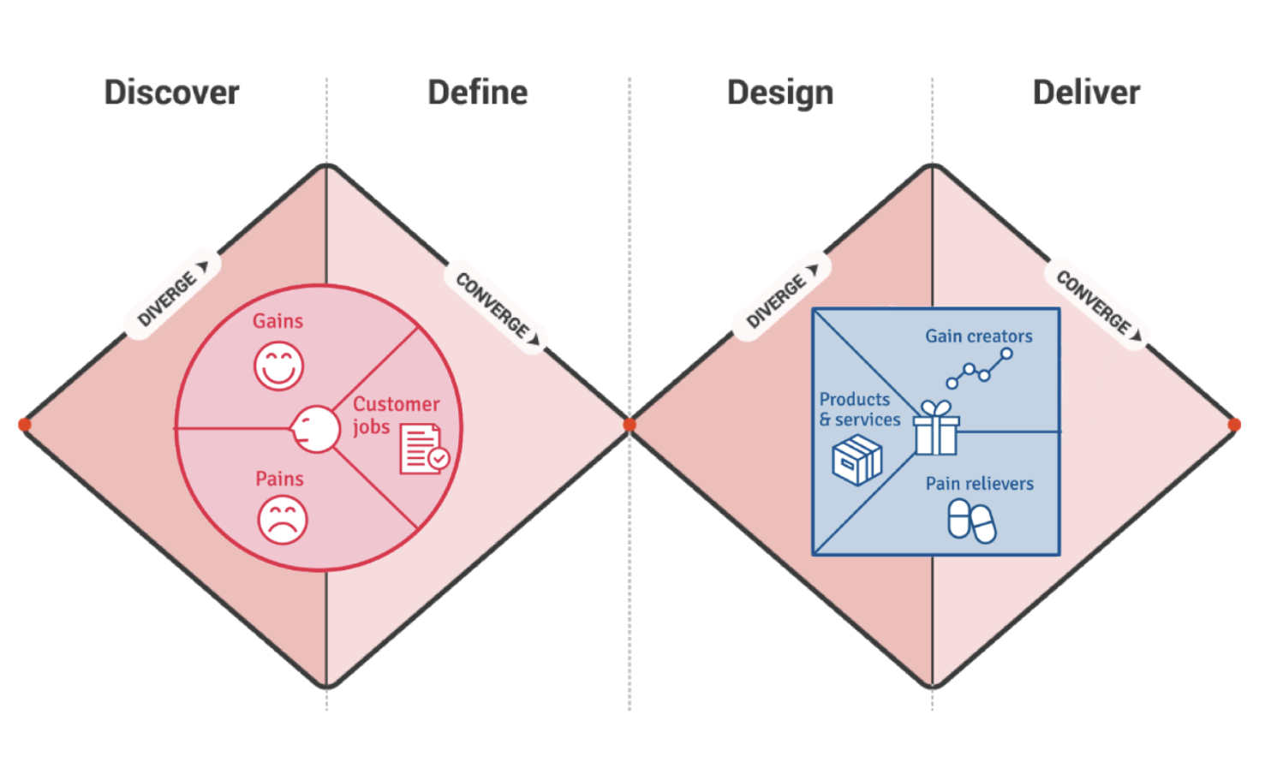
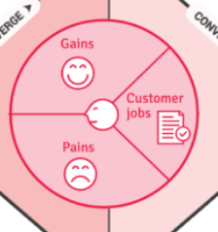
Learning labs- focus on process Deliver, Discover, Define, Design, Deliver
K2P-Solution design-
Guidance, decision tools
models of care (MOC)
ECHO
SE3
ECHO
SE4
ECHO
SE1
ECHO
SE2
D2K-Diagnostic-
Evidence- gaps/needs
D2K
Data to Knowledge
K2P
Knowledge to Practice
K2P and P2-Accessing treatment, Public Health Notifications
P2D
Practice to Data
P2D-Case for change-
Policy to Practice
ECHO
SE5
CPD and QI 2023
EHR auditing
The problem: People with Communicable diseases not receiving testing, care or management
Notes:
Both making

Slide 6
Learning Health System approach
Identify the problem:
Synthesise the evidence
Design Interventions
Generate change ideas
Transform and sustain
P2D
Practice to Data
D2K
Data to knowledge
K2P
Knowledge to Practice
-1
K2P
Knowledge to Practice
-2
P2D
Practice to Data
People with communicable diseases unable to access testing, care or management
Access, extract, map and represent health information for analysis
Make knowledge actionable and sharable, generate tailored messages for decision making
Develop system wide improvements
Make knowledge actionable and sharable, generate tailored messages for decision making
Consider change at the practice level
Implement changes in practice that support the next cycle
Eg data recording in EHR, notification data
Assess scalability and sustainability at the system, practice, process and patient level

Slide 7
Agenda for COVID and Communicable Diseases Network Series 11: Session 4 “Closing the care loop: Mapping care for communicable diseases across the patient journey Hepatitis B case example”
Dr Jeff Urquhart, GPLU Consultant, Barwon Health
Barwon Health update – pulse check on primary care
Naomi White, Covid Operations Manager, Western Victoria PHN
New announcements in Commonwealth and state Policy and regional services
Dr Amanda Wade, Blood Borne Viruses Medical Lead, Barwon Health
Hepatitis B management in Western Victoria
Case Presentation: Inga Tribe, Barwon Health Hepatitis Clinical nurse specialist
Panel for Discussion:
Dr Kate Graham, GP and Clinical Editor – HealthPathways and COVID Clinical Advisor, Western Victoria PHN

Slide 8
Barwon South West PHU Update
BH Covid Positive Pathways extended further 6 months
> 80 yo
Significant co morbidity diagnoses
Pt identifying as Ist nations or with significant social disadvantage/disability requiring community supports
Assistance with complex antiviral Rx
Tx
Severely immunospressed pts
Pregnant pts
Tel ID reg 0481 456 956
Future state still being considered ? delivery via HITH

Slide 9
Barwon South West PHU Update
160 to 280 cases reported daily in Nov
262 new cases reported 2/7 ago
Majority RAT test vs PCR
Total active cases 1515
BH Inpatients 13 with 1 in ICU
RPM
last month there were 339 pts monitored
43 currently being monitored

Slide 11
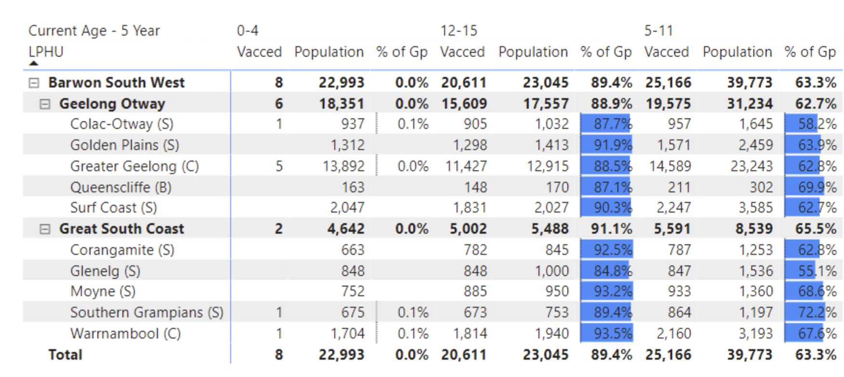
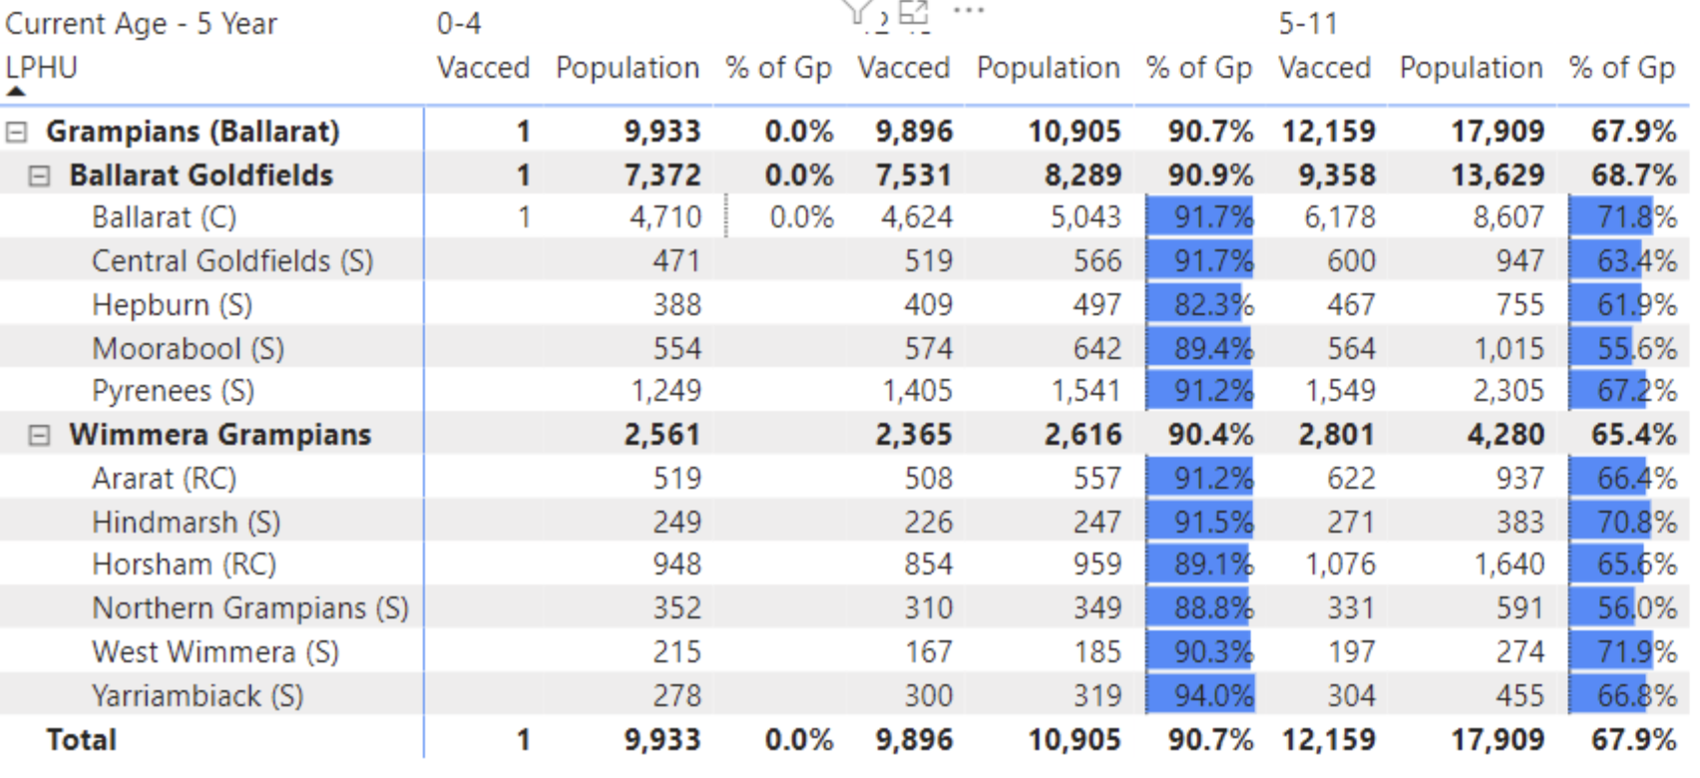
COVID-19 Vaccinations
Bivalent vaccine Pfizer and moderna
Booster only option
Automatic onboarding
Better coverage for Omicron
Jab in the arm is better than a whole vial in the fridge
0-5 yr vaccine Pfizer
No change to eligibility
*only 9 children in our region have been vaccinated
Notes:
Naomi

Slide 12
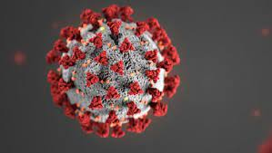
COVID Management
Pharmacy stock
There was a reported issue with one supplier, but seems to be back to normal despite an increase of prescriptions dispensed.
Evusheld
Continue to offer to patients as there is less awareness of the increased eligibility criteria and many patients are on medications that may make them eligible
Antivirals
Ensure patients aged > 70 years are offered them even if asymptomatic
Notes:
Medications for patients with COVID-19 | health.vic.gov.au

Slide 13
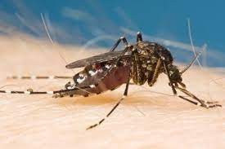
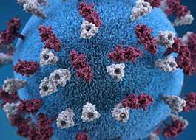
Health Alert
Measles
3 new cases identified in Vic in returned travelers.
More likely over summer – outbreak in Europe
MMR vaccine best protection
Initial symptoms similar to COVID but followed by rash. Urgent notifiable condition
Thunderstorm Asthma
Ross River Virus (and Barmah Forest Virus this summer)
Endemic in Victoria
Remove mosquito breeding sites around home and avoid bites
No vaccine currently available
Blood test early in symptoms and should be repeated two weeks later.
See Healthpathways for specific test requirements
Poppy seeds
Non-food grade poppy seeds have incorrectly entered the food supply chain.
Be alert for severe toxicity if brewed as a tea or concentrated. Product recalls are occurring
Notes:
New Measles cases - New measles cases in Victoria - November 2022 | health.vic.gov.au
Health warning on mosquitoes and Ross River virus - Health warning on mosquitoes and Ross River virus | health.vic.gov.au
Health warning on poppy seeds Health warning on poppy seeds | health.vic.gov.au

Slide 14
Monkeypox Vaccination (MPX)
Grampians
https://www.bhs.org.au/services-and-clinics/grampians-public-health-unit/monkeypox/
Springs Medical, Daylesford: (03) 5348 2227
Lister House, Horsham: 0458 969 778
UFS Medical, Doveton St. Ballarat: (03) 5364 9100
Ballarat Community Health, Lucas: (03) 5338 4500
East Grampians Health Service, Ararat: (03) 5352 9363
Please phone the clinics directly to make an appointment.
Barwon
https://bswphu.org.au/news/item/health-alert-monkeypox
Includes links to make MPX vaccination in Belmont, Warrnambool, Hamilton & Portland by appointment
The Barwon South West Public Health Unit is currently planning further regional vaccination clinics for MPX vaccine. To register your interest for a pop-up clinic in your area email MPXvaccines@barwonhealth.org.au
Notes:
https://www.bhs.org.au/services-and-clinics/grampians-public-health-unit/monkeypox/
Barwon South West Public Health Unit - Monkeypox (MPX) vaccination bookings now open (bswphu.org.au)
email MPXvaccines@barwonhealth.org.au

Slide 15
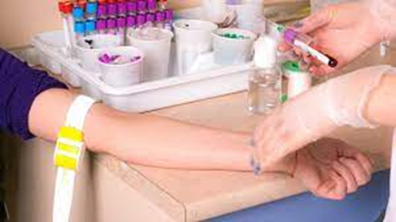
Testing
COVID PCR webpage updated- here
Respiratory clinics- PCR test without pre-filled path slip
State run testing centres- PCR test without pre-filled path slip
Private providers- require pathology slip
Mosquito borne virus – RRV/BFV - HP updated yesterday!
Consider presentations that fit with illness – myalgia, arthralgia, arthritis, rash in 2/3, fever less common
PCR can be done in initial days of illness, otherwise serology early in illness with IgG/IgM for arboviruses and flaviviruses (specify location and travel history), repeat 2 weeks later to detect seroconversion or fourfold rise in titre
Measles – urgent notifiable condition
Notes:
Respiratory and Assessment Clinics | Western Victoria Primary Health Network (westvicphn.com.au)
Kate

Slide 16
Testing
IT'S TRAVEL SEASON! BRING BACK MEMORIES, NOT....
Measles
urgent notifiable condition – suspected and confirmed cases
Use PPE if suspected and isolate the patient
Consider if respiratory presentations develop a rash, especially if recent travel history. Incubation period 8-12 days
Nasopharyngeal PCR + serology
Must document timing of last vaccine (live virus vaccine and PCR will detect)

Slide 17
Medication shortages?

Slide 18
Across the loop Discussion- Revisiting our problem statement
5 mins
People living with Hepatitis B need to access to diagnosis, care and treatment but they face a challenge - stigma, language barriers, cost, geography and time to attend appointments.
The problem is happening because it is a low incidence issue that is complex to manage, requires S100 prescriber registration and specialist knowledge, services not meeting peoples needs, the issue may not be prioritised.
Based on prevalence and morbidity of untreated hepatitis B, we think that ….
(what do we think could solve the problem in the Western Victorian region?)
Process: Ask 5 whys........
The Victorian Government is committed to eliminating HBV as a public health concern by 2030.
Goal
20% of PLW Hep B access treatment
vic-hep-b-plan-2022-23-online-pdf.pdf (health.vic.gov.au)
Notes:
vic-hep-b-plan-2022-23-online-pdf.pdf (health.vic.gov.au)

Slide 19
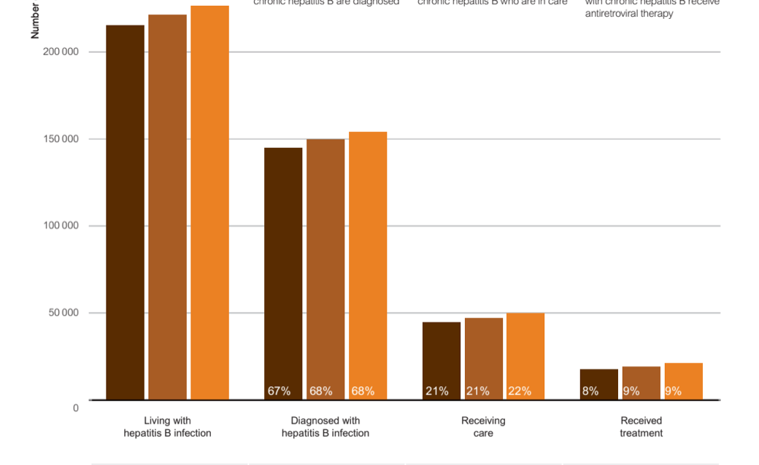
Practice to Data “Cascade of care”- Hepatitis B How do we bridge the gaps?
Prevent Transmission
Vaccination data
Identify people at risk- ethnicity, country of birth data
Interpret results correctly- guidelines and decision support. Audit gaps?
Notification data
Enhanced notification data
Surveillance data
How do we link people to the right care?
?
What monitoring long term is needed?
Have the infection
Access testing and correct diagnosis
Access appropriate care
Complete appropriate treatment
Complete follow up as appropriate
Notes:
Bianca presents

Slide 20
Knowledge to Practice- review- assessment Health Pathways and decision support
https://ashm.org.au/wp-content/uploads/2022/08/ASHM-Decision-Making-in-Hepatitis-B-2021-update-2.pdf
https://westvic.communityhealthpathways.org/28204.htm
Notes:
https://westvic.communityhealthpathways.org/28204.htm

Slide 21
Statutory required notification -Public Health and Wellbeing Regulations 2019
https://www.health.vic.gov.au/infectious-diseases/notifiable-infectious-diseases-conditions-and-micro-organisms
Please ensure that the case has been informed of the following:
their diagnosis,
that you are providing this information to the department (as required by the Health Records Act 2001), and
that the department may contact them for further information about their illness.
Commonwealth and State privacy legislation does not negate the responsibility to notify the specified conditions nor to provide the information requested on this form.

Slide 22
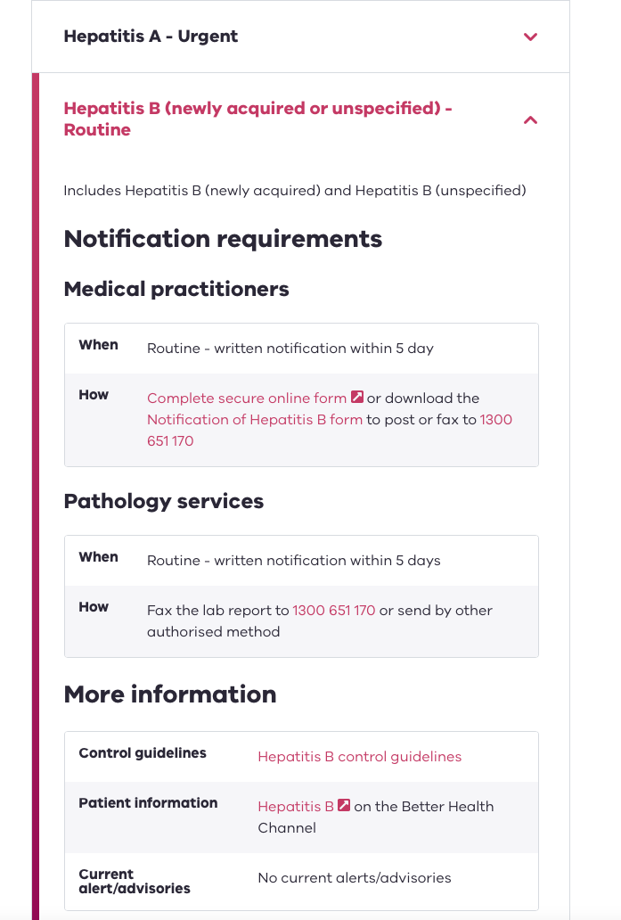

Slide 23
Currently under the Regional PHUs
COVID
Influenza
RSV
Pertussis
Myobacterium ulcerans
Varicella
Invasive pneumoccoal disease
Hepatitis B
Hepatitis C
Shigella
Ross River / Barmah Forest
Chlamydia
Notes:
Highlighted areas are taken care of by LPHU
COVID
Influenza
RSV
Pertussis
Myobacterium ulcerans
Varicella
Invasive pneumoccoal disease
Hepatitis B
Hepatitis C
Shigella
Ross River / Barmah Forest
Chlamydia
Q Fever – TBC
STEC – TBC
Gonorrhoea – TBC

Slide 24
“Cascade of care”- Hepatitis B Understand the patient care journey and our role as primary care clinicians in this pathway
Prevent Transmission
Vaccination data
Identify people at risk- ethnicity, country of birth data
Interpret results correctly- guidelines and decision support. Audit gaps?
Notification data
Enhanced notification data
Surveillance data
How do we link people to the right care?
?
What monitoring long term is needed?
Have the infection
Access testing and correct diagnosis
Access appropriate care
Complete appropriate treatment
Complete follow up as appropriate
Notes:
Data used to
How many people have a hep b diagnosis?
Audit, how many blood tests or ultrasounds have these specific patients had?
What other data can we use here radiology, u/s, blood test,

Slide 25
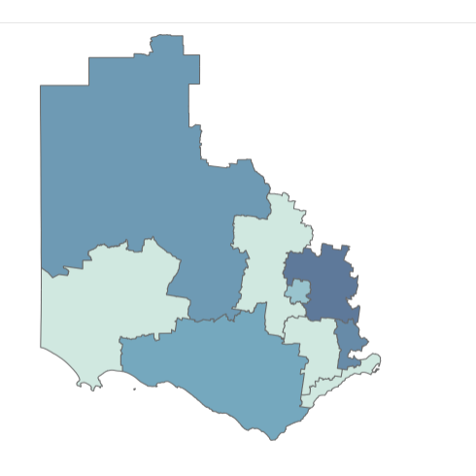
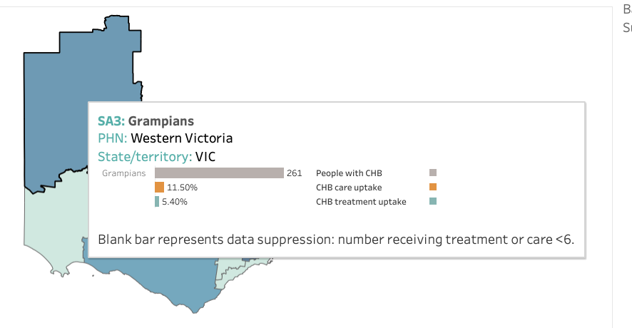
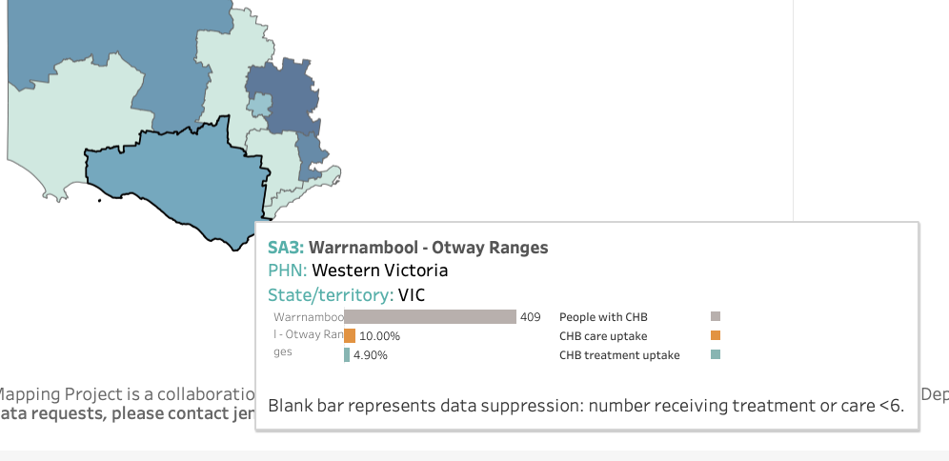
Surveillance data Hepatitis B Mapping Project- West Vic PHN Data
Treatment gap = 15.1%
Treatment gap = 14.5%
Goal
20% of PLW Hep B access treatment
Notes:
I don’t know if we can call this a treatment gap

Slide 26
Question:
What additional information would be needed to ensure we close the loop and link people into care?

Slide 27
Hepatitis B management in Western Victoria
Indicator | National 2018 level | National 2019 level | National 2020 level | West Vic 2020 | Target by 2022 | Year Australia projected to reach target
Diagnosis | 70.9% | 71.3% | 73% |  | 80% | 2023
Care* (treatment or monitoring) | 22.8% | 23.2% | 22.6% | 12.3% | 50.0% | 2045
Treatment | 9.7% | 10.2% | 10.7% | 4.8% | 20.0% | 2046
*”Engaged in care” indicator reflects a snapshot of the proportion of people who received guideline based care in a given year (only 11.9% receive optimal annual testing)
Viral Hepatitis Mapping Project 2020, Doherty Institute
Notes:
Amanda taks over here

Slide 28
Hepatitis B management
Monitoring
Treatment
All people with hepatitis B need annual
LFTs; and
An HBV viral load.
This determines when treatment is needed
Some people with hepatitis B need hepatocellular carcinoma surveillance which is 6 monthly
Liver ultrasound; and
Alpha fetoprotein.
20% of people with hepatitis B are eligible for treatment
Treatment is with
Entecavir; or
Tenofovir.
Both are
one tablet once a day
well tolerated
taken indefinitely to suppress viral replication
Prescribed by
a specialist; or
an HBV S100 GP; or
NP

Slide 29
Adherence vs flares

Slide 30
Barriers to engagement in hepatitis B care
Misinterpretation of serology
Low risk perception of hepatitis B
Casual employment without sick leave – unable to attend appointments
Lack of availability of interpreters
Problems with pathology – collection of appropriate samples
Lack of access to bulk billing radiology specialist or general practice services
Asymptomatic nature of infection
Low risk perception of hepatitis B
Stigma
Fear
Distrust in medical institutions or professionals
Differing cultural understandings of health
Low health literacy

Slide 31
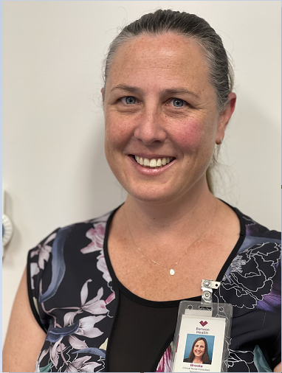
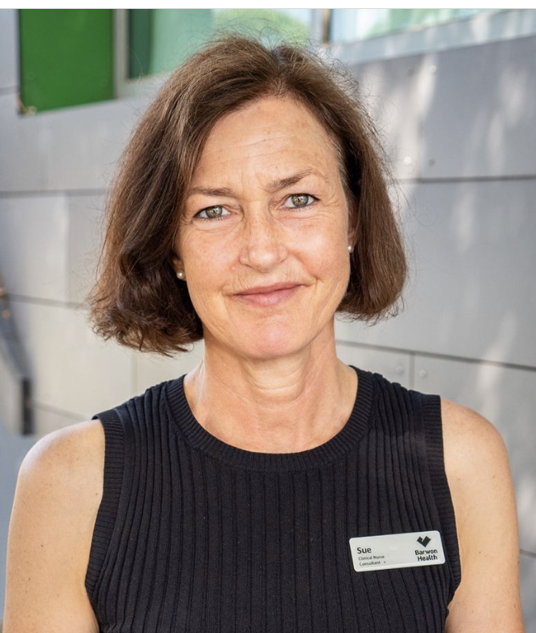
Accessing hepatitis B treatment in BSW Region
Inga
HBV S100 GP x 2
Brooke
Sue

Slide 32
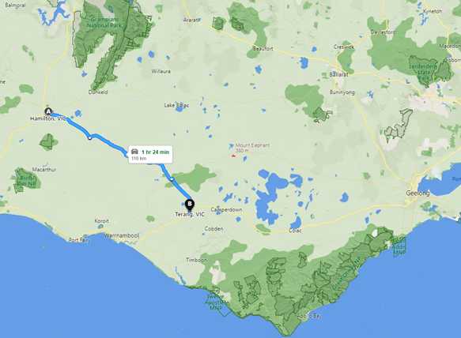
Case Study – MF 28 year old Male.
Born Sudan. Migrated to Australia 2010, lost to follow up post discharge from paediatric Hep B service at RCH to interstate.
Occupation- Works in dairy related food production Hamilton region.
Family- Wife works part –time, 2 children primary school
No interpreter required. Non-drinker. No Health Care Card
Ix- Hepatitis B c Ab positive. sAg positive, eAg negative, Viral Load 292, ALT 28.
Mx- Referred to Physician by GP 2020 – abnormal LFT’s, fatigue, positive hep serology
reviewed, flare identified, commenced on Entecavir.
Intermittent adherence due to cost.
Feels he is fit and strong therefore medication not always required. Brother has Hepatitis B but does not need to take medication.
Wife tested for and vaccinated for Hepatitis B.
Plan- Due to age and ethnicity requires lifelong 6 monthly HCC screening (abdo US, AFP LFT UE FBE) and Hepatitis B Viral Load
Challenges faced- No Bulk Billing US in Hamilton – travels to Terang US six monthly, requires medical certificate to attend appointment.
Pathology collection in Hamilton (dorevitch)
R/V 6 monthly by physician, authority script written 1 plus 5 repeats.
Seen by BSWRLC for FibroScan and education session – better compliance with medication, Hep B Story (Arabic).
List the barriers to care
How would you support this man in your context?

Slide 33
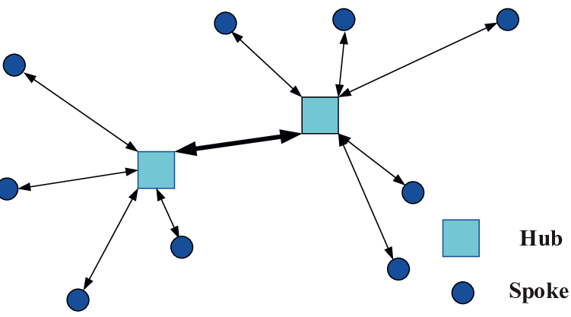
Across the loop Discussion- Revisiting our problem statement
5 mins
People living with Hepatitis B need to access to diagnosis, care and treatment but they face a challenge - stigma, language barriers, cost, geography and time to attend appointments.
The problem is happening because it is a low incidence issue that is complex to manage, requires S100 prescriber registration and specialist knowledge, services not meeting peoples needs, the issue may not be prioritised.
Based on prevalence and morbidity of untreated hepatitis B, we think that ….
Eg a well-developed hub and spoke model of care and supported access can solve the problem. (More s100 prescribers could be great too)
Process: Ask 5 whys
The Victorian Government is committed to eliminating HBV as a public health concern by 2030.
Goal
20% of PLW Hep B access treatment
https://content.health.vic.gov.au/sites/default/files/2022-09/vic-hep-b-plan-2022-23-online-pdf.pdf

Slide 34
Webinar today - Avant
Thursday 24 November 1:00- 2:00pm
Hosted by: Sonya Black, Avant Legal Team Manager
The session will provide attendees with a greater understanding of how best to manage unvaccinated staff, face coverings and COVID positive patients given public health directions are no longer in force.
The practice’s legal obligations and responsibilities
The importance of ongoing risk assessment and
Managing non-compliance with the practice’s requirements
Notes:
Register here
https://us02web.zoom.us/webinar/register/WN_P4U193zGThy9ldaBglJoVA

Slide 35
Liverwell Forum Ballarat – Today 10am – 2.00pm
Free training workshop
Expert presenters
Lived experience speaker
Community-based health experts
Oscar’s Hotel – Garden Room
18 Doveton St Ballarat Central VIC
Use the QR code to register.
Notes:
Register here www.liverwell.org.au

Slide 36
World AIDS Day – Tuesday 29 November 12pm
World AIDS Day activation
12.00pm Tuesday 29 November
Lt Malop St Mall – Across from the Geelong Advertiser office - Wear red!!!

Slide 37
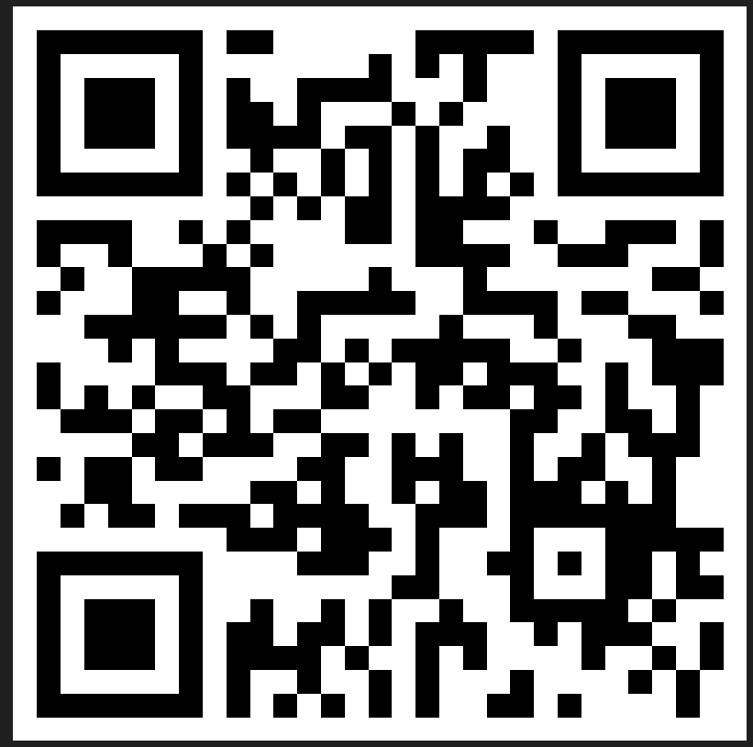
Evaluation
Session evaluation
Please take the time to evaluate this session
Link pasted into the chat
Session evaluation
Upcoming Sessions
1 December (last for the year)
If you have a case you would like to discuss with the group:
New case template here
Email projectechocovid19@westvicphn.com.au
Use the comment box in the evaluation form
Notes:
Session evaluation link https://forms.office.com/r/ru6KcfndEa
Case template link https://forms.office.com/r/xFPCCRSkzc

Slide 38
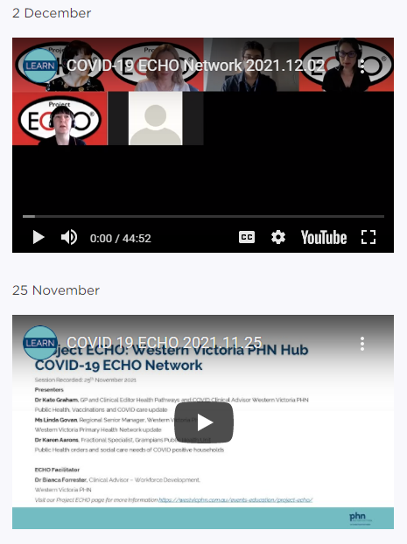
Listen and watch back previous sessions
Content is available on the WVPHN website
Listen back to all the series through Project ECHO: WVPHN Hub
COVID-19 ECHO network on Whooshkaa
https://westvicphn.com.au/events-education/project-echo/project-echo-covid19/
Notes:
https://player.whooshkaa.com/shows/project-echowvphn-hub-covid-19-echo-network
https://www.youtube.com/watch?v=nB5N57z9zG8&t=1s
Townhall 13th January 2022 https://www.youtube.com/watch?v=sr3uHtknLWs
Weekly emails,
Interactive discussions
To watch to view – Youtube
To listen - Whooshkaa
To listen to read – newsletter, resource pack, Zac’s notes
to participate – ECHO
To get in touch with us, email, healthpathways,

