Slide 1

Welcome to Project ECHO
COVID and Communicable Diseases Network
Series 11: Session 5
“Pandemic wrap up for 2022: Discussing the year that was, planning the year ahead”

Slide 2


Acknowledgement of Countries
I’d like to begin by acknowledging the Traditional Owners and custodians of the lands and waterways from which we are all zooming in from today.
the Wadda Wurrung, Gulidjan, Gadubanud, Keeray Wurrung, Peek Wurrung, Gunditjmara, Djab Wurrung, Wotjobaluk, Dja Dja Wurrung, Jadawadjarli, Wergaia, Jaadwa and Jupagalk peoples
We recognise their diversity, resilience, and the ongoing place that First Peoples hold in our communities.
We pay our respects to the Elders, both past and present and commit to working together in the spirit of mutual understanding, respect and reconciliation.
We support self-determination for First Nations Peoples and organisations and will work together on Closing the Gap.
Ask the question. Do you identify as Aboriginal or Torres Strait Islander?

Slide 3







Acknowledgements
Thank you to everyone who contributed as our Subject Matter experts
Dr Deb Friedman
Dr Kate Graham
Dr Raquel Cowan
Dr Jeff Urquhart
Prof Rosemary Aldrich
Dr Alison Miller
Linda Govan
Janine Rigby
Dr Callum Maggs
Dr Karen Aarons
Western Victoria PHN Executive
and management teams
Danielle Trezize
Dr Caroline Bartolo
Dr Nom Mothobi
Dr Arvind Yerramilli
Dr Aaron Bloch
Robyn Wilson
Naomi White
Dr Belinda Carne
Dr Gerard Ingham
Emma Johns
Dr Bernard Shiu
Dr Misha Coleman
Dr Jane Standish
Dr Anita Phillips
Prof Lena Sanci
Prof Eugene Athan
Dr Akhtar Hussain
Dr Tim Denton
Dr Tom Souchen
Dr Bethan Knapp
Adam Muir
Prof Mark Yates
Dr Sarah Huffam
Dr John Henderson
Dr Lisa Mitchell
Dr Kate McCloskey
Dr Lisa Clinnick, Dr Sarah Huffam
Dr Chris Cooper, Dr Gemma Stickland
Dr Piraveen Pirakalathanan, Tania Dalton
Dr Gerladine Masson, Dr Alan Aplebe
Dr David Wilson, Amanda Wilson
Jane Campbell, Kristen Douglas
Christine Morgan, Caitlin Yates
Matthew Drake, Dr Billy Garvey
Especially a big thank you to all our ECHO participants…

Slide 4


Etiquette/Zoom use
Chat
Introduce yourself / Role / Region / Organisation in “chat”
Use chat to ask questions
Please remain on ‘mute’ except when speaking
Please turn video on
In-session Evaluation at the end
These sessions will be recorded for ongoing training and quality improvement purposes.
The didactic presentations ONLY will be disseminated on our learning channel.
Discussions will be de-identified where used for QI or research purposes.
Please let us know if you would not like your comments recorded.
RACGP and ACCRM accredited, certificates PD

Slide 5

Learning outcomes
Series
Opportunity to review and discuss policy and guidelines in practice
Discuss emerging models of primary care with a focus on:
  Communicable disease prevention
  Communicable disease testing, assessment and management
  Continuing care provision in primary care and in partnership with specialist services
Consider real-world experiences of implementing new care models in different settings
Build knowledge about current resources, supports & referral pathways
Engage in a community of practice and rapid learning network
Session 5 Learning outcomes
Contribute to designing continuing professional development for 2023
Describe the application of polar to data collection at the practice level
Discuss covid policy and legislation advice
Participate in a summer quiz

Slide 6
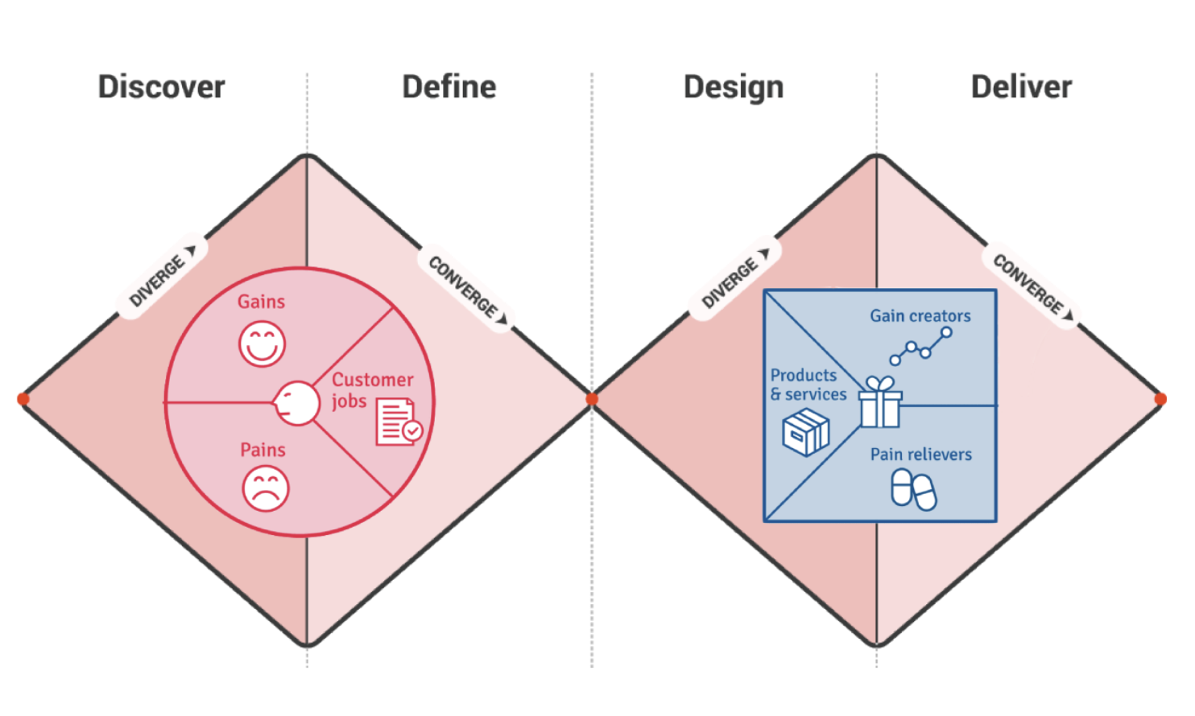
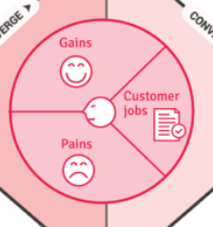
Learning labs- focus on process
Deliver, Discover, Define, Design, Deliver
K2P-Solution design-
Guidance, decision tools
models of care (MOC)
ECHO
SE3
ECHO
SE4
ECHO
SE1
ECHO
SE2
D2K-Diagnostic-
Evidence- gaps/needs
D2K
Data to Knowledge
K2P
Knowledge to Practice
K2P and P2-Accessing treatment, Public Health Notifications
P2D
Practice to Data
P2D-Case for change-
Policy to Practice
ECHO
SE5
CPD and QI 2023
EHR auditing
The problem: People with Communicable diseases not receiving testing, care or management
Notes:
Both making

Slide 7

Learning Health System approach
Identify the problem:
Synthesise the evidence
Design Interventions
Generate change ideas
Transform and sustain
P2D
Practice to Data
D2K
Data to knowledge
K2P
Knowledge to Practice
-1
K2P
Knowledge to Practice
-2
P2D
Practice to Data
People with communicable diseases unable to access testing, care or management
Access, extract, map and represent health information for analysis
Make knowledge actionable and sharable, generate tailored messages for decision making
Develop system wide improvements
Make knowledge actionable and sharable, generate tailored messages for decision making
Consider change at the practice level
Implement changes in practice that support the next cycle
Eg data recording in EHR, notification data
Assess scalability and sustainability at the system, practice, process and patient level

Slide 8


Agenda for COVID and Communicable Diseases Network Series 11: Session 5
“Pandemic wrap up for 2022: Discussing the year that was, planning the year ahead ”
Naomi White, Manager Public Health and Emergency Preparedness, Western Victoria PHN
  New announcements in Commonwealth and state Policy and regional services
Christmas Quiz: The year that was 2022
Katrina Martin, Workforce Development Program Lead, Western Victoria PHN
  CPD Packages in the new triennium
Panel for Discussion:
Dr Kate Graham, GP and Clinical Editor – HealthPathways and COVID Clinical Advisor, Western Victoria PHN
Notes:
Sarah Crowe, Digital Health Manger, Western Victoria PHN
The Polar express

Slide 9

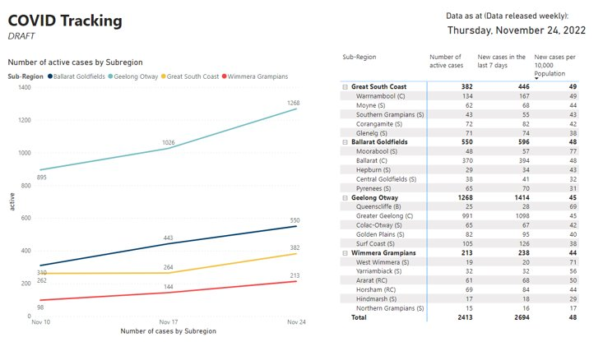
Covid Rates
Australia wide
Over last week 75,590 new cases of COVID-19 were reported across Australia (10,799 cases per day)
Compares to 54,661 reported cases of COVID-19 across Australia in the week before (7,800 cases/day)
Although there is underreporting of new cases, this represents an increase of 38.3%.
Hospitalised with COVID-19 has increased by an average of 27.1% to a daily average of 1,973, compared to 1,553 in the previous week.
Cases in critical care has remained relatively stable, with 52 people in ICU each day this past week, compared to 50 each day last week.

Slide 10
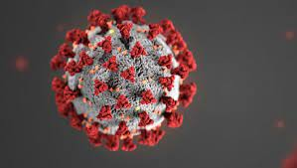
COVID Management
Antivirals
Continue to see an increase in PBS prescriptions for the COVID-19 oral treatments, Lagevrio and Paxlovid, with over 23,180 prescriptions dispensed in the past week throughout Australia, compared to 14,264 prescriptions in the previous week.
There has been a total of 367,480 prescriptions dispensed - approximately 287,570 prescriptions filled for Lagevrio (Molnupiravir), and 79,910 for Paxlovid.
Vic CHO promoting the positive results from Lagevrio use as a COVID treatment.
Notes:
Medications for patients with COVID-19 | health.vic.gov.au

Slide 11
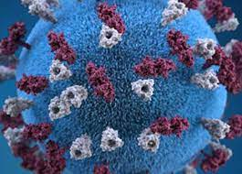

Health Alert – Monkeypox (MPX)
Monkey Pox - As of 24 November 2022:
  There are 143 cases (confirmed and probable) of MPX in Australia.
  This includes 70 in Victoria, 56 in New South Wales, 7 in Western Australia, 5 in Queensland, 3 in the Australian Capital Territory, and 2 in South Australia.
https://www.health.gov.au/health-alerts/monkeypox-mpx?language=en
Notes:
https://www.health.gov.au/health-alerts/monkeypox-mpx?language=en

Slide 12

Monkeypox Vaccination (MPX)
Reminder regarding access to MPX Vaccinations
Grampians
https://www.bhs.org.au/services-and-clinics/grampians-public-health-unit/monkeypox/
Springs Medical, Daylesford: (03) 5348 2227
Lister House, Horsham: 0458 969 778
UFS Medical, Doveton St. Ballarat: (03) 5364 9100
Ballarat Community Health, Lucas: (03) 5338 4500
East Grampians Health Service, Ararat: (03) 5352 9363
Please phone the clinics directly to make an appointment.
Barwon
https://bswphu.org.au/news/item/health-alert-monkeypox
Includes links to make MPX vaccination in Belmont, Warrnambool, Hamilton & Portland by appointment
The Barwon South West Public Health Unit is currently planning further regional vaccination clinics for MPX vaccine. To register your interest for a pop-up clinic in your area email MPXvaccines@barwonhealth.org.au
Notes:
https://www.bhs.org.au/services-and-clinics/grampians-public-health-unit/monkeypox/
Barwon South West Public Health Unit - Monkeypox (MPX) vaccination bookings now open (bswphu.org.au)
email MPXvaccines@barwonhealth.org.au

Slide 13



The festive season is coming
WVPHN will be closed from 2pm on the 23rd December 2022 and will re-open on January 3rd
The COVID team will be on leave for this period.
Public Health Units remain operational.
  Contact details are on HealthPathways
Visit https://westvic.communityhealthpathways.org/
Notes:
New to HealthPathways? Visit https://westvic.communityhealthpathways.org/ and select ‘register now’
Questions? Email us at healthpathways@westvicphn.com.au

Slide 14



Christmas Quiz: The year that was…. Music in 2022
The song that spent the longest at No. 1 in Australia during 2022 was
  Running up that hill, Kate Bush
  As it was, Harry Styles
  Stay, The kid Laroi and Justin Bieber
  All I want for Christmas is You, Mariah Carey
What did Taylor Swift become the first music artist to achieve in 2022 when she released her new album Midnights?
    received 15 Grammy awards
    first female artist to achieve 4 artist of the year awards at the CMA awards
    First artist to have 10 songs fill the top 10 songs on the billboard top 200 chart ever
    First artist to lip sync their award speech
Why was this year's Eurovision the most controversial yet?
  It expelled Russia from the program
  Four Russian babushkas (nannas) danced naked
  The French contender was actually from Belfast
  Finland did not submit a heavy metal band

Slide 15



The year that was... News and current affairs 2022
The end of the pandemic declaration in Victoria was on which date
  1 October
  9 October
  12 October
  still in operation
2022 saw a change in federal government. Since 1930, how many changes of federal government have there been?
  6
  10
  18
  30
What date did Queen Elizabeth die?
  5 September
  8 September
  10 September
  15 September

Slide 16




The year that was... Sports 2022
Who won the AFL Brownlow medal in 2022?
  Patrick Cripps, Carlton
  Lachlan Neale, Brisbane
  Andrew Brayshaw, Freemantle
  Nick Daicos, Collingwood
On Jan 29, Ash Barty became the first Australian woman to win the Australian Open in how many years?
  12
  26
  35
  44
Who won the Melbourne cup this year?
  Gold Trip
  Emissary
  High Emocean
  Verry Elleegant
Which of the following sports will Ballarat NOT be hosting for the Commonwealth games
  Rowing
  Athletics
  Boxing
  T20 cricket

Slide 17
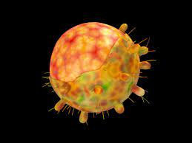

The year that was... COVID 2022
Which COVID variant was first detected in South Africa on 24 November 2021 and spread very fast at the beginning of 2022?
  Alpha
  Beta
  Delta
  Omicron
Which region had the best vaccination and oral anti viral prescribing rates in Australia?
  Central Coast (NSW)
  Ours
  Gippsland
  South West (WA)
How many COVID ECHO’s have there been since the beginning of the pandemic?
  46
  63
  85
  1,000,000

Slide 18
Christmas Quiz: The year that was…. Music in 2022
The song that spent the longest at No. 1 in Australia during 2022 was
  Running up that hill, Kate Bush
  As it was, Harry Styles
  Stay, The kid Laroi and Justin Bieber
  All I want for Christmas is You, Mariah Carey
What did Taylor Swift become the first music artist to achieve in 2022 when she released her new album Midnights?
    received 15 Grammy awards
    first female artist to achieve 4 artist of the year awards at the CMA awards
    First artist to have 10 songs fill the top 10 songs on the billboard top 200 chart ever
    First artist to lip sync their award speech
Why was this year's Eurovision the most controversial yet?
  It expelled Russia from the program
  Four Russian babushkas (nannas) danced naked
  The French contender was actually from Belfast
  Finland did not submit a heavy metal band

Slide 19
The year that was... News and current affairs 2022
The end of the pandemic declaration in Victoria was on which date
  1 October
  9 October
  12 October
  still in operation
2022 saw a change in federal government. Since 1930, how many changes of federal government have there been?
  6
  10
  18
  30
What date did Queen Elizabeth die?
  5 September
  8 September
  10 September
  15 September

Slide 20
The year that was... Sports 2022
Who won the AFL Brownlow medal in 2022?
  Patrick Cripps, Carlton
  Lachlan Neale, Brisbane
  Andrew Brayshaw, Freemantle
  Nick Daicos, Collingwood
On Jan 29, Ash Barty became the first Australian woman to win the Australian Open in how many years?
  12
  26
  35
  44
Who won the Melbourne cup this year?
  Gold Trip
  Emissary
  High Emocean
  Verry Elleegant
Which of the following sports will Ballarat NOT be hosting for the Commonwealth games
  Rowing
  Athletics
  Boxing
  T20 cricket

Slide 21
The year that was... COVID 2022
Which COVID variant was first detected in South Africa on 24 November 2021 and spread very fast at the beginning of 2022?
  Alpha
  Beta
  Delta
  Omicron
Which region had the best vaccination and oral anti viral prescribing rates in Australia?
  Central Coast (NSW)
  Ours
  Gippsland
  South West (WA)
How many COVID ECHO’s have there been since the beginning of the pandemic?
  46
  63
  85, but feels like 1,000,000
  1,000,000

Slide 22
CPD for GPs is changing
CPD for 2023-25 Triennium and beyond

Slide 23
Questions to be answered today
Why is CPD changing?
What are the changes?
Where does Project ECHO fit into the new triennium?
How can WVPHN assist you to meet your CPD requirements?
  Tip: lots of ways!!

Slide 24

Why is CPD changing?
Medical Board Australia (MBA) has introduced a Professional Performance Framework
Take effect from 1 Jan 2023
The min CPD requirements GP must meet to maintain registration
  The introduction of CPD Homes
  The introduction of professional development plans (PDPs) for all doctors
  A requirement for doctors to do different types of CPD to improve the value of their professional development
  A requirement for doctors to do 50 hours of CPD each year
Notes:
CPD Home – your specialist medical college - RACGP or ACRRM (will be automatic for you)
PDPs – will be easily completed on the GPs RACGP portal – approx. 1-2 hours
The role of the MBA is to:
Register medical practitioners and medical students
Develop standards, codes and guidelines for the medical profession
Investigate notifications and complaints
Where necessary, conduct panel hearings and refer serious matters to Tribunal hearings
Assess IMGs who wish to practice in Australia
Approve accreditation standards and accredited courses of study.

Slide 25
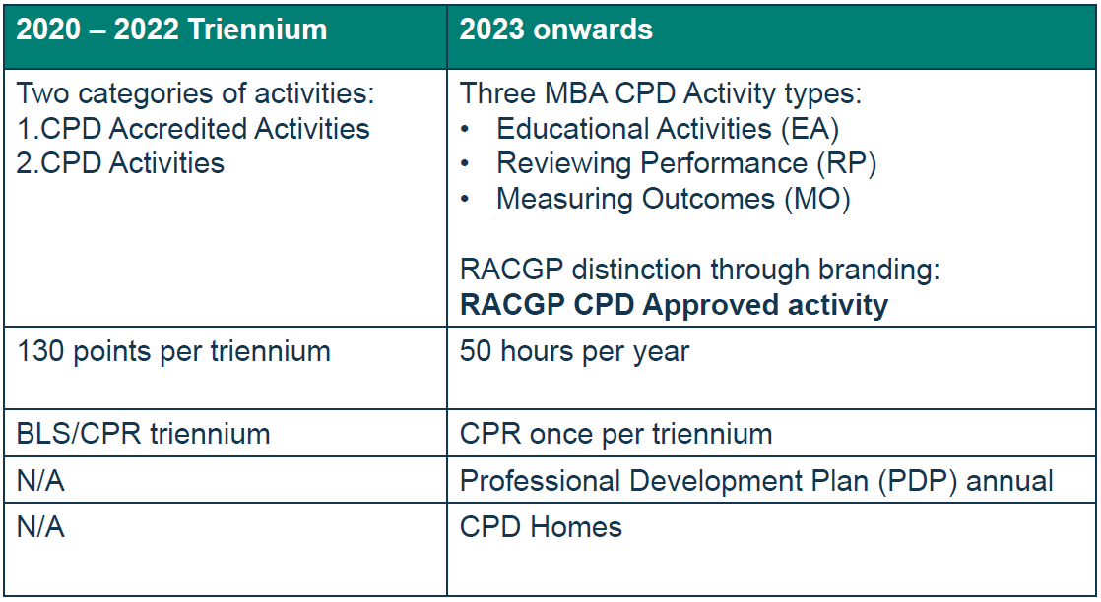
What is changing for doctors?
Notes:
CPR: Each triennium, you will need to complete a Cardiopulmonary Resuscitation (CPR) course (Providing CPR HLTAID009). While the other tasks are annual, you will have three years to update your skills. This is an RACGP high level requirement, not mandated by the MBA. We will also accept other courses that meet the requirements of HLTAID009 such as BLS and ALS courses which include CPR.
PDP will be a simple tool on the myCPD Dashboard for GPs to complete
CPD Home – RACGP or ACRRM

Slide 26

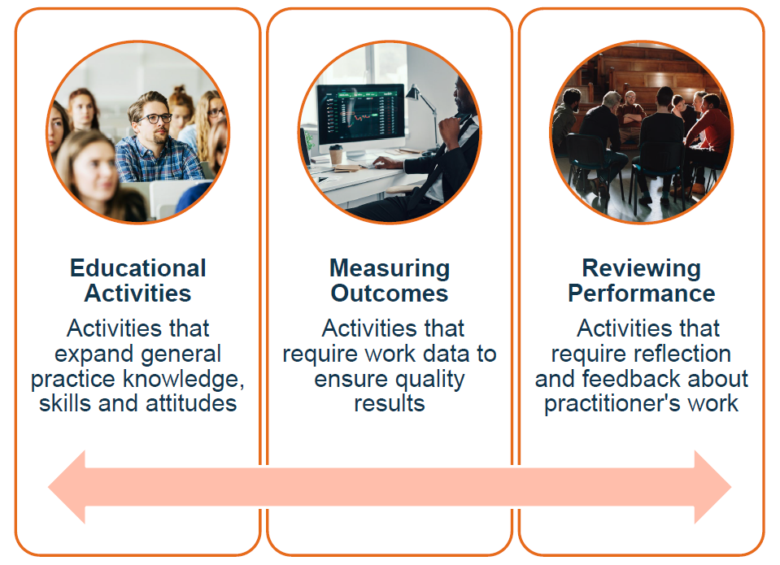

MBA Activity Types
Notes:
Educational Activities: Activities that expand General Practice knowledge, skills and attitudes, related to GP's scope of practice.
These activities will be very familiar and include learning opportunities like lectures, webinars, workshops, reading, podcasts and courses.
Measuring Outcomes: Activities that use GP work data to ensure quality results.
When measuring outcomes, GPs use data from their work to show they’re aware of current evidence and best practice in a particular area.
GPs could achieve this by conducting activities like research, audits or evaluations. This type of learning can help GPs achieve high-quality performance in their scope of practice.
Reviewing Performance: Activities that require reflection on feedback about their work. Feedback might be from patients, peers or even from self-reflection.
In each of these situations, GPs receive information about their performance that can either validate what they already do or identify areas for improvement.
Meaningful reflection on this information is where the learning occurs and can result in improved capability in their scope of practice.
Participants give and receive feedback and have an opportunity to reflect on performance
ECHO sits best here because the whole model has baked in that participants are upskilling by teaching each other, reflecting on their practice and reflecting on the principles of shared learning

Slide 27
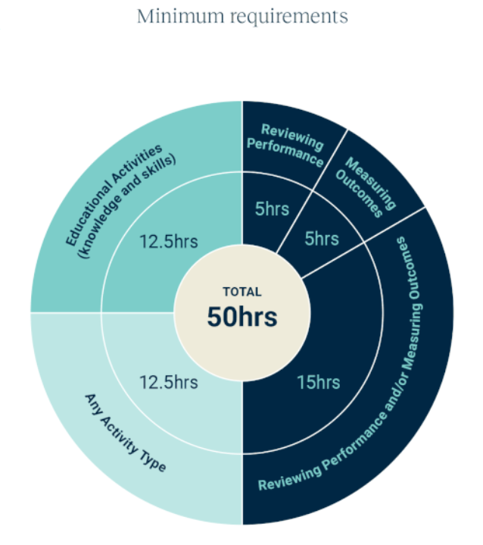
Minimum Annual CPD
50 hours per calendar year
50 hours must be made up of a minimum number of hours in each of the 3 activity types
50 hours… approx 1 hour per week
WVPHN recognises that this is a significant jump from previous years’
We are here to help
Notes:
Comparison
Previously: 12 hours per year*
From 1 Jan: 50 hours per year
2020-22 Triennium (convert points > hrs)
130 CPD points consisting of:
2 x Cat 1 activities @ 40 points per activity (usually 6 hrs in duration) = 12 hrs
1 x basic life support (BLS) activity @ 5 points = 1 hour
Remaining 45 points usually made up of Cat 2 activities calculated at 2 points per hour = 45/2= 22.5 hours
Total hours = 35.5 hours over three years (approx. 12 hrs per year)

Slide 28
50 CPD hours per calendar year
Category | Hours (min)
EA – Educational activities | 12.5
RP – Reviewing Performance | (5) | 25
MO – Measuring Outcomes | (5)
Any | 12.5
TOTAL | 50

Slide 29
Examples
Activities WVPHN provides or supports
Activity | Description | Examples
Educational Activities (Knowledge and Skills) | Activities that expand knowledge skills and attitudes | Workshops Conferences Lectures, Webinars Podcasts Short Courses Case Based discussions
Measuring Outcomes (with evidence of outcomes) | Activities that use work data to ensure quality results | Mini Audit /Audit Plan, Do, Study, Act (PDSA) Research Practice Accreditation Development of clinical guidelines
Reviewing Performance (with evidence of feedback) | Activities that require reflection on feedback about the practitioner's work | Case Based Discussion Peer Group Learning Professional Development Plan (PDP) Patient feedback Self-Care review Supervisor activities
ECHO, SIGs, peer groups

Slide 30
RACGP CPD Approved Activity Logos

Slide 31
Hybrid activities
Hybrid activities are activities that are made up of 2 or more CPD activity types
  Educational activities
  Measuring outcomes
  Reviewing performance

Slide 32

Project ECHO’s time to shine!
RACGP has indicated that Reviewing Performance (RP) hours will be the most challenging for GPs to obtain
Project ECHOs will be accredited by WVPHN as Peer Group Learning (PGL) activities
Will qualify for Reviewing Performance (RP) hours
Case studies – presenting and discussing cases remain the heart of ECHO

Slide 33
Why Provider (WVPHN) led?
GPs can self-report CPD via RACGP CPD Dashboard/QuickLog
What does WVPHN do for you as an accredited CPD Provider?
  As a CPD Provider, WVPHN delivers high quality, accredited activities
    Relevant to GPs and the patient population in our region
    No guesswork whether an activity qualifies or not
  Save you time navigating/interpreting the CPD changes
    may be confusing deciding what type of activity: EA / RP / MO
  Save you time taken to gather relevant information + remember to self-report!
  WVPHN does all admin for GPs, points will automatically be loaded to your dashboard
  If GP gets audited, we have all the required documentation on file
Notes:
MBA required that 5% of CPD activities shall be audited

Slide 34

Opportunities
Create high value activities that are five hours or longer
  meeting one activity type’s minimum annual requirement
Create blended or hybrid activities that have two or more activity types contained within
Create a series of activities that over time will assist GPs to fulfill their annual requirements with WVPHN as an RACGP CPD Provider
      be innovative and creative when we design education
      to be meaningful and relevant to the GPs in our region

Slide 35

WVPHN as your CPD ‘one stop shop’
The following slides show how GPs can tick off some, or all, of their annual CPD requirements by attending various WVPHN activities
We will let you know what is coming up in the year ahead so you can plan early
Let’s look at some examples…

Slide 36

Annual CPD requirements – Project ECHO x 1 sprint
If a GP attends:
ECHO
  1 x ECHO PGL cycle (sprint) per year
  @ 5 sessions per sprint
  5 Reviewing Performance hours
You have completed your minimum RP hours for the year

Slide 37
Annual CPD requirements – Project ECHO x 1 sprint + QI
If a GP attends:
ECHO
  1 x ECHO PGL cycle (sprint) per year
  @ 5 sessions per sprint
  5 Reviewing Performance hours
Add in a QI activity
  Related to the ECHO sprint
  Developed and supported by PFs
  5 Measuring Outcomes hours
Add in a 5hr QI activity
You have completed your minimum RP & MO hours for the year

Slide 38
Annual CPD requirements – Project ECHO x 4 sprints
If a GP attends:
ECHO
  4 x ECHO PGL cycles (sprints) per year
  @ 5 sessions per sprint
  20 Reviewing Performance hours
You have completed your minimum RP hours for the year + the remaining RP and/or MO hours

Slide 39
Annual CPD requirements – Project ECHO x 4 sprints + QI
If a GP attends:
ECHO
  4 x ECHO PGL cycles (sprints) per year
  @ 5 sessions per sprint
  20 Reviewing Performance hours ✓
Add in QI activities
  Related to one or more of the ECHO sprints
  Developed and supported by PFs
  5 Measuring Outcomes hours ✓
Add in 5hrs QI activity
You have completed all of the RP and MO requirements for the year
Notes:
The amount of time you spend on quality improvement activities is flexible. You can do small mini-audits or patient reviews. Or you could extend them out and do full practice PDSAs with the assistance of your practice facilitator. In this way, you could potentially complete up to 75% of your annual CPD requirements through ECHO and quality improvement activities alone.

Slide 40
Annual CPD requirements - ECHO + QI + other
Combination of WVPHN education activities:
Primary Care Conference
Emergency Skills training
Town Halls
Webinars
Workshops
Reviewing Performance activities
  4 ECHO sprints / yr
  20 hr
Measuring Outcomes activity as part of learning cycle
  QI activity (e.g. PDSA)
  5 hr

Slide 41
More information
WVPHN
  communications relating to the changes
  WestVic News, Practice Communique, Practice Connect, Website
  workforcedevelopment@westvicphn.com.au
RACGP
  2023-25 Triennium
  Watch on demand webinar: RACGP CPD 2023-25 Information Session
ACRRM
  2023-25 Triennium
  Webinar 1 Feb 2023 Register

Slide 42
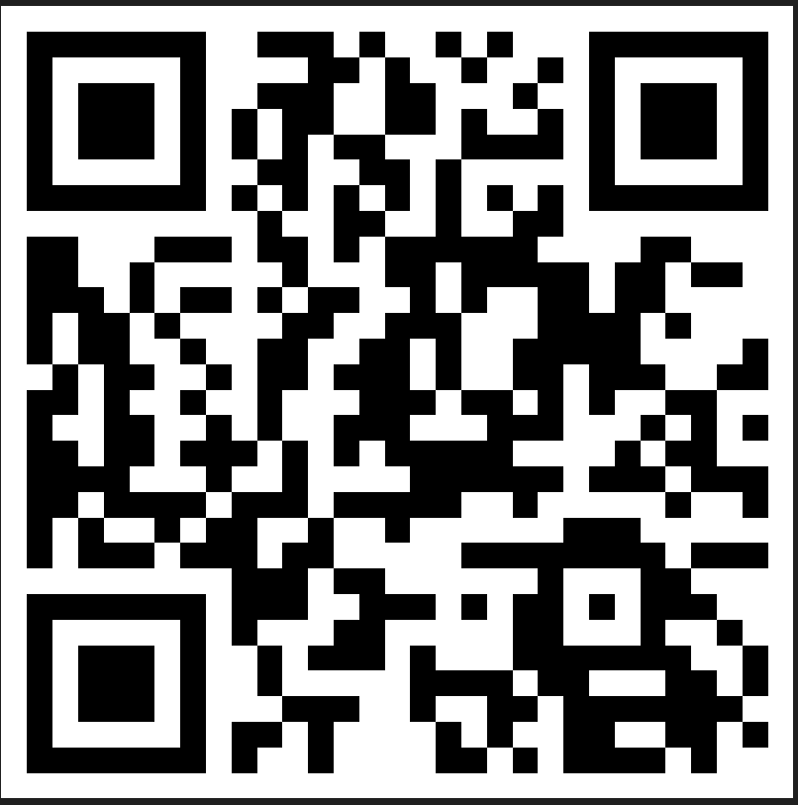



Evaluation
Session evaluation
Please take the time to evaluate this session
  Link pasted into the chat
Session evaluation
Upcoming Sessions
Join us next year February 2023
If you have a case you would like to discuss with the group:
New case template here
Email projectechocovid19@westvicphn.com.au
Use the comment box in the evaluation form
Notes:
Session evaluation link https://forms.office.com/r/7hxpHtNu85
Case template link https://forms.office.com/r/xFPCCRSkzc

Slide 43
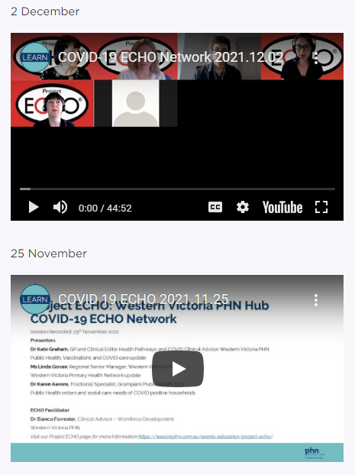

Listen and watch back previous sessions
Content is available on the WVPHN website
Listen back to all the series through Project ECHO: WVPHN Hub
COVID-19 ECHO network on Whooshkaa
https://westvicphn.com.au/events-education/project-echo/project-echo-covid19/
Notes:
https://player.whooshkaa.com/shows/project-echowvphn-hub-covid-19-echo-network
https://www.youtube.com/watch?v=nB5N57z9zG8&t=1s
Townhall 13th January 2022 https://www.youtube.com/watch?v=sr3uHtknLWs
Weekly emails,
Interactive discussions
To watch to view – Youtube
To listen - Whooshkaa
To listen to read – newsletter, resource pack, Zac’s notes
to participate – ECHO
To get in touch with us, email, healthpathways,

