Slide 1
Welcome to Project ECHO COVID and Communicable Diseases Network
Series 12: Session 1
“Catching up on STIs: Putting Policy into practice in Western Victoria”

Slide 2
Acknowledgement of Countries
I’d like to begin by acknowledging the Traditional Owners and custodians of the lands and waterways from which we are all zooming in from today.
the Wadda Wurrung, Gulidjan, Gadubanud, Keeray Wurrung, Peek Wurrung, Gunditjmara, Djab Wurrung, Wotjobaluk, Dja Dja Wurrung, Jadawadjarli, Wergaia, Jaadwa and Jupagalk peoples
We recognise their diversity, resilience, and the ongoing place that First Peoples hold in our communities.
We pay our respects to the Elders, both past and present and commit to working together in the spirit of mutual understanding, respect and reconciliation.
We support self-determination for First Nations Peoples and organisations and will work together on Closing the Gap.
Ask the question. Do you identify as Aboriginal or Torres Strait Islander?

Slide 3
Etiquette/Zoom use
Clearly name yourself with first name and surname.
Introduce yourself / Role / Region / Organisation in “chat”
Use chat to ask questions
Please remain on ‘mute’ except when speaking
Please turn video on
In-session Evaluation at the end
These sessions will be recorded for ongoing training and quality improvement purposes.
The didactic presentations ONLY will be disseminated on our learning channel.
Discussions will be de-identified where used for QI or research purposes.
Please let us know if you would not like your comments recorded.

Slide 4
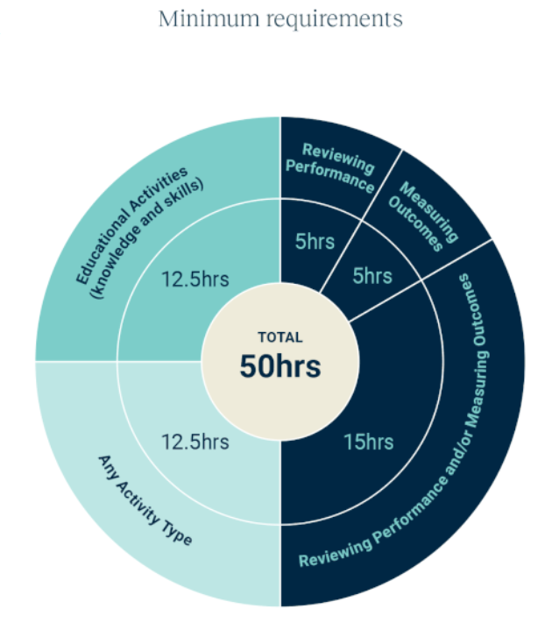
WVPHN – Your CPD Centre
Attend all 5 sessions in series
We are here to help you complete your CPD requirements for the 2023-25 Triennium
Project ECHO
accredited as a Peer Group Learning (PGL) Activity with RACGP and ACRRM
eligible for Reviewing Performance hours
If a GP attends
Each of the 5 ECHO sessions in a series
We upload 5 Reviewing Performance hours to your CPD Dashboard
Add in a QI activity
Related to the ECHO series
Developed and supported by PFs
5 Measuring Outcomes hours
Minimum Annual Requirements
Add in a 5hr QI activity

Slide 5
LeLearning outcomes
Series learning outcomes
Describe the prevalence of STIs in the Western Victoria region and the needs of people at risk of and living with STIs along the continuum
Describe the role of primary care in STI policy implementation and discuss service barriers and enablers in regional Victoria
Describe how to use the Polar GP data extraction tool to analyse routinely collected patient data
Contribute to the development of a quality improvement plan that could be used in primary care to bridge care gaps for people living with STIs
Opportunity to review and discuss emerging COVID-19 pandemic information relevant to general practice
Session 1 Learning outcomes
Describe the principles of STI prevention, screening, treatment and care
Recognise priority populations for recommended enhanced intervention
Discuss service gaps and barriers that priority populations experience in regional settings
Discuss the role of primary care in providing STI services and support

Slide 6
Learning Health System Improvement cycle -A community of learning and change
External Evidence
Interpret results
Design Intervention
Take action
Assemble data
Analyse data
Capture Practice as data
If community decides that something of importance has been learned that points towards something that could be improved, then…..
Community comes together in pursuit of a Health Problem of interest

Slide 7
Problem: Sexually Transmissible Infections Start with a problem statement.....
People at risk of/or living with Sexually transmitted infections need access to prevention, testing, treatment and care….but they face barriers...
Who are our priority populations?
What barriers do they face?
What barriers do we as health care providers face?
What is the extent of the problem? Epidemiology? Service use and demand? Morbidity?
What can be done? (Treatment and care guidelines, culturally sensitive and supportive care)
Are there any areas for improvement at the patient, practice and systems levels?
Policy context:
The new Victorian STI Strategy and STI Systems enablers strategy
The local context: A community of interest (ECHO) and 2 new Public Health Units
vic-sti-plan-2022-23-pdf.pdf (health.vic.gov.au)
Notes:
The First National Bloodborne Viruses and Sexually Transmissible Infections Research Strategy 2021–2025 | Australian Government Department of Health and Aged Care
Victorian sexually transmissible infections (STI) plan 2022–30 | health.vic.gov.au

Slide 8
Early in the cycle Assembling data and insights- Best available evidence
Consumers
Their families
Service Mapping
Stakeholders
Research
Data
Implementation
Community Providers
Strategy
?
Health services and Health organisations
Incentives
Electronic Medical Records
Data quality
Extraction tools
?
Best practice Guidelines
Best practice care
Epidemiology
Notifications
Demand and service utilization data

Slide 9
Agenda for COVID and Communicable Diseases Network Series 12: Session 1 “Catching up on STIs: Putting Policy into practice in Western Victoria”
Facilitator: Dr Bianca Forrester, Clinical Lead of Innovation and Learning, Western Victoria PHN
Naomi White, Manager Public Health and Emergency Preparedness, Western Victoria PHN
New announcements
A/Prof Deborah Friedman, Deputy Chief Health Officer, Communicable Disease, Department of Health Division
Syphilis
Panel for Discussion:
Dr Sarah Huffam, Infectious Disease and Sexual Health Physician, Barwon Health
Dr Kate Graham, GP and Clinical Editor – HealthPathways and COVID Clinical Advisor, Western Victoria PHN
Network Co-ordinator: Jemma Missbach, Western Victoria PHN

Slide 10
Agenda for COVID and Communicable Diseases Network Series 12: Session 1 “Catching up on STIs: Putting Policy into practice in Western Victoria”
Facilitator: Dr Bianca Forrester, Clinical Lead of Innovation and Learning, Western Victoria PHN
Naomi White, Manager Public Health and Emergency Preparedness, Western Victoria PHN
New announcements
A/Prof Deborah Friedman, Deputy Chief Health Officer, Communicable Disease, Department of Health Division
Syphilis
Panel for Discussion:
Dr Sarah Huffam, Infectious Disease and Sexual Health Physician, Barwon Health
Dr Kate Graham, GP and Clinical Editor – HealthPathways and COVID Clinical Advisor, Western Victoria PHN
Network Co-ordinator: Jemma Missbach, Western Victoria PHN

Slide 11
COVID-19 Update
In the past three months, 5,860 COVID patients were hospitalised in Victoria. Of those hospitalised, 41.2 per cent had not received their third vaccine dose and 30.8 per cent were unvaccinated.
Of Victorians aged 50 to 64 years, 80.1 per cent have had their third dose and 32.2 per cent have had their recommended fourth dose. Of those aged over 65, 90.9 per cent have had their third dose and 68.4 per cent have had their fourth dose. 70.6 per cent of people aged 16 and over have had three doses.
70 COVID related deaths last week in Victoria, 730 in Australia.
There remain only two detected cases of subvariant XBB.1.5 in Victoria. While known to be one of the most immune-evasive subvariants to date, there has been no indication XBB.1.5 is any more severe than other Omicron variants.
Clinicians are no longer required to report positive COVID-19 test results. Laboratories continue to be required to report positive COVID-19 PCR results. People who have tested positive using a rapid antigen test (RAT) should report their result to the Department of Health online or by calling 1800 675 398.
Notes:
Naomi

Slide 12
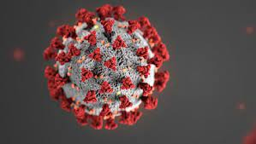
COVID Management
Antivirals
Expansion of COVID-19 Antiviral prescribing criteria
First Nations people, aged 30 years or over require only one risk factor (from the current list of risk factors) instead of two, to meet the definition of high risk for the purpose of PBS eligibility.
Anyone over 18 years who has previously been hospitalised with COVID-19 is now eligible for antiviral treatment with any subsequent infection.
patients with any significantly immunocompromising condition where in the last 12 months, the patient has received anti-CD20 monoclonal antibody treatment
Over the past week 58% of prescriptions were for Lagevrio with 42% for Paxlovid. A reminder that Lagevrio should be considered for use only if Paxlovid is contraindicated or otherwise unsuitable.
Evusheld
Availability for Evusheld is now very limited. There has been no official update to information since December 22nd.
Patients are encouraged to speak with their specialist about need going forward. Access is available through Public Hospitals if deemed necessary
Efficacy is low in new variants
Notes:
Medications for patients with COVID-19 | health.vic.gov.au

Slide 13
COVID-19 Vaccine – DOSE 5 is coming!
ATAGI recommends a 2023 COVID-19 vaccine booster dose for adults in the following groups, if their last COVID-19 vaccine dose or confirmed infection (whichever is the most recent) was 6 months ago or longer, and regardless of the number of prior doses received:
All adults aged 65 years and over; and
Adults aged 18-64 years who have medical comorbidities that increase their risk of severe COVID-19, or disability with significant or complex health needs.
ATAGI 2023 booster advice | Australian Government Department of Health and Aged Care
Notes:
ATAGI 2023 booster advice | Australian Government Department of Health and Aged Care

Slide 14
Respiratory Clinics
Commonwealth funding for GPRC program ends Feb 28th
Ballarat, Geelong, and Bellarine clinics will close
Lister House who run Horsham plan to have an alternative service
Warrnambool GPRC is funded through Vic Gov until end of October.
New federal standby program expected to be operational end of March.
GP
RC

Slide 15
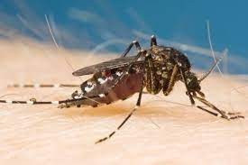
Health Alert – Mosquito Borne Diseases
Murray Valley Encephalitis
Detected in northern and northwestern Vic for first time since 2011
Last epidemic in Victoria in 1974 – 2011 last human cases in NSW and SA
Of those presenting with encephalitis in Victoria in the 1974 epidemic, approximately one-fifth died and one-third were left with residual neurological complications.
Japanese Encephalitis
2 cases in Victoria this season
Most recent case spent time in Buloke and Swan Hill shire during contraction period
Detection of JEV remains northern LGAs
Reminder that mosquito trapping programs are only in select locations there is likely more spread than is known.
Reminder Ross River Fever and Barmah Forrest Virus are endemic to parts of our catchment – consider all mosquito borne diseases when clinically suspecting infection.
Murray Valley encephalitis (health.vic.gov.au)
Japanese encephalitis virus (health.vic.gov.au)
Notes:
Health Alerts Mosquito-borne diseases (health.vic.gov.au)
Health Alert: Murray Valley encephalitis (health.vic.gov.au)

Slide 16
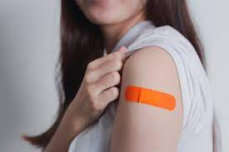
Human papillomavirus (HPV) dosing schedule change
From 6 February 2023, the human papillomavirus (HPV) vaccine dosing schedule on the National Immunisation Program (NIP) will change from two doses of HPV vaccine Gardasil®9 to a single dose for immunocompetent people.
The schedule will not change for immunocompromised people (people with a weakened immune system), and they may still need three doses of HPV vaccine.
Immunocompetent people who have received a single dose of HPV vaccine are now considered fully vaccinated and don’t need a second dose of HPV vaccine.
The age of eligibility for free catch-up vaccination will also increase from 19 to 25 years of age
Human papillomavirus (HPV) dosing schedule change | health.vic.gov.au
Notes:
Human papillomavirus (HPV) dosing schedule change | health.vic.gov.au

Slide 17
STIs Syphilis Strategy
Deb Friedman
Deputy CHO, Communicable Diseases
Victorian Dept of Health

Slide 18
Victorian elimination agenda
Victorian sexually transmissible infections (STI) plan 2022–30 | health.vic.gov.au
Notes:
Our new Victorian STI Plan 2022-30 (part of the new Victorian sexual and reproductive health and viral hepatitis strategy 2022-30) was launched in October 2022.
Specific syphilis key priority actions in the plan are:
Coordinate and strengthen public health actions to reduce rates of syphilis and eliminate congenital syphilis
Support an evidencebased review of national clinical STI, pregnancy and perinatal testing and management guidelines to ensure consistency of syphilis screening and management for population groups who are at risk
Develop early treatment and care linkage pathways between primary care and specialist services for babies of women diagnosed with syphilis
Engage with key stakeholders to further explore the establishment of a Victorian syphilis register

Slide 20
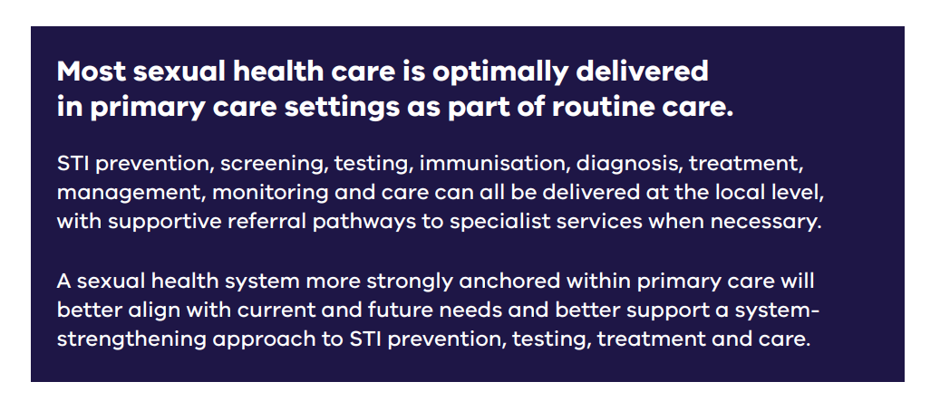

Slide 21
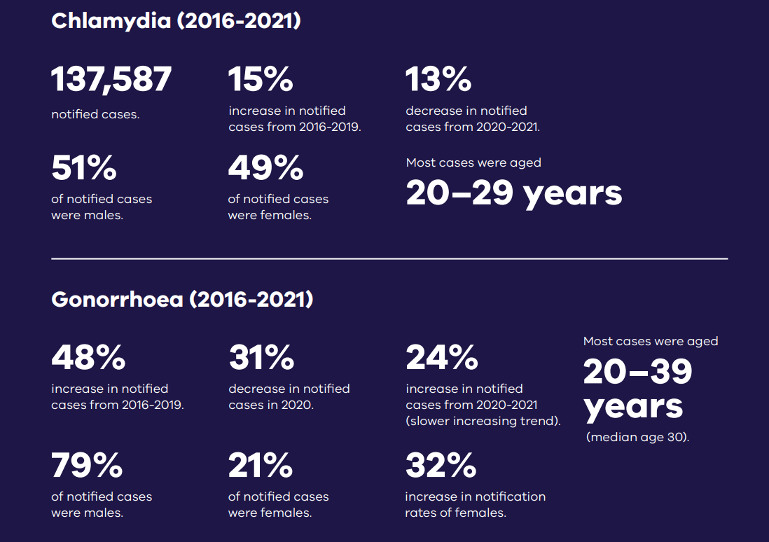

Slide 22
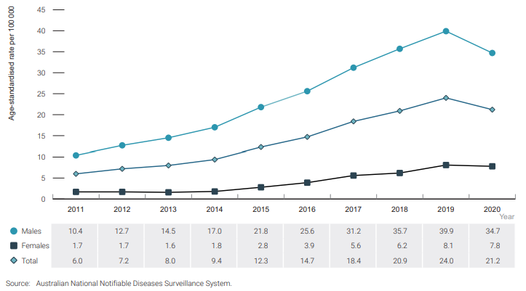
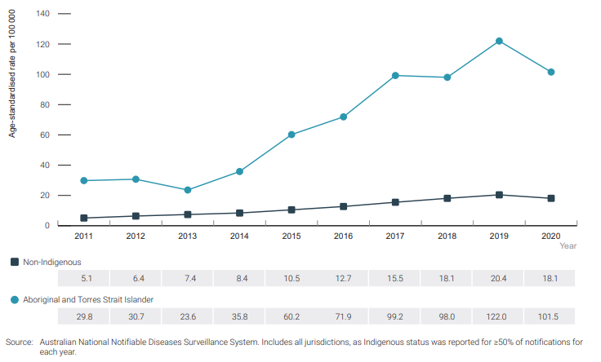
Infectious syphilis in Australia
Fig 1. Infectious syphilis notification rate per 100 000 population by gender, 2011–2020
Fig 2. Infectious syphilis notification rate per 100 000 population by Aboriginal and Torres Strait Islander status, 2011–2020
https://kirby.unsw.edu.au/sites/default/files/kirby/report/Annual-Surveillance-Report-2021_STI-221107.pdf

Slide 23
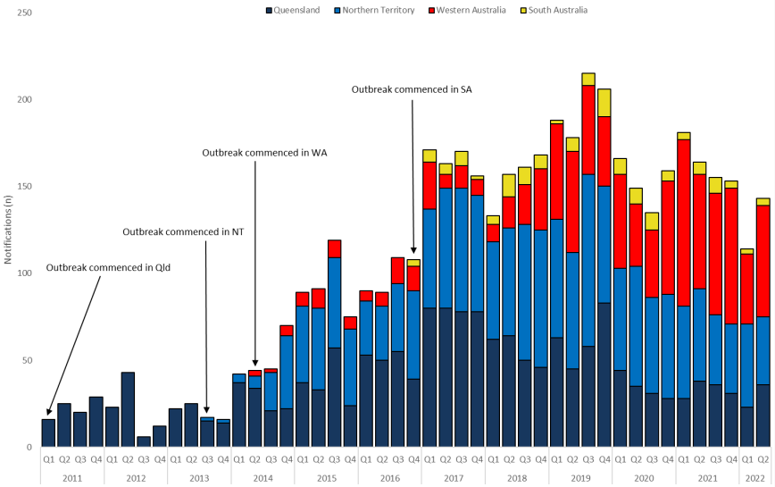
Multijurisdictional outbreak
Fig 3. Epidemic curve showing infectious syphilis outbreak cases notified in Aboriginal and Torres Strait Islander people residing in outbreak-declared regions of QLD, NT, WA, and SA from the commencement of the outbreak in each jurisdiction to 30 June 2022.
https://www.health.gov.au/resources/collections/national-syphilis-monitoring-reports

Slide 24
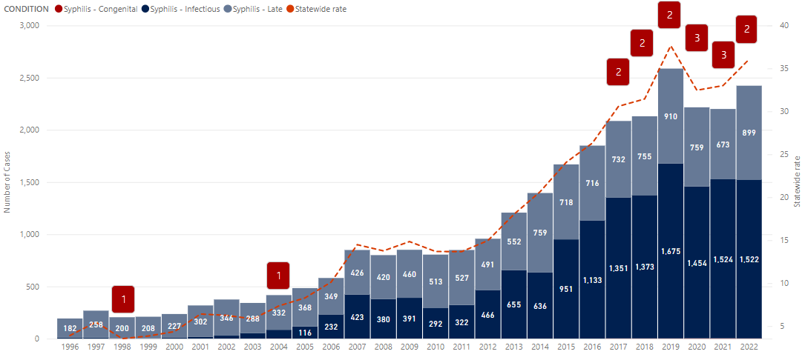
Syphilis cases in Victoria
In 2019, Victoria experienced its’ highest number of infectious and late syphilis cases with a 474% and 77% increase in cases respectively since 2010.
There has been a re-emergence of congenital syphilis since 2017 with 14 cases of congenital syphilis notified in Victoria, including 6 foetal deaths. Prior to 2017, only 2 congenital cases were notified in the past 25 years.
Fig 4. The number of infectious, late and congenital syphilis cases notified in Victoria 1996 – 2021, year-to-date 2022. State-wide rate per 100,000 population.

Slide 25
Heat map of syphilis in the Barwon South region
Deeper shades of red of inner Melbourne indicating the highest rates of infectious syphilis.

Slide 26
Syphilis: The role of GPs
Regular screening of pregnant cases to prevent congenital syphilis.
Helps to detect primary syphilis -> early detection before patients reach secondary syphilis which is the most infectious stage, helps prevent further transmission
If a rash is present think of testing for syphilis to rule this out.
Notification platform on the department website has been updated.
GPs can notify cases and fill out the notification form that includes enhanced surveillance data fields. This will help us monitor changes in syphilis epidemiology across the state.
https://content.health.vic.gov.au/sites/default/files/2022-09/notification-of-syphilis.pdf

Slide 27
Recommendations for Syphilis testing in Pregnancy
When to test?
Women at increased risk of syphilis in pregnancy:
Those with >1 sexual partner
Partners of men who have sex with men
People who inject drugs
Women of Aboriginal or Torres Strait Islander origin
Those with overseas sexual contacts
Those presenting with any other STI during pregnancy
Initial Antenatal Review
All pregnant women
28-32 weeks
High risk groups and all women in communities experiencing syphilis outbreaks
At Delivery
High risk groups and all women in communities experiencing syphilis outbreaks
Vic Department of Health Guidelines

Slide 28
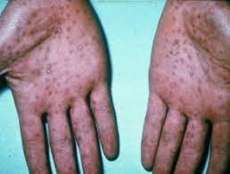
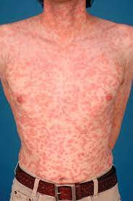
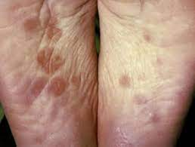
Secondary Syphilis

Slide 29
Common themes
1
2
3
4
Awareness
Behaviours
Case finding
Documentation
Awareness of supply and need for long acting Benzathine Penicillin by low case load clinics or emergency service
Awareness of Partner Management and testing and treatment
Cases with a complex history sometimes present late, have low tolerance in waiting and ability to attend scheduled appointments.
Cases were not aware that they were at risk of Syphilis. They may have declined, refused or delayed testing.
Services not aware of what tests to take once baby was delivered and formal diagnosis was delayed or not able to be made
Missed alerts. repeated or missed contacts and follow ups. Documentation missing or not reviewed to ensure care and treatment and testing happened during pregnancy and at time of birth
Notes:
Cases who have a history of being difficult to engage with, will have a low tolerance in waiting for care and attending scheduled appointments. Need to be seen as quickly as possible and never turned away.
Ensure communication and recording of issues within the service happened. Use alerts, handovers etc. Involve social worker service early if required
Benzathine Benzylpenicillin access and awareness of how to treat
Syphilis infection within the broader community remains high. Knowledge about risk of syphilis within the non-MSM community is low

Slide 31
Online Notification
https://www.health.vic.gov.au/infectious-diseases/notifiable-infectious-diseases-conditions-and-micro-organisms#notify-an-infectious-disease-or-medical-condition
https://forms.business.gov.au/smartforms/servlet/SmartForm.html?formCode=cd_stis2022&tmFormVersion

Slide 32
Victorian elimination agenda
Victorian sexually transmissible infections (STI) plan 2022–30 | health.vic.gov.au
Notes:
Our new Victorian STI Plan 2022-30 (part of the new Victorian sexual and reproductive health and viral hepatitis strategy 2022-30) was launched in October 2022.
Specific syphilis key priority actions in the plan are:
Coordinate and strengthen public health actions to reduce rates of syphilis and eliminate congenital syphilis
Support an evidencebased review of national clinical STI, pregnancy and perinatal testing and management guidelines to ensure consistency of syphilis screening and management for population groups who are at risk
Develop early treatment and care linkage pathways between primary care and specialist services for babies of women diagnosed with syphilis
Engage with key stakeholders to further explore the establishment of a Victorian syphilis register

Slide 33
Case Presentation:
Situation: Vaginal discharge and irritated eyes
Background: 18 year old female, Caucasian, no significant past medical history, lives with parents
Assessment: Vaginal swab confirmed Chlamydia ( recurrent ); eye swab- trachoma
Recommendation: Reviewed by eye specialist. Discussed implications regarding fertility with recurrent infections; need for regular screening for STIs, safe sex
Question: How do I counsel this young woman regarding recurrent infections and risk to general health.

Slide 34
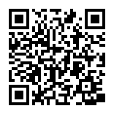
Emerging Public Health Risks – Webinar Series
Professional Networking Evenings
Wed 22 February 6-8pm
Join us at one of four locations – Geelong, Ballarat, Warrnambool and Horsham
Bring your whole team for a relaxed night of networking with colleagues
Mix with your fellow primary care professionals, meet some local specialists and health services representatives.
Thursday 2 March, 7 – 8.30pm
COVID-19 and Emerging Communicable Diseases Update
Public Health Units

Slide 35
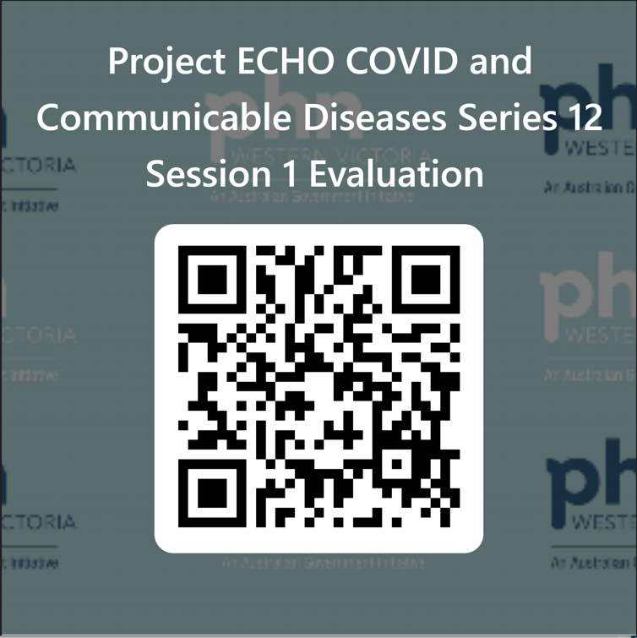
Evaluation
Session evaluation
Please take the time to evaluate this session
Link pasted into the chat
Upcoming Sessions
23 February
9 March
23 March
6 April
If you have a case, you would like to discuss with the group:
Case template here
Email projectechocovid19@westvicphn.com.au
Use the comment box in the evaluation form
Notes:
Session evaluation link https://forms.office.com/r/5arZ6FE99v
Case template link https://forms.office.com/r/JGtcXzehKJ

