Slide 1

Welcome to Project ECHO
COVID and Communicable Diseases Network
Series 12: Session 2
“Assembling data and insights- Exploring routinely collected data through the lens of Sexually Transmissible infections”

Slide 2


Acknowledgement of Countries
I’d like to begin by acknowledging the Traditional Owners and custodians of the lands and waterways from which we are all zooming in from today.
the Wadda Wurrung, Gulidjan, Gadubanud, Keeray Wurrung, Peek Wurrung, Gunditjmara, Djab Wurrung, Wotjobaluk, Dja Dja Wurrung, Jadawadjarli, Wergaia, Jaadwa and Jupagalk peoples
We recognise their diversity, resilience, and the ongoing place that First Peoples hold in our communities.
We pay our respects to the Elders, both past and present and commit to working together in the spirit of mutual understanding, respect and reconciliation.
We support self-determination for First Nations Peoples and organisations and will work together on Closing the Gap.
Ask the question. Do you identify as Aboriginal or Torres Strait Islander?

Slide 3


Etiquette/Zoom use
Clearly name yourself with first name and surname.
Introduce yourself / Role / Region / Organisation in “chat”
Use chat to ask questions
Please remain on ‘mute’ except when speaking
Please turn video on
In-session Evaluation at the end
These sessions will be recorded for ongoing training and quality improvement purposes.
The didactic presentations ONLY will be disseminated on our learning channel.
Discussions will be de-identified where used for QI or research purposes.
Please let us know if you would not like your comments recorded.

Slide 4

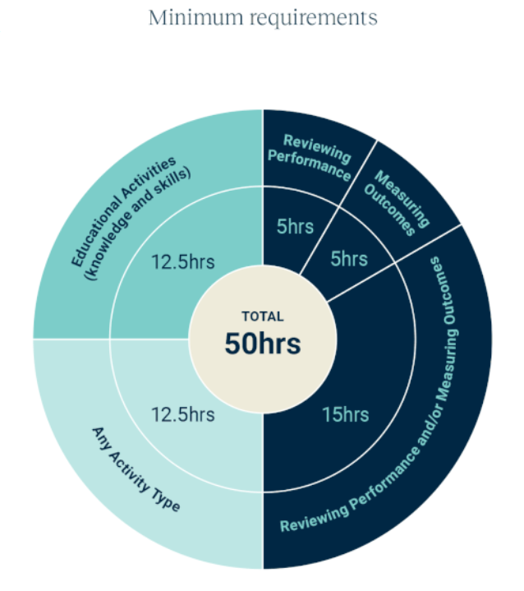
WVPHN – Your CPD Centre
Attend all 5 sessions in series
We are here to help you complete your CPD requirements for the 2023-25 Triennium
Project ECHO
accredited as a Peer Group Learning (PGL) Activity with RACGP and ACRRM
eligible for Reviewing Performance hours
If a GP attends
Each of the 5 ECHO sessions in a series
We upload 5 Reviewing Performance hours to your CPD Dashboard
Add in a QI activity
Related to the ECHO series
Developed and supported by PFs
5 Measuring Outcomes hours
Minimum Annual Requirements
Add in a 5hr QI activity

Slide 5

LeLearning outcomes
Series learning outcomes
Describe the prevalence of STIs in the Western Victoria region and the needs of people at risk of and living with STIs along the continuum
Describe the role of primary care in STI policy implementation and discuss service barriers and enablers in regional Victoria
Describe how to use the Polar GP data extraction tool to analyse routinely collected patient data
Contribute to the development of a quality improvement plan that could be used in primary care to bridge care gaps for people living with STIs
Opportunity to review and discuss emerging COVID-19 pandemic information relevant to general practice
Session 2 Learning outcomes
Describe the utility of the care cascade in data visualisation
Relate care gaps represented in the data to regional real-world settings
Discuss strategies that could close care gap represented by the data presented, at the systems and practice level
Report on the use of data extraction tool “Polar” in primary care practice settings

Slide 6

Early in the cycle- Practice to Data (P2D Phase)
Assembling data and insights- Exploring Routinely collected EMR data
Working up towards an audit of our data
Stakeholders
Research
Data
Implementation
Focus on EMR data
Polar Extraction tool
GP incentives to extract and track data
Consumers
Their families
Community Providers
Incentives
Electronic Medical Records
  Data quality
  Extraction tools
Epidemiology
  Notifications
  Demand and service utilization data
Four types of evidence….

Slide 7

Refine the problem statement
CPD Mini-audit Step 1: Identification of need (what’s the subject of the study?)
People at risk of and living with STIs need access to prevention, testing, treatment and care
…but they cannot do it, or they face a challenge
The problem is happening because [explain the cause of the problem that you identified in your needs analysis]
Access issues, patients at risk but not requesting service
Notification data not linked to service utilisation data (ie notification data and EMR data not linked)
Data gaps that could potentially be filled by looking at EMR data
and [describe the problem facing frontline workers]
Based on [quantitative data] and [qualitative data collected]
Health literacy issues, health access issues, re-infection from untreated partner,
We (as a community of interest) think that [your insights] and [design needs] can solve the problem.

Slide 8
Learning Health System Improvement cycle
-A community of learning and change
External Evidence
Step 4: Data Analysis
and change implementation
CPD mini-audit Step 2
Audit criteria, data to be collected
Interpret results
Design Intervention
Take action
Assemble data
Analyse data
Capture Practice as data
If community decides that something of importance has been learned that points towards something that could be improved, then…..
Clinicians
Data Analyst
“Polar walkthrough”
+
=
Step 3: Data Collection
Care Pathway
Cascade of care
Data Generating Process
Community comes together in pursuit of a Health Problem of interest
Sexually transmissible infections

Slide 9
Agenda for COVID and Communicable Diseases Network Series 12: Session 2
Facilitator: Dr Bianca Forrester, Clinical Lead of Innovation and Learning, Western Victoria PHN
Naomi White, Senior Manager Regional Partnerships and Public Health, Western Victoria PHN
  New announcements
Dr Sarah Huffam, Infectious Disease and Sexual Health Physician, Barwon Health and BSW PHU
  Notification and practice data
  Limitations and use in improving care at the patient, practice and pop health level
Sarah Crowe, Digital Health Manager, Western Victoria PHN
  Polar walkthrough
Case presentation: Dr Kerry Archer, GP, Ballarat Medical Centre
Panel for Discussion: Dr Kate Graham, GP and Clinical Editor – HealthPathways and COVID Clinical Advisor, Western Victoria PHN
Network Co-ordinator: Jemma Missbach, Western Victoria PHN

Slide 10


COVID-19 Vaccine update
NEW Pfizer bivalent COVID-19 vaccine
  All vaccinating practices will be able to order
  Commencement from:
    March 6th for tranche 1 sites
    March 13th tranche 2 sites
  Booster only for 12+
  Encouraging practices to ensure stock is available and on hand prior to making appointments
Plan for vaccinating patients residing in RACF's
  GP/Primary care provider preferred model
  VAPP may be used as a last resort
Withdrawing from vaccine products or the program, to be completed via CVAS, please ensure this is up to date
  Reminder to update Vaccine Clinic Finder (VCF)
Notes:
ATAGI recommendations on use of the Pfizer bivalent (Original/Omicron BA.4/5) COVID-19 vaccine | Australian Government Department of Health and Aged Care

Slide 11
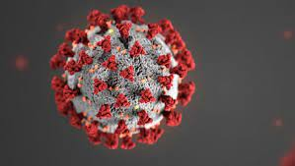
COVID Management
Closure of GP respiratory clinics- Feb 28th
Bellarine
Geelong
Ballarat
May see an influx of patients seeking respiratory assessments and/or care for COVID + diagnosis and anti-viral prescribing.
Ensure processes in place to manage these patients
Example.
Inform staff to advise patients to wait outside/car if suspect COVID,
encourage respiratory patients to wear mask,
alerts on booking platforms,
ensure staff updated on triage processes when booking
GP's are relied upon to provide care and treatment for COVID+ persons.
Refer to health pathways for further information
Visit https://westvic.communityhealthpathways.org/
Notes:
Medications for patients with COVID-19 | health.vic.gov.au
New to HealthPathways? Visit https://westvic.communityhealthpathways.org/ and select ‘register now’
Questions? Email us at healthpathways@westvicphn.com.au

Slide 12
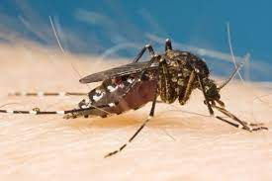
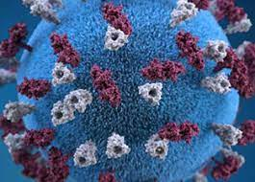
Health Alert
Murray Valley Encephalitis (MVE)
detected in mosquitoes trapped across northern Victoria and Horsham.
MVE virus is circulating widely in the mosquito population.
risk of contracting MVE virus in these areas and symptomatic human cases may occur
risk is expected to continue for coming weeks and months.
Japanese Encephalitis Virus (JEV)
Likely expansion of JEV vaccination eligibility in our northern LGAs. No official notification yet but watch this space.
Further information will be provided on this once available.
The most effective method to avoiding mosquito borne disease remains reducing your potential to be bitten.
Notes:
MVE - Murray Valley encephalitis (health.vic.gov.au)
JEV - Japanese encephalitis virus (JEV) | Australian Government Department of Health and Aged Care

Slide 13

Health Alert continued
Extreme weather alert – Heat in place for remainder of this week 22-24 Feb
  Severe warning for south west and low warning for remainder of WVPHN catchment
  Heatwaves can affect anyone. Older people, people with a pre-existing medical condition, pregnant women and young children and babies are most at risk.
Gastroenteritis in child care Health Alert 21/02/23
  Increasing outbreaks across the state
  Children should remain home while unwell and for 48hrs after symptoms resolve
Notes:
Extreme weather alert - Heatwave warning (bom.gov.au)
Gastroenteritis - https://www.health.vic.gov.au/health-advisories/increase-in-gastroenteritis-outbreaks-in-childcare

Slide 14

Sexually Transmitted Infections
Dr Sarah Huffam
Infectious Diseases and Sexual Health Physician

Slide 15


Contents
STI Notification data (courtesy of PHU Epi team)
Cascades of care, and STI prevention and care continuum
Auditable data in primary care

Slide 16
Emerging role of the BSW PHU in support for Sexual and Reproductive Healthcare
Notifiable Diseases
BRaSH Clinic (s)
HIV Outreach Nurse (formerly HARP)
SRHVH PHU Nurse
SRH working group (Clinical, Epi, Research etc)
Partnerships to support a SRH provider network in primary care

Slide 17


STI Notifications
Chlamydia - Confirmed cases. Routine (lab only),
further follow-up (minors <16, partner notification request)
Gonorrhoea – Confirmed cases. Routine (lab/Dr), Enhanced Surveillance Form (incl partner notification)
further follow-up (minors <16, pregnant, AMR)
Syphilis – Infectious (<2 years infection – primary, secondary, early latent. Confirmed/Probable. Urgent);
Late (>2 years, Confirmed. Routine)

Slide 18
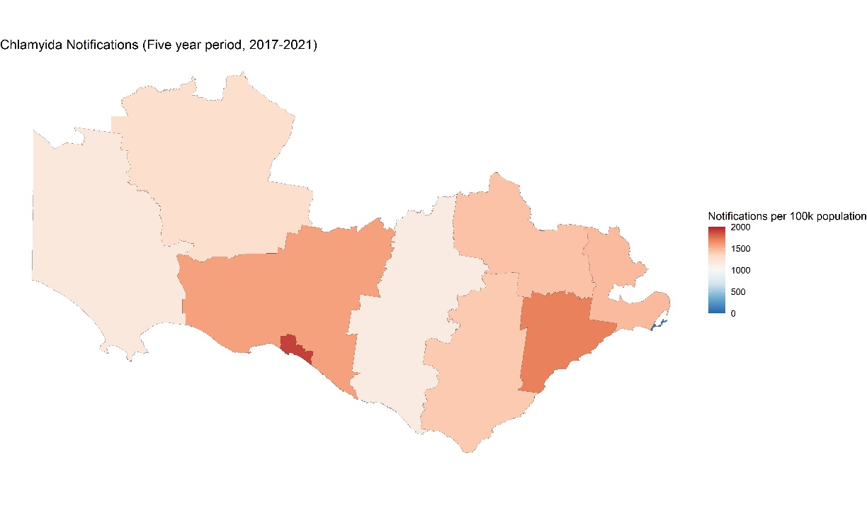
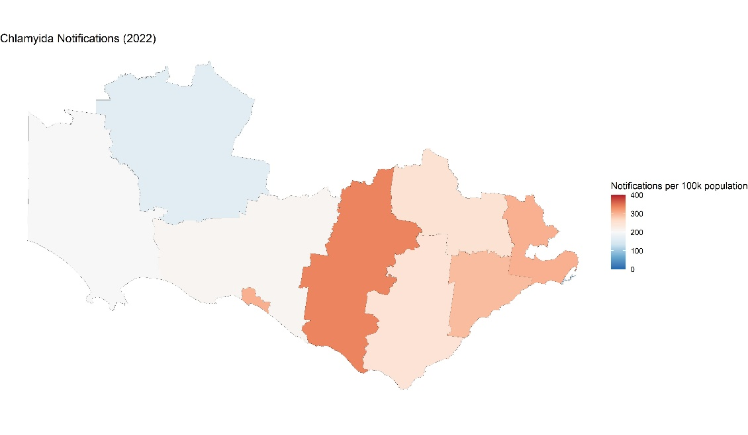
Chlamydia
Chlamydia Trachomatis (Five year period, 2017-2021)
Chlamydia Trachomatis (2022)
BSW n=1314
LGA | Total Cases | Cases per 100k | ERP 2021
Colac Otway | 313 | 1403.3 | 22304
Corangamite | 184 | 1147.9 | 16029
Glenelg | 236 | 1176.7 | 20056
Golden Plains | 357 | 1434.9 | 24879
Greater Geelong | 3979 | 1469.5 | 270776
Moyne | 272 | 1573.1 | 17291
Queenscliff | 2 | 61.8 | 3235
Southern Grampians | 212 | 1285.8 | 16488
Surf Coast | 638 | 1695.8 | 37623
Warrnambool | 675 | 1905.8 | 35419
LGA | Total Cases | Cases per 100k
Colac Otway | 55 | 246.6
Corangamite | 54 | 336.9
Glenelg | 40 | 199.4
Golden Plains | 62 | 249.2
Greater Geelong | 819 | 302.5
Moyne | 36 | 208.2
Queenscliff | 4 | 123.6
Southern Grampians | 27 | 163.8
Surf Coast | 110 | 292.4
Warrnambool | 107 | 302.1

Slide 19
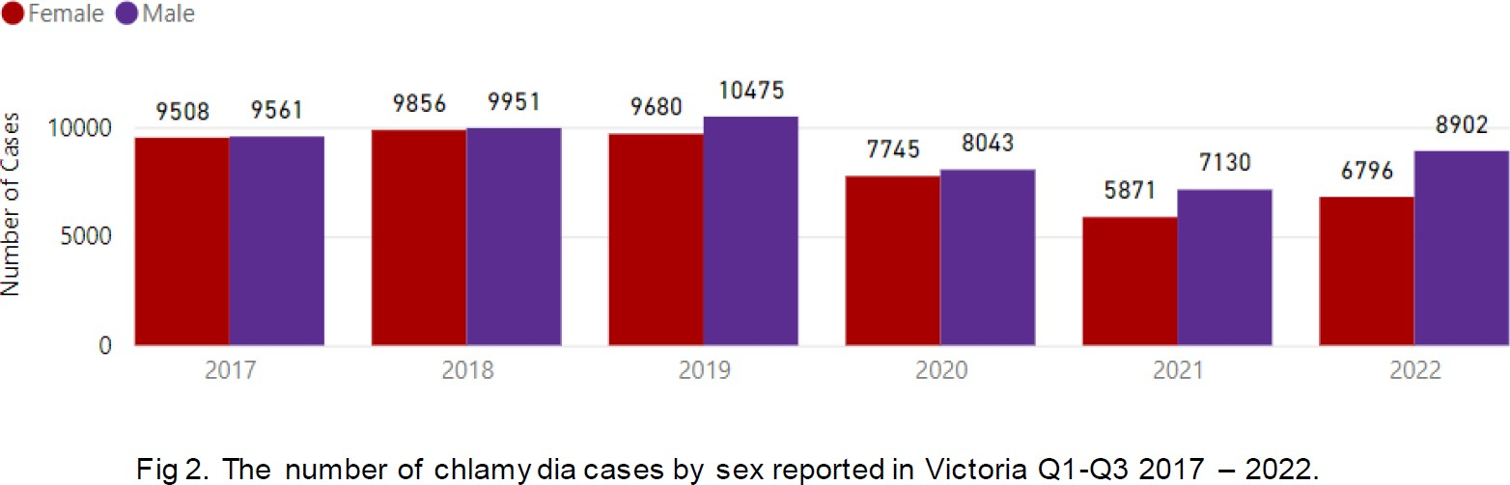
Chlamydia; No of Notifications by Year and Age Group
Age Group 00-04 05-09 10-14 15-19 20-24 25-29
100%
30-34
35-39
40-44
45-49
50-54
No of Notifications by Year and Sex (groups)
Sex (groups)
Female Male Not stated & Other
988
Chlamydia No of Notifications
7.61%
8.03%
8.50%
8.07%
8.98%
12.62% 11.92%
14.80%
8.80%
9.67%
11.18%
No of Notifications
1000
973
946
11.75%
17.53%
17.39%
19.16%
871
883
840
18.36%
19.35%
19.49%
38.71%
43.54%
43.97%
553
584
647
50%
43.67%
41.43%
41.94%
536
438
525
529
42.93%
40.82%
44.41%
39.58%
500
364
35.79%
32.20%
32.70%
29.02%
25.31%
22.51%
20.79%
16.89%
17.07%
18.88%
4
0
2 0
9
2 4
0%
0
2010
2015
2020
2012
2014
2016
Year
2018
2020
2022
Year
No of Notifications by Year
2000
1545
1472
1557
1564
1598
1500
1367
1443
No of Notifications
1309
1261
1000
662
Statewide (Note only specific quarters not yearwide) Data from Q1-Q3 Chlamydia 2017-2021 Overall Victoria
500
0
2012
2014
2016
Year
2018
2020
2022
Chlamydia
NB: 2022 Data only half year (June 30 2022

Slide 20
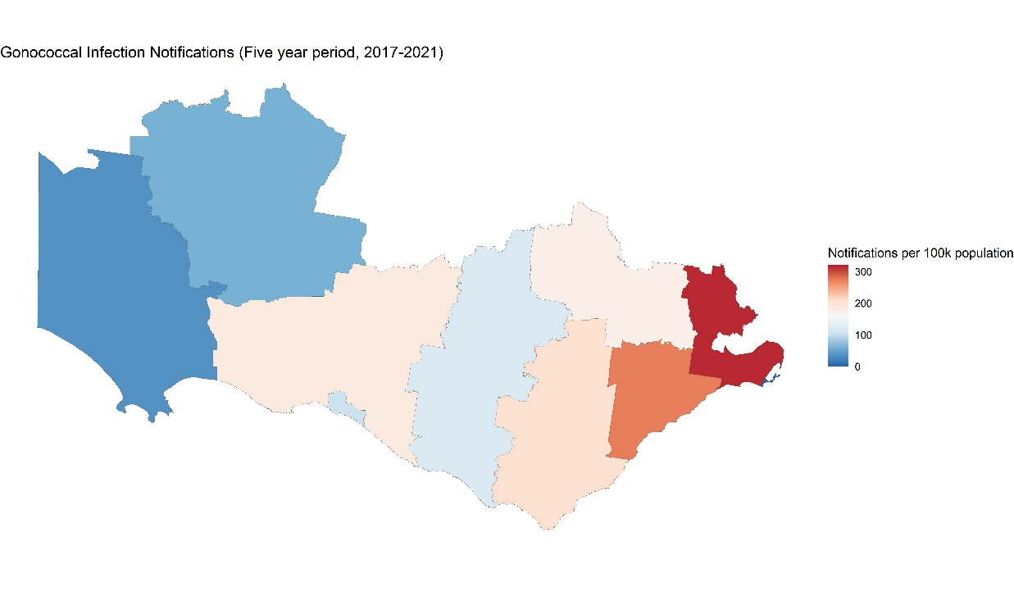
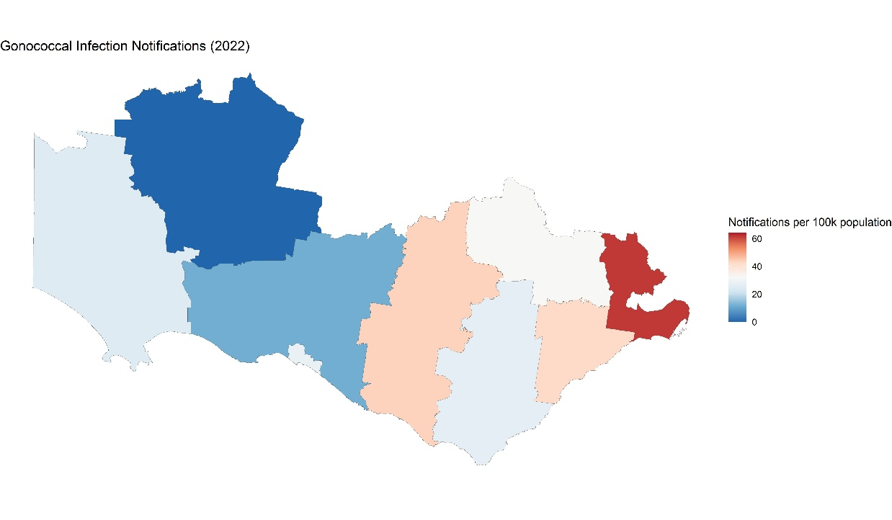
Gonorrhoea
Gonococcal infection (Five year period, 2017-2021)
Gonococcal infection (2022)
BSW n=222
LGA | Total Cases | Cases per 100k | ERP 2021
Colac Otway | 45 | 201.8 | 22304
Corangamite | 19 | 118.5 | 16029
Glenelg | 7 | 34.9 | 20056
Golden Plains | 44 | 176.9 | 24879
Greater Geelong | 853 | 315 | 270776
Moyne | 32 | 185.1 | 17291
Queenscliffe | 0 | 0 | 3235
Southern Grampians | 10 | 60.7 | 16488
Surf Coast | 103 | 273.8 | 37623
Warrnambool | 37 | 104.5 | 35419
LGA | Total Cases | Cases per 100k
Colac Otway | 6 | 26.9
Corangamite | 7 | 43.7
Glenelg | 5 | 24.9
Golden Plains | 8 | 32.2
Greater Geelong | 167 | 61.7
Moyne | 2 | 11.6
Queenscliffe | 1 | 30.9
Southern Grampians | 0 | 0
Surf Coast | 16 | 42.5
Warrnambool | 10 | 28.2

Slide 21
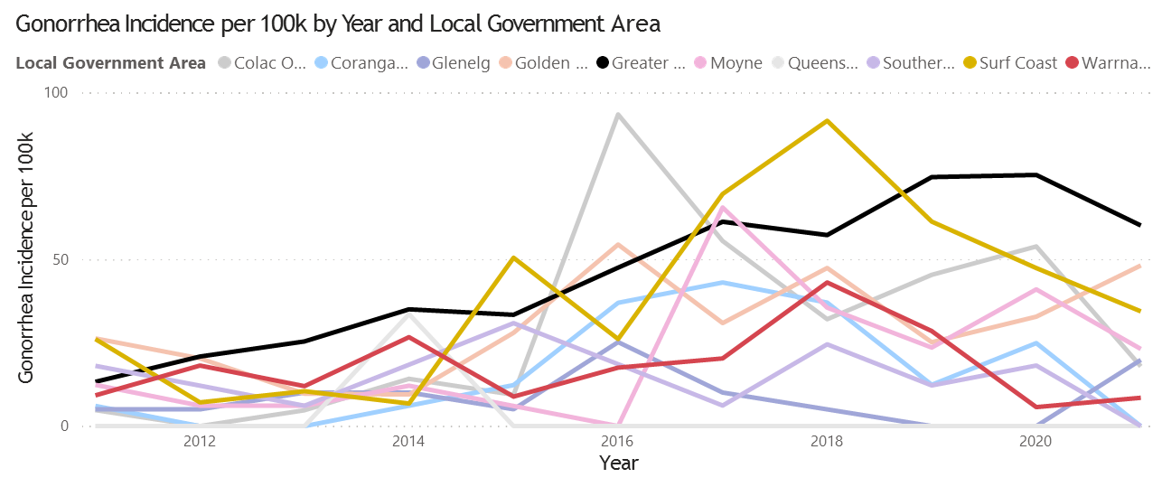
Gonorrhea: No of Notifications by Year and Age Group
AgeGroup (groups) 14 and under 15-29 30-44 45-64
300
65 and over
Unknown
No of Notifications by Year and Sex
Sex (groups) Female Male Not stated & Other
No of Notifications
31
77
136
162
200
83
117
27
86
101
No of Notifications
150
104
111
116
25
69
100
91
97
100
48
78
69
42
52
49
54
95
25
50
29
35
29
41
41
75
75
44
10
9
18
0
0
0
1
1
0
1
0
2
0
2012
2014
2016
Year
2018
2020
2022
2010 2015
2020
GONORRHEA
NB: 2022 Data only half year (June 30 2022)

Slide 22
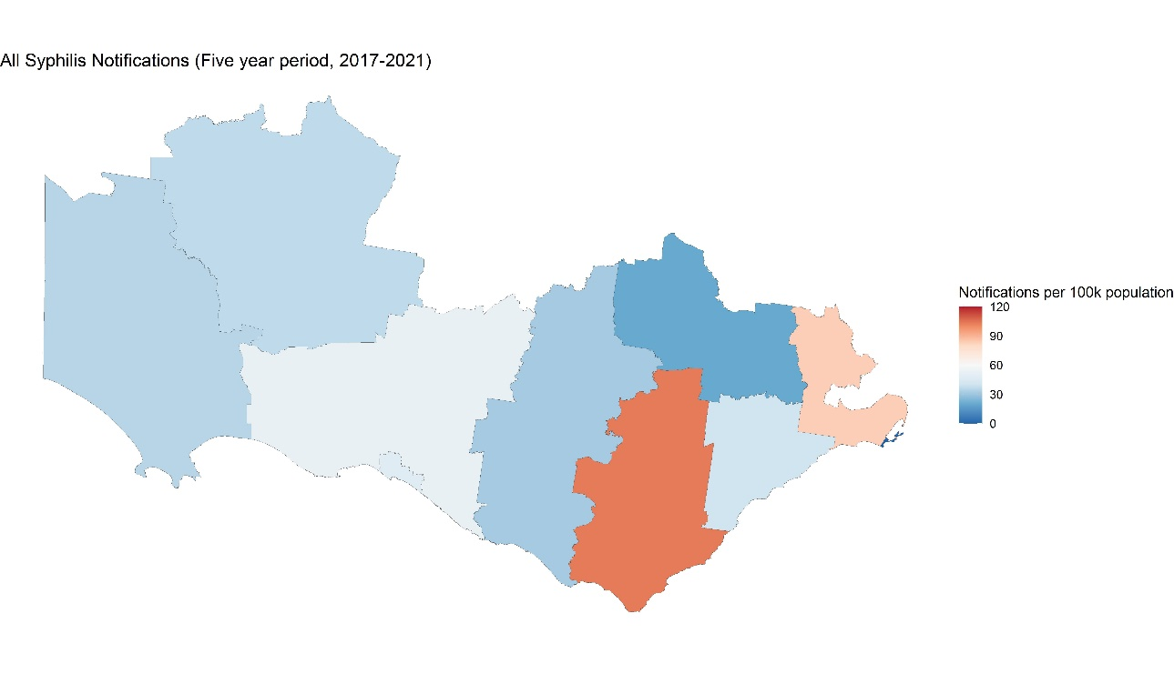
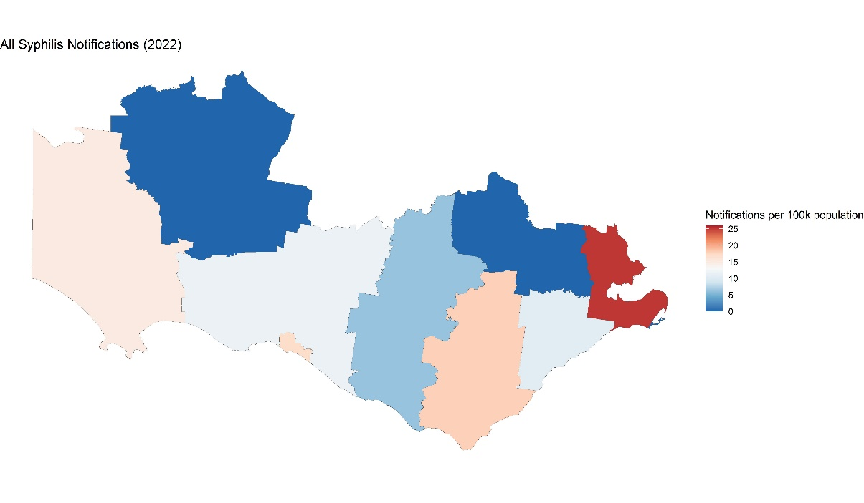
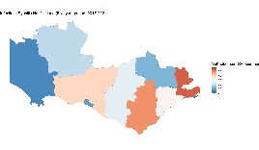
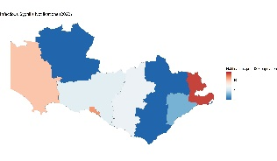
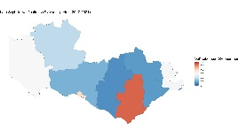
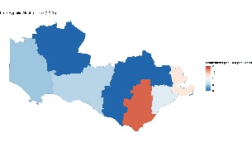
Syphilis
Syphilis – Infectious & Late (Five year period, 2017-2021)
Syphilis (2022)
BSW n=88
Infectious
Infectious
Late
Late
LGA | Total Cases | Cases per 100k | ERP 2021
Colac Otway | 23 | 103.1 | 22304
Corangamite | 5 | 31.2 | 16029
Glenelg | 7 | 34.9 | 20056
Golden Plains | 5 | 20.1 | 24879
Greater Geelong | 225 | 83.1 | 270776
Moyne | 9 | 52.1 | 17291
Queenscliffe | 0 | 0 | 3235
Southern Grampians | 6 | 36.4 | 16488
Surf Coast | 15 | 39.9 | 37623
Warrnambool | 17 | 48 | 35419
LGA | Total Cases | Cases per 100k
Colac Otway | 4 | 17.9
Corangamite | 1 | 6.2
Glenelg | 3 | 15
Golden Plains | 0 | 0
Greater Geelong | 68 | 25.1
Moyne | 2 | 11.6
Queenscliffe | 0 | 0
Southern Grampians | 0 | 0
Surf Coast | 4 | 10.6
Warrnambool | 6 | 16.9

Slide 23
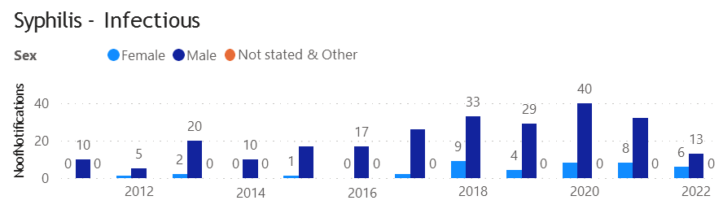
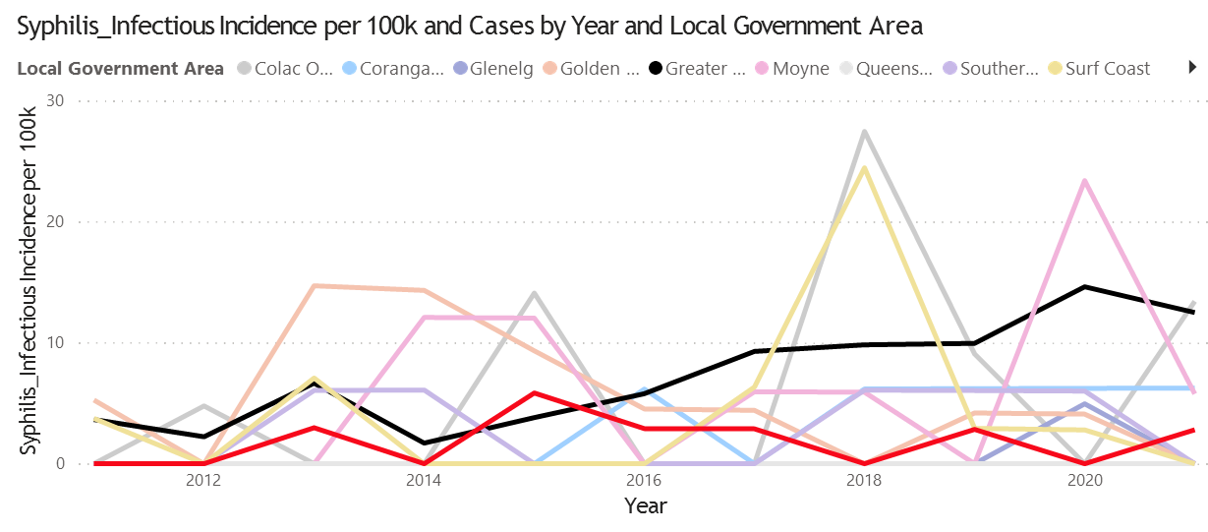
Syphilis - Infectious
Age Group 14 and under
15-29 30-44 45-64 65 and over Unknown
40
7
13
NoofNotifications
5
6
14
20
22
14
20
9
5
10
6
8
14
21
13
10
6
6
9
7
11
12
5
0
2012
2014
2016
2018
2020
2022

Slide 24
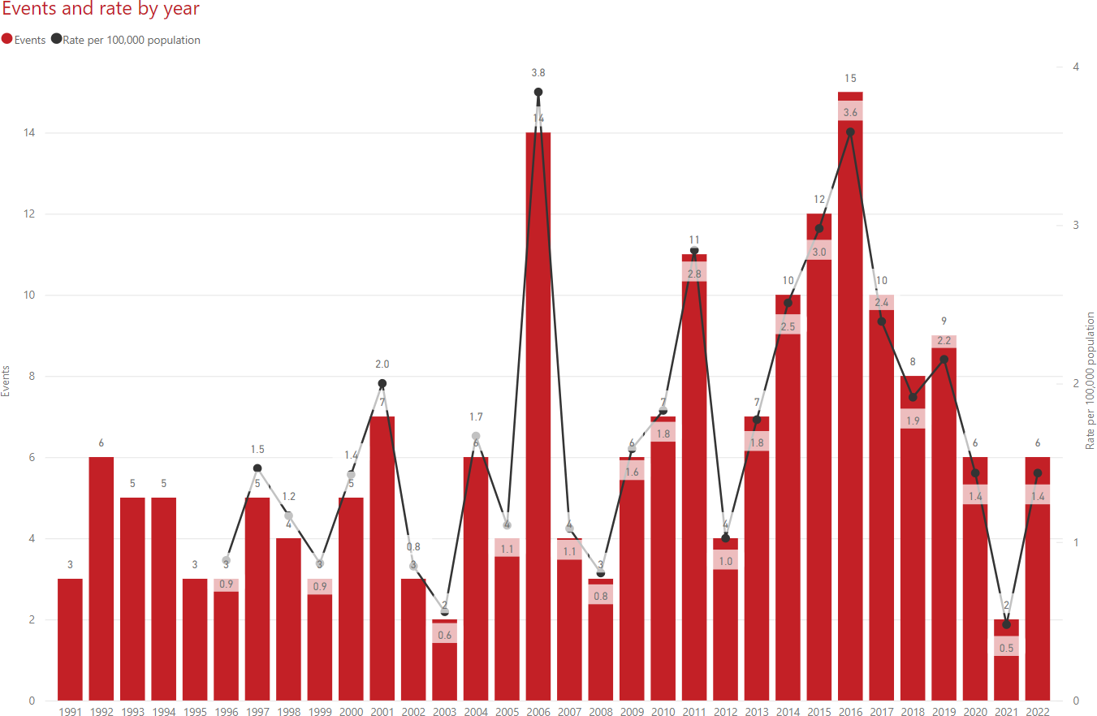
HIV All notifications in BSW
Source: DH Public Report PBI
https://www.health.vic.gov.au/infectious-diseases/local-government-areas-surveillance-report

Slide 25
Data considerations
Limitations
No denominator data
No understanding of rates or adequacy of testing for symptomatic or asymptomatic infection
Potential under-capture of (particularly asymptomatic) cases
No success at obtaining laboratory testing data so far
-> Practice data will inform better understanding of regional patterns in testing and treatment access

Slide 26
STI prevention and care continuum
Prevention
  knowledge, agency (incl mental health, D+A), risk identification
  specific means (incl condoms, PrEP, contraception)
Diagnosis
  access to care – free of stigma + discrimination, privacy, Medicare card, affordable, timely appointment..
  clinical assessment and laboratory testing
Treatment / follow up
Partner notification
Re –testing for new infection (3 months)

Slide 28
Cascade of care https://kirby.unsw.edu.au/sites/default/files/kirby/report/Annual-Surveillance-Report-2022_STI.pdf

Slide 29

Auditable data across the continuum
Persons identifiable as within a sub pop at higher risk of STI (eg MSM, ATSI, youth..)
Number of patients tested, and % positive diagnosis amongst tested
Guideline concordant testing and care:
  Screening and diagnostic testing (including appropriate sample sites)
  Antenatal STI testing performed according to guidelines (HIV and syphilis)
  Treatment regimen prescribed
  Test of cure performed (only if indicated, at the correct duration post Rx)
  Re-test at 3 months for reinfection (% tested, % re-infected)
  Partner (s) informed and tested / treated
  PrEP discussed / prescribed
Access
  Waiting time from booking to appointment for symptomatic STI and contacts of STI
  Duration from symptom onset or screening to treatment
  Completion of cascade
Contraception
  % 15 – 29 year olds tested (+ % positive) for STI, and contraception discussed / prescribed (LARC)
Clinic / training activities: LGBTQI inclusion – eg rainbow ready roadmap, SRH training etc

Slide 30
Resources
Australasian STI management guidelines https://sti.guidelines.org.au/
MSHC: history and examination, treatment guidelines partner notification, patient fact sheets, education modules + much more https://www.mshc.org.au/
Australasian contact tracing guidelines 2022 https://contacttracing.ashm.org.au/
Let Them Know https://letthemknow.org.au/
ASHM decision making tools for PrEP, Syphilis, HCV, HBV, Mpox, HIV, etc https://ashm.org.au/resources/
ASHM PrEP guidelines https://www.ashm.org.au/resources/the-ashm-national-prep-guidelines/
ASHM Post Exposure Prophylaxis for HIV – Australian National Guidelines https://www.ashm.org.au/resources/post-exposure-prophylaxis-for-hiv-australian-national-guidelines/
ASHM HIV guidelines https://www.ashm.org.au/resources/antiretroviral-guidelines/
Centre for Excellence in Rural Sexual Health (CERSH) 12 modules, free, online, Online Learning Modules (unimelb.edu.au) (RACGP and ACRRM accredited, CPD points)
Rainbow ready roadmap https://www.vic.gov.au/rainbow-ready-roadmap

Slide 31
POLAR data extraction Tool- Chlamydia “walkthrough” & “bookmark”
Data analysis specs
CPD mini-audit Step 2: Method for data collection in practice, Audit criteria, data to be collected
People at risk of STIs need to access to screening-
Screening audit:
How many patients in my practice have had a Chlamydia screen in the last 12 months? 6 months?
Regular patients or walk ins?
  Regular patients: RACGP active patients
Time frame: 6/12 or 12/12
Population group: 15-29 year olds
Test: Chlamydia urine, throat, vaginal, rectum
People at risk of STIs access timely diagnosis
For a testing to diagnosis audit:
Of those who have tested, what percentage test positive?
Percentage positive?

Slide 32

Case Presentation: 22 yr old female
Situation presented with 3 weeks of post coital bleeding without noting any dyspareunia or vaginal discharge
Background: Recent diagnosis of Crohn’s disease commenced azathioprine In previous month and on weaning doses of prednisolone - now 20mg daily
In last 3 weeks has bled with intercourse, periods remain regular.
On Levlen
Noted some loose bowel motions but these were improving since commencing Crohns treatment. New relationship in last 3 months. Previous partner for 2.5 years, nil others.
Assessment: Yellow vaginal discharge and cervix bled ++ on contact
No abdominal tenderness
Normal obs and not systemically unwell
Swabs, Cervical screening test and bloods including Bhcg in view of immunosuppression and azathioprine use- Chlamydia detected
Recommendation: Discussed with gynaecologist in view of immunosuppression. Treated with azithromycin 1g stat and Doxycycline 100mg bd for 10 days, partner notified, full STD check completed - Hep B immune, negative HIV and syphilis negative. Retest at 3 months = negative.
As she is at increased risk of PID should she have been managed any differently and would follow-up change?

Slide 33
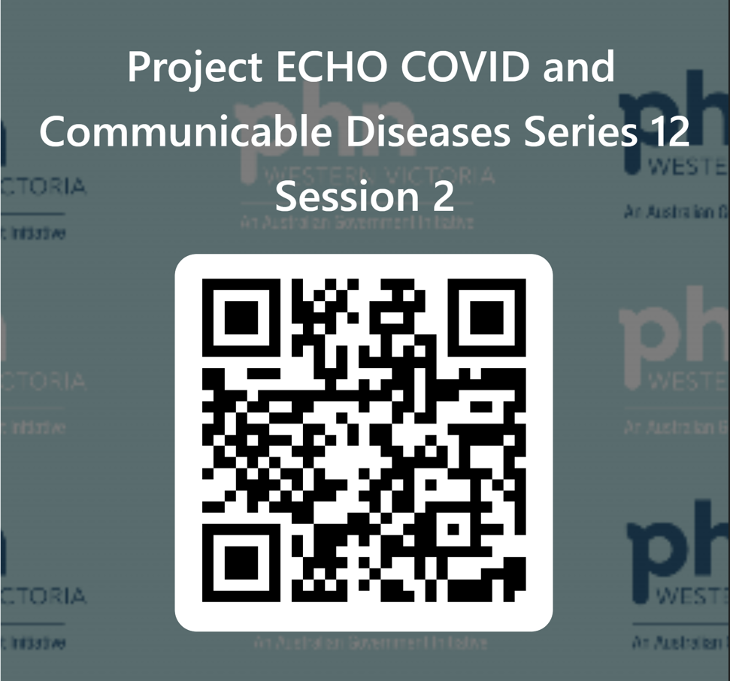


Evaluation
Session evaluation
Please take the time to evaluate this session
  Link pasted into the chat
Upcoming Sessions
9 March
23 March
6 April
If you have a case, you would like to discuss with the group:
Case template here
Email projectechocovid19@westvicphn.com.au
Use the comment box in the evaluation form
Notes:
Session evaluation link https://forms.office.com/r/623SLBfApV
Case template link https://forms.office.com/r/JGtcXzehKJ

Slide 34

Emerging Public Health Risks – Webinar Series
Thursday 2 March, 7 – 8.30pm
Please join us for this session where we will hear from the Barwon South West and Grampians Public Health Units (PHU) to:
Enable primary care clinicians to consider their role in communicable disease outbreak management in 2023
Receive an update on mosquito-borne disease risk in western Victoria
Receive a COVID-19 update including hospitalisations and expansion of COVID-19 antiviral eligibility
Notes:
COVID and Emerging Communicable Diseases Update - 2 March | Western Victoria Primary Health Network (westvicphn.com.au)

