Slide 1
Welcome to Project ECHO COVID and Communicable Diseases Network
Series 12: Session 3
Tailoring knowledge to practical challenges:
Management of infected IUDs

Slide 2
Acknowledgement of Countries
I’d like to begin by acknowledging the Traditional Owners and custodians of the lands and waterways from which we are all zooming in from today.
the Wadda Wurrung, Gulidjan, Gadubanud, Keeray Wurrung, Peek Wurrung, Gunditjmara, Djab Wurrung, Wotjobaluk, Dja Dja Wurrung, Jadawadjarli, Wergaia, Jaadwa and Jupagalk peoples
We recognise their diversity, resilience, and the ongoing place that First Peoples hold in our communities.
We pay our respects to the Elders, both past and present and commit to working together in the spirit of mutual understanding, respect and reconciliation.
We support self-determination for First Nations Peoples and organisations and will work together on Closing the Gap.
Ask the question. Do you identify as Aboriginal or Torres Strait Islander?

Slide 3
Etiquette/Zoom use
Clearly name yourself with first name and surname.
Introduce yourself / Role / Region / Organisation in “chat”
Use chat to ask questions
Please remain on ‘mute’ except when speaking
Please turn video on
In-session Evaluation at the end
These sessions will be recorded for ongoing training and quality improvement purposes.
The didactic presentations ONLY will be disseminated on our learning channel.
Discussions will be de-identified where used for QI or research purposes.
Please let us know if you would not like your comments recorded.

Slide 4
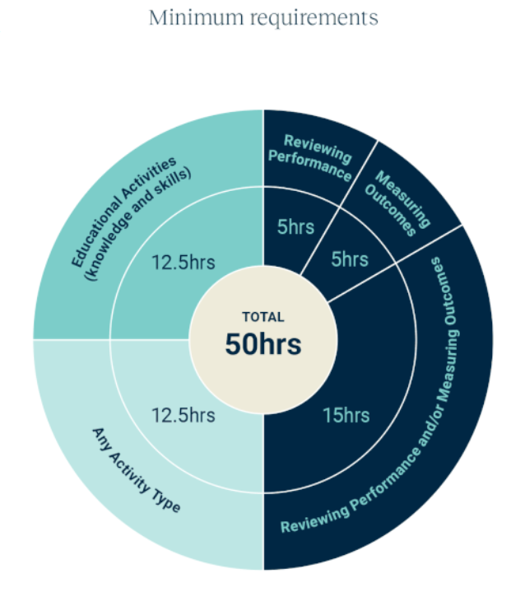
WVPHN – Your CPD Centre
Attend all 5 sessions in series
We are here to help you complete your CPD requirements for the 2023-25 Triennium
Project ECHO
accredited as a Peer Group Learning (PGL) Activity with RACGP and ACRRM
eligible for Reviewing Performance hours
If a GP attends
Each of the 5 ECHO sessions in a series
We upload 5 Reviewing Performance hours to your CPD Dashboard
Add in a QI activity
Related to the ECHO series
Developed and supported by PFs
5 Measuring Outcomes hours
Minimum Annual Requirements
Add in a 5hr QI activity

Slide 5
LeLearning outcomes
Series learning outcomes
Describe the prevalence of STIs in the Western Victoria region and the needs of people at risk of and living with STIs along the continuum
Describe the role of primary care in STI policy implementation and discuss service barriers and enablers in regional Victoria
Describe how to use the Polar GP data extraction tool to analyse routinely collected patient data
Contribute to the development of a quality improvement plan that could be used in primary care to bridge care gaps for people living with STIs
Opportunity to review and discuss emerging COVID-19 pandemic information relevant to general practice
Session 3 Learning outcomes
Discuss potential barriers that people living with or at risk of STIs face in accessing prevention, testing, treatment and care
Locate best practice resources, guidelines and decision support tools relevant to STI prevention, screening, treatment and care
Describe management for complicated STI infection in the setting of an IUD
Apply best practice approaches to a case based discussion

Slide 6
Learning Health System Improvement cycle -A community of learning and change
External Evidence
Step 4: Data Analysis
and change implementation
CPD mini-audit Step 2
Audit criteria, data to be collected
Interpret results
Design Intervention
Take action
Assemble data
Analyse data
Capture Practice as data
If community decides that something of importance has been learned that points towards something that could be improved, then…..
“Polar walkthrough”
Step 3:
Data Collection
Knowledge gap analysis
Service gap analysis
Generate tailored messages for decision making
Community comes together in pursuit of a Health Problem of interest
Sexually transmissible infections

Slide 7
Refine the problem statement
CPD Mini-audit Step 1: Identification of need (what’s the subject of the study?)
People at risk of and living with STIs need access to prevention, testing, treatment and care
…but they cannot do it, or they face a challenge
The problem is happening because [explain the cause of the problem that you identified in your needs analysis]
Access issues, patients at risk but not requesting service
Notification data not linked to service utilisation data (ie notification data and EMR data not linked)
Data gaps that could potentially be filled by looking at EMR data
and with the move towards LARCs and later cervical screening, young women and people with uteruses, opportunities for opportunistic screening have decreased.
Based on [quantitative data] and [qualitative data collected]
Health literacy issues, health access issues, re-infection from untreated partner
We (as a community of interest) think that [your insights] and [design needs] can solve the problem.

Slide 8
Data to knowledge (D2K Phase) Make knowledge actionable and shareable Generate tailored messages for decision making
Stakeholders
Research
Data
Implementation
Consumers
Their families
Community Providers
Case studies
Four types of evidence….

Slide 9
Agenda for COVID and Communicable Diseases Network Series 12: Session 3 Tailoring knowledge to practical challenges: Management of infected IUDs
Facilitator: Dr Bianca Forrester, Clinical Lead of Innovation and Learning, Western Victoria PHN
Naomi White, Senior Manager Regional Partnerships and Public Health, Western Victoria PHN
New announcements
Dr Jasmine Schuijers, O & G Registrar, The Royal Women’s Hospital and Barwon Health
Case presentation: Dr Mike O’Sullivan, GP, Ballarat Medical Centre
Panel for Discussion:
Dr Kate Graham, GP and Clinical Editor – HealthPathways and COVID Clinical Advisor, Western Victoria PHN
Dr Caroline Bartolo, Infectious Diseases Physician, Barwon South West Public Health Unit
Network Co-ordinator: Jemma Missbach, Western Victoria PHN

Slide 10
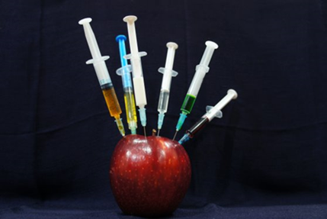
COVID-19 Vaccine update
Australian Technical Advisory Group on Immunisation (ATAGI) recommends
2023 booster dose for people at higher risk of severe illness, including:
everyone aged 65 and above
everyone aged 18 and above who are at risk.
2023 booster dose is available for:
everyone aged 18 and above
at risk children aged between 5 and 17 years.
Withdrawing from vaccine products or the program, to be completed via CVAS, please ensure this is up to date
Reminder to update Vaccine Clinic Finder (VCF)
Notes:
ATAGI 2023 booster advice | Australian Government Department of Health and Aged Care
ATAGI recommendations on use of the Pfizer bivalent (Original/Omicron BA.4/5) COVID-19 vaccine | Australian Government Department of Health and Aged Care

Slide 11
COVID-19 Booster doses in RACFs
COVID boosters in RACFs will be relied upon by primary care providers.
RACFs should utilise their existing relationships with Primary care providers to obtain vaccinations.
Eg. Usual GP rounds undertaking vaccination on residents, existing relationships with vaccinating pharmacies.
Reach out to WVPHN, if RACFs are unable to source vaccines.
WVPHN will assist with linking up a provider with a RACF.
As a last resort a VAPP referral can be made by WVPHN.
Notes:
With the scale back of services offered by the PHU's COVID boosters in RACFs will be relied upon by primary care providers.
It is encouraged that RACFs utilise their existing relationships with Primary care providers to obtain these vaccinations. Eg. Usual GP rounds undertaking vaccination on residents, existing relationships with vaccinating pharmacies.
In circumstances where RACFs are unable to source vaccines from their usual primary care providers, RACFs are encouraged to reach out to the WVPHN and we might be able to will assist with linking up a provider with a RACF. As a last resort a VAPP referral can be made by the PHN

Slide 12
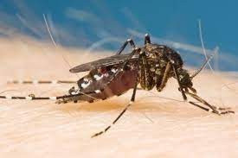
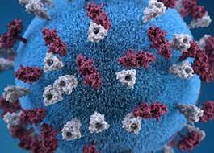
Health Alert
Murray Valley Encephalitis (MVE)
detected in mosquitoes trapped across northern Victoria and Horsham.
New case of MVE this week making 3 known cases including one death.
Japanese Encephalitis Virus (JEV)
Expansion of JEV vaccination eligibility in our northern LGAs. Buloke, Greater Bendigo, Hindmarsh, Horsham, Northern Grampians, West Wimmera and Yarriambiack
Local councils offering the vaccine to communities – not yet known how available that will be
General Practice encouraged to provide access to their communities.
Require a one link account.
All orders via email to immunisation@health.vic.gov.au
The most effective method to avoiding mosquito borne disease remains reducing your potential to be bitten.
Japanese Encephalitis Vaccination | Western Victoria Primary Health Network (westvicphn.com.au)
Notes:
MVE - Murray Valley encephalitis (health.vic.gov.au)
JEV – Update on Japanese encephalitis and Murray Valley encephalitis in Victoria | health.vic.gov.au
Japanese encephalitis virus (JEV) | Australian Government Department of Health and Aged Care

Slide 13
Pelvic Inflammatory Disease & Intrauterine Devices
Jasmine Schuijers, O&G registrar RWH/UHG

Slide 14
IUD
 | MirenaTM | KyleenaTM | Copper (T 380 or multiload 375)
Dose | 52mg levonorgestrel | 19.5mg levonorgestrel | Cu
Cost | PBS $40 ($5.60), $213 private | PBS $40 ($5.60), $170 private | Non-PBS, $70-100
Indication | Contraception, HMB, prog component of MRT (dysmenorrhoea) | Contraception (HMB, dysmenorrhoea) | Contraception, including emergency
Duration | 5 years | 5 years | 5 years (multiload), 10 years (T)
Efficacy | 99.9% | 99.7% | 99.5%
ADR | = | = | HMB
1, 2, 3

Slide 15
PBS claims for IUDs doubled between 2006 and 2018
3-fold increase in the 15-24yo age group
Australia still has comparably low rates (4.5% vs 9.5% in US, 10% in UK, 23% in Norway
4, 5, 6

Slide 16
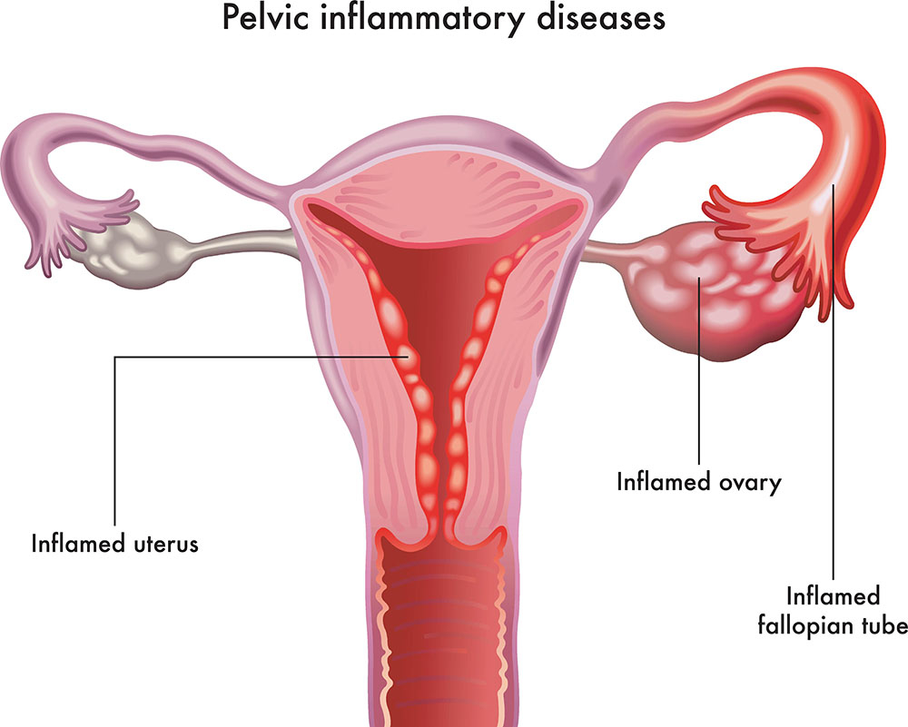
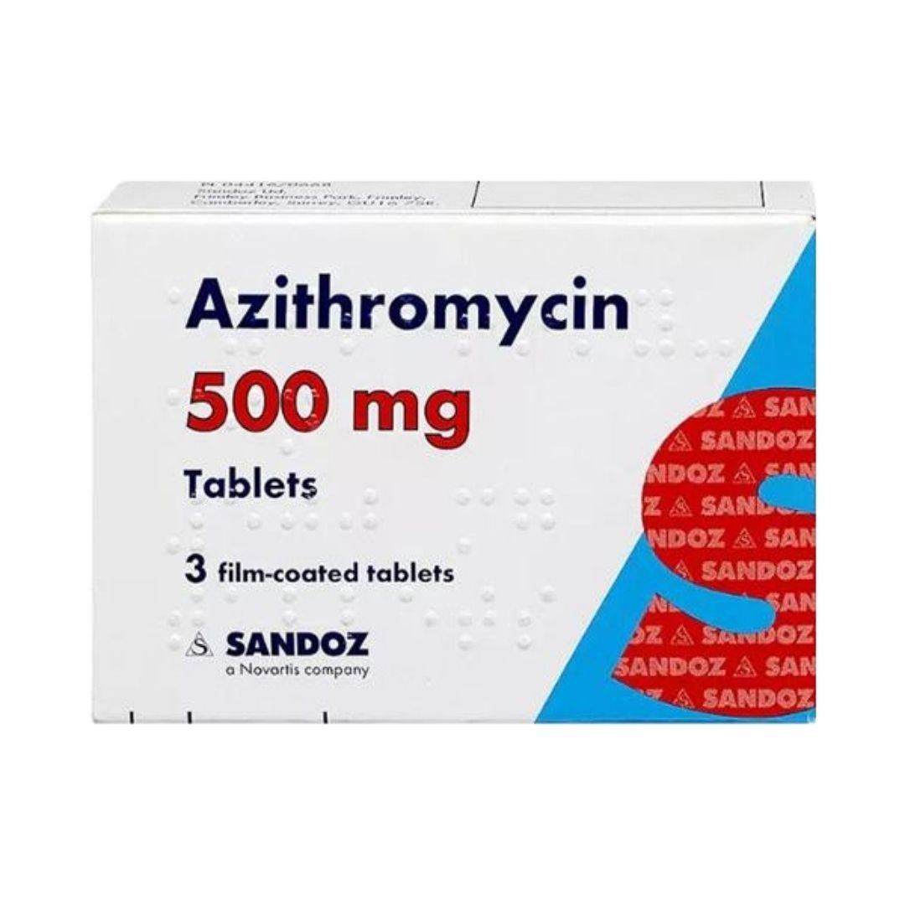
PID
Infection of the upper reproductive system (endometritis, salpingitis, TOA, cellulitis, peritonitis)
Aetiology:
Sexually acquired: chlamydia trachomatis > N. gonorrhoea > mycoplasma genitalium
Post-procedural: polymicrobial, usually from vaginal flora
Usually, no pathogen is identified
Symptoms: abdominal pain, dyspareunia, dysuria, IMB/PCB/HMB, unusual PV discharge
Signs: cervical motion tenderness, uterine/adnexal tenderness, fever/sepsis
Investigations: endocervical swab > self-collected vaginal swab > first pass urine
Treatment:
Antibiotics (as per eTG) – commence promptly (do not wait for results), STI until proven otherwise
Analgesia, contact tracing, avoid intercourse (minimum 1/52)
Ddx: ectopic pregnancy, appendicitis, endometriosis, complication of ovarian cyst, UTI
7, 8
Notes:
Negative swab does not exclude diagnosis
Treat as STI unless a pre-procedure STI screen was performed

Slide 17
Sexually acquired
Mild-moderate
Severe
Ceftriaxone 500mg IM once
PLUS
Metronidazole 400mg BD for 14/7
PLUS
Doxycycline 100mg BD for 14/7
OR
Azithromycin 1g STAT then repeat in 1/52
Ceftriaxone 2g IV daily
PLUS
Metronidazole 500mg IV BD
PLUS
Azithromycin 500mg IV daily
M. GENITALIUM
Moxifloxacin 400mg PO daily for 14/7
8
Notes:
Azithromycin option only if poor compliance expected

Slide 18
Post-procedural
Mild-moderate
Severe
Augmentin Duo Forte 875/125mg PO BD for 14/7
Gentamicin IV (variable dosing)
PLUS
Metronidazole 500mg IV BD
PLUS
Amoxicillin/ampicillin 2g IV Q6H
8

Slide 19
IUD & STI/PID
MYTH: IUDs are associated with higher risk of PID
Stems from 1970s class action against Dalkon Shield
Procedural infection risk = 1:300
Limited to 3/52 post-insertion
High risk of STI
Possible very small increased risk of PID, limited to first 3/52
Current algorithms for determining increased risk have poor predictive value
Pre-existing undiagnosed/asymptomatic STI
PID rates are comparable to baseline, absolute risk is low
Screen for STIs before IUD insertion, then treat before or at time of insertion
Don’t give prophylactic antibiotics unless very high individual risk (e.g., partner positive)
IUD insertion contraindicated with symptomatic STI or active PID
Most studies look at copper IUD, but PID rates seem to be equal or less with levonorgestrel IUD
9, 10, 11
Notes:
After 20 days, rates of Pelvic Inflammatory Disease (PID) in IUD users is approximately the same as would be expected in the general population not using IUD
Exception to 3/52 rule is actinomyces (very rare)
High risk of STIs - individualise risk assessment
Large retrospective cohort study: incidence of PID within 90 days following IUD insertion = 0.54%, regardless of whether screening & treatment took place (either same day or pre-screening) . Therefore, IUD can be inserted before STI results are available, provided patient is asymptomatic and can be contacted and treated promptly when results are known
Cochrane Review: effectiveness of prophylactic antibiotics before IUD insertion (primary outcomes = IUD-related complications, discontinuations within 3 months of insertion) – risk of IUD-related infections was low, with or without antibiotic prophylaxis, possible reduction in unscheduled return visits but limited evidence to support cost-effectiveness
Symptomatic STI/PID widely considered a contraindication, in practice in high-risk populations (e.g., socially complex STOP) can treat concurrently

Slide 20
PID diagnosed when an IUD is in situ
Arguments for removal
Arguments against removal
Historically, IUDs were associated with a higher risk of infection
Infectious tissue = remove foreign body
IUD removal is easy
PID has high rates of morbidity (ectopic pregnancy, infertility, chronic pain)
Infections require effective and opportune treatment to reduce sequelae
Types of materials in IUDs have changed
Re-insertion may be difficult
Unplanned pregnancy related morbidity
Evidence suggests no difference in antibiotic efficacy either way
12
Notes:
These morbidities are particularly relevant for the group of people PID affects the most – young women

Slide 21
PID diagnosed when an IUD is in situ
Arguments for removal
Arguments against removal
Historically, IUDs were associated with a higher risk of infection
Infectious tissue = remove foreign body
IUD removal is easy
PID has high rates of morbidity (ectopic pregnancy, infertility, chronic pain)
Infections require effective and opportune treatment to reduce sequelae
Types of materials in IUDs have changed
Re-insertion may be difficult
Unplanned pregnancy related morbidity
Evidence suggests no difference in antibiotic efficacy either way
12
Notes:
These morbidities are particularly relevant for the group of people PID affects the most – young women

Slide 22
Keep IUD in and treat with antibiotics, consider removal if no clinical response in 48-72 hours
Current guidelines

Slide 23
Mild to moderate PID – leave IUD in situ, review in 48-72 hours, remove if significant clinical improvement has not occurred
RCT evidence is limited
Balance decision against risk of pregnancy, consider emergency hormonal contraception if removing
IUD removal not routinely required in women with PID, but should be removed if no response to treatment in ~72 hours
Balance decision against risk of pregnancy, consider emergency hormonal contraception if removing
Screen for STIs before IUD insertion, then treat before or at time of insertion. Consider antibiotic prophylaxis only in high-risk women.
13, 10
Notes:
British Association for Sexual Health and HIV
Faculty of Sexual and Reproductive Healthcare

Slide 24
Do not remove IUD, treat with antibiotics, follow-up closely
If no clinical improvement within 48–72 hours consider removal
Treat the STI/PID using appropriate antibiotics
Usually no need for IUD removal (informed choice, individual risk factors for STI/PID)
IUD (Cu & levenogetrel) + PID: - Initiation = 4 - Continuation = 2
14, 11
4 = unacceptable health risk if method continued
2 = advantages of using method outweigh theoretical or proven risks
Notes:
Medical Eligibility Criteria for contraceptive use

Slide 25
Watch this space…
Removal of intrauterine device as part of the treatment for women with pelvic inflammatory disease
Protocol published 2020
Intervention: early (before 48 hours) IUD removal + conventional treatment (antibiotics +/- analgesia etc.)
Comparison: conventional treatment without early IUD removal (i.e., after 48 hours).
Primary outcomes: symptomatic improvement (at various time intervals), clinical improvement (at various time intervals), recurrence of PID, PID complications (peritonitis, abscess formation, sepsis ICU)
Secondary outcomes: microbiological clearance, length of hospital stay, chronic pelvic pain, pregnancy, treatment failure, hospital readmission
Subgroup analyses by: type, PID clinical stage, age, time before IUD removal
12

Slide 26
Reference List
Hormonal IUDs available in Australia Comparison Chart [Internet]. [cited 2023Mar7]. Available from: https://shvic.org.au/assets/img/content/Hormonal-IUDs-available-in-Australia-comparison-chart-for-prescribers-and-IUD-inserters-TOOLS.pdf
Intrauterine device (IUD) comparison - fpt.org.au [Internet]. [cited 2023Mar7]. Available from: https://fpt.org.au/wp-content/uploads/2022/05/FPT211125-IUD-Comparison-Fact-Sheet-A4_V4.pdf
Long-acting reversible contraceptives - royal australian college of ... [Internet]. [cited 2023Mar7]. Available from: https://www1.racgp.org.au/getattachment/85bdb975-c440-44f1-b4cc-9c7eecb5f45c/Long-acting-reversible-contraceptives.aspx
Stewart C. IUD contraception use in Europe 2018 [Internet]. Statista. 2021 [cited 2023Mar7]. Available from: https://www.statista.com/statistics/1063631/iud-contraception-use-in-europe/
Contraceptive use in Australia: LARCs slowly on the rise [Internet]. Family Planning NSW. 2020 [cited 2023Mar7]. Available from: https://www.fpnsw.org.au/media-news/media-releases/contraceptive-use-australia-larcs-slowly-rise
Eeckhaut MCW, Sweeney MM, Gipson JD. Who is using long-acting reversible contraceptive methods? findings from nine low-fertility countries [Internet]. Perspectives on sexual and reproductive health. U.S. National Library of Medicine; 2014 [cited 2023Mar7]. Available from: https://www.ncbi.nlm.nih.gov/pmc/articles/PMC4167921/
Sexual health information networking & education [Internet]. SHINE SA. 2021 [cited 2023Mar7]. Available from: https://shinesa.org.au/
Therapeutic Guidelines Limited [Internet]. Therapeutic Guidelines. 2022 [cited 2023Mar7]. Available from: https://www.tg.org.au/
The Royal Australian College of general Practitioners. LARCs as first-line contraception – what can general practitioners advise young women? [Internet]. Australian Family Physician. The Royal Australian College of general Practitioners; [cited 2023Mar7]. Available from: https://www.racgp.org.au/afp/2017/october/larcs-as-first-line-contraception
FSRH FSRH clinical guideline: Intrauterine contraception (April 2015, amended September 2019) [Internet]. FSRH Clinical Guideline: Intrauterine Contraception (April 2015, amended September 2019) - Faculty of Sexual and Reproductive Healthcare. [cited 2023Mar7]. Available from: https://www.fsrh.org/standards-and-guidance/documents/ceuguidanceintrauterinecontraception/
Medical eligibility criteria for contraceptive use [Internet]. World Health Organization. World Health Organization; [cited 2023Mar7]. Available from: https://www.who.int/publications/i/item/9789241549158
Viveros-Carreño DA, Grillo-Ardila CF, Amaya-Guio J. Removal of intrauterine device as part of the treatment for women with pelvic inflammatory disease. Cochrane Database of Systematic Reviews 2020, Issue 6. Art. No.: CD013618. DOI: 10.1002/14651858.CD013618. Accessed 07 March 2023.
BASHH guidelines. [cited 2023Mar7]. Available from: https://www.bashhguidelines.org/current-guidelines/systemic-presentation-and-complications/pid-2019/
Pelvic inflammatory disease (PID) - STI treatment guidelines [Internet]. Centers for Disease Control and Prevention. Centers for Disease Control and Prevention; 2022 [cited 2023Mar7]. Available from: https://www.cdc.gov/std/treatment-guidelines/pid.htm

Slide 27
Health Pathways review
Does this reflect the evidence base?
Does this support Decision making on the ground?
https://westvic.communityhealthpathways.org/31721.htm
Notes:
https://westvic.communityhealthpathways.org/31721.htm

Slide 28
Case Presentation:
Situation: 26 year old female with copper IUCD in situ presents with dyspareunia and vaginal discharge
Background: Sexually active from age 17. Up until the age of 19 had SE’s from 3 different OCP’s. At 19 had Mirena inserted and PAP smear done CIN 1 detected - subsequent PAPs and HPV have been normal. After 6/12 of sporadic and then prolonged bleeding with Mirena , had this replaced with copper IUCD At age 24 had Copper IUCD replaced. Had 6 months of irregular heavy periods that then settled.
Assessment: On this testing at this presentation Chlamydia was detected
Recommendation: Copper IUCD removed. Patient and partner treated with Azithromycin. Happy to use condoms only. Negative Chlamydial Ag at 3 months.
Question: 1. Interested in what risks she has for cervical cancer when there would never have been a PAP done at 19 on today’s guidelines 2. Would anyone risk a further IUCD or are risks for PID too great
Notes:
Case template link https://forms.office.com/r/JGtcXzehKJ

Slide 29
Resources
Australasian STI management guidelines https://sti.guidelines.org.au/
MSHC: history and examination, treatment guidelines partner notification, patient fact sheets, education modules + much more https://www.mshc.org.au/
Australasian contact tracing guidelines 2022 https://contacttracing.ashm.org.au/
Let Them Know https://letthemknow.org.au/
ASHM decision making tools for PrEP, Syphilis, HCV, HBV, Mpox, HIV, etc https://ashm.org.au/resources/
ASHM PrEP guidelines https://www.ashm.org.au/resources/the-ashm-national-prep-guidelines/
ASHM Post Exposure Prophylaxis for HIV – Australian National Guidelines https://www.ashm.org.au/resources/post-exposure-prophylaxis-for-hiv-australian-national-guidelines/
ASHM HIV guidelines https://www.ashm.org.au/resources/antiretroviral-guidelines/
Centre for Excellence in Rural Sexual Health (CERSH) 12 modules, free, online, Online Learning Modules (unimelb.edu.au) (RACGP and ACRRM accredited, CPD points)
Rainbow ready roadmap https://www.vic.gov.au/rainbow-ready-roadmap

Slide 30
GPs needed for Survey
Seeking prescribing health care providers in Victoria for a brief online survey about patient delivered partner therapy (PDPT) for chlamydia.
You do not need to have any experience or knowledge of PDPT to participate.
You could win one of five $100 gift vouchers.
Take the survey here: https://go.unimelb.edu.au/n43e
Survey is open until 30th March 2023.
Questions: Contact jane.goller@unimelb.edu.au
Approved by University of Melbourne Human Research Ethics (ID: 24990).
Notes:
https://go.unimelb.edu.au/n43e

Slide 31
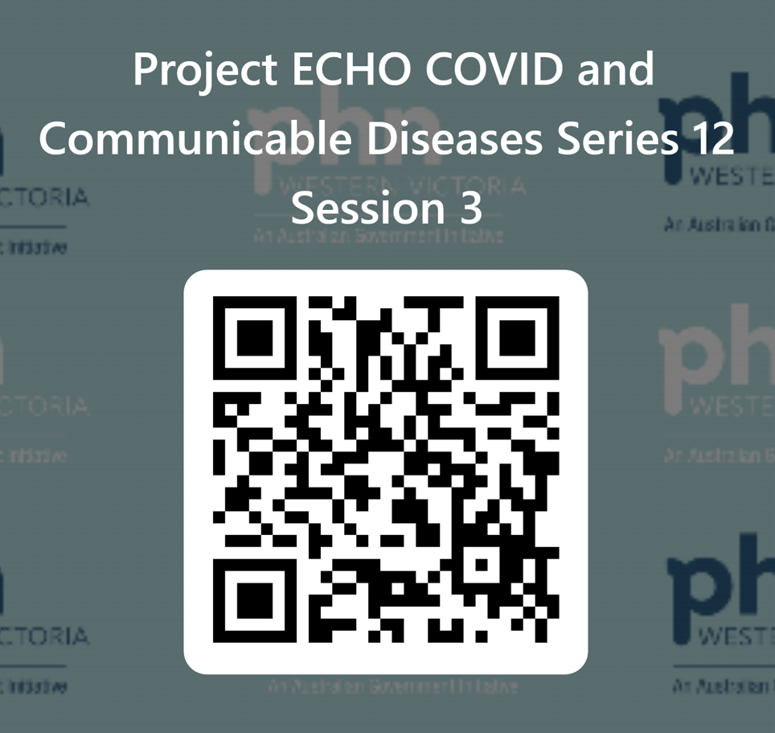
Evaluation
Session evaluation
Please take the time to evaluate this session
Link pasted into the chat
Upcoming Sessions
23 March
6 April
If you have a case, you would like to discuss with the group:
Case template here
Email projectechocovid19@westvicphn.com.au
Use the comment box in the evaluation form
Notes:
Session evaluation link https://forms.office.com/r/spiz90A6Da
Case template link https://forms.office.com/r/JGtcXzehKJ

Slide 32
POLAR data extraction Tool- Chlamydia “walkthrough” & “bookmark” Data analysis specs
CPD mini-audit Step 2: Method for data collection in practice, Audit criteria, data to be collected
People at risk of STIs need to access to screening-
Screening audit:
How many patients in my practice have had a Chlamydia screen in the last 12 months? 6 months?
Regular patients or walk ins?
Regular patients: RACGP active patients
Time frame: 6/12 or 12/12
Population group: 15-29 year olds
Test: Chlamydia urine, throat, vaginal, rectum
People at risk of STIs access timely diagnosis
For a testing to diagnosis audit:
Of those who have tested, what percentage test positive?
Percentage positive?

