Slide 1

Welcome to Project ECHO
COVID and Communicable Diseases Network
Series 12: Session 4
“Catching up on the changes in STI guidelines”

Slide 2


Acknowledgement of Countries
I’d like to begin by acknowledging the Traditional Owners and custodians of the lands and waterways from which we are all zooming in from today.
the Wadda Wurrung, Gulidjan, Gadubanud, Keeray Wurrung, Peek Wurrung, Gunditjmara, Djab Wurrung, Wotjobaluk, Dja Dja Wurrung, Jadawadjarli, Wergaia, Jaadwa and Jupagalk peoples
We recognise their diversity, resilience, and the ongoing place that First Peoples hold in our communities.
We pay our respects to the Elders, both past and present and commit to working together in the spirit of mutual understanding, respect and reconciliation.
We support self-determination for First Nations Peoples and organisations and will work together on Closing the Gap.
Ask the question. Do you identify as Aboriginal or Torres Strait Islander?

Slide 3


Etiquette/Zoom use
Clearly name yourself with first name and surname.
Introduce yourself / Role / Region / Organisation in “chat”
Use chat to ask questions
Please remain on ‘mute’ except when speaking
Please turn video on
In-session Evaluation at the end
These sessions will be recorded for ongoing training and quality improvement purposes.
The didactic presentations ONLY will be disseminated on our learning channel.
Discussions will be de-identified where used for QI or research purposes.
Please let us know if you would not like your comments recorded.

Slide 4

Learning outcomes
Series learning outcomes
Describe the prevalence of STIs in the Western Victoria region and the needs of people at risk of and living with STIs along the continuum
Describe the role of primary care in STI policy implementation and discuss service barriers and enablers in regional Victoria
Describe how to use the Polar GP data extraction tool to analyse routinely collected patient data
Contribute to the development of a quality improvement plan that could be used in primary care to bridge care gaps for people living with STIs
Opportunity to review and discuss emerging COVID-19 pandemic information relevant to general practice
Session 4 Learning outcomes
Discuss potential barriers that people living with or at risk of STIs face in accessing prevention, testing, treatment and care
Locate best practice resources, guidelines and decision support tools relevant to STI prevention, screening, treatment and care
Describe management for common problems
Apply best practice approaches to a case based discussion

Slide 5

Refine the problem statement
CPD Mini-audit Step 1: Identification of need (what’s the subject of the study?)
People at risk of and living with STIs need access to prevention, testing, treatment and care
…but they cannot do it, or they face a challenge
The problem is happening because:
Prevention:
Health literacy issues, health access issues, re-infection from untreated partner. Advances in HPV vaccination however-single dose.
Testing:
Access issues, patients at risk but not requesting service
and with the move towards LARCs and later cervical screening, young women and people with uteruses, opportunities for opportunistic screening have decreased.
Treatment and care:
Complex clinical decision making not represented well in guidelines- knowledge gaps.
Mycoplasma Testing not funded by MBS and medication not funded by PBS or accessible at a reasonable cost.
Based on quantitative data and qualitative insights gathered:
Notification data not linked to service utilisation data (ie notification data and EMR data not linked)
Data gaps that could potentially be filled by looking at EMR data- practice audit?
We (as a community of interest) think that [your insights] and [design needs] can solve the problem.

Slide 6
Learning Health System Improvement cycle
-A community of learning and change
External Evidence
Step 4: Data Analysis
and change implementation
CPD mini-audit Step 2
Audit criteria, data to be collected
Interpret results
Design Intervention
Take action
Assemble data
Analyse data
Capture Practice as data
If community decides that something of importance has been learned that points towards something that could be improved, then…..
“Polar walkthrough”
Step 3:
Data Collection
Knowledge gap analysis
Service gap analysis
Guidelines-refresh
Next Session:
Measuring Outcomes (MO) template launch
Review Practice Connect
Community comes together in pursuit of a Health Problem of interest
Sexually transmissible infections

Slide 7
Agenda for COVID and Communicable Diseases Network Series 12: Session 4
“Bridging the Sexually transmissible infections testing, treatment and care gap: ideas for change”
Facilitator: Dr Bianca Forrester, Clinical Lead of Innovation and Learning, Western Victoria PHN
Katrina Martin: Project Lead, Continuing Professional Development, Western Victoria PHN
  CPD update
Naomi White, Senior Manager Regional Partnerships and Public Health, Western Victoria PHN
  New announcements
Dr Sarah Huffam, Infectious Disease and Sexual Health Physician, Barwon Health and BSW PHU
  STI management guidelines
Case presentation: Dr Anna Glue, Ballarat Medical Centre
Panel for Discussion: Dr Kate Graham, GP and Clinical Editor – HealthPathways and COVID Clinical Advisor, Western Victoria PHN
Dr Caroline Bartolo, Infectious Diseases Physician, Barwon South West Public Health Unit
Network Co-ordinator: Whitney Flower, Western Victoria PHN

Slide 8

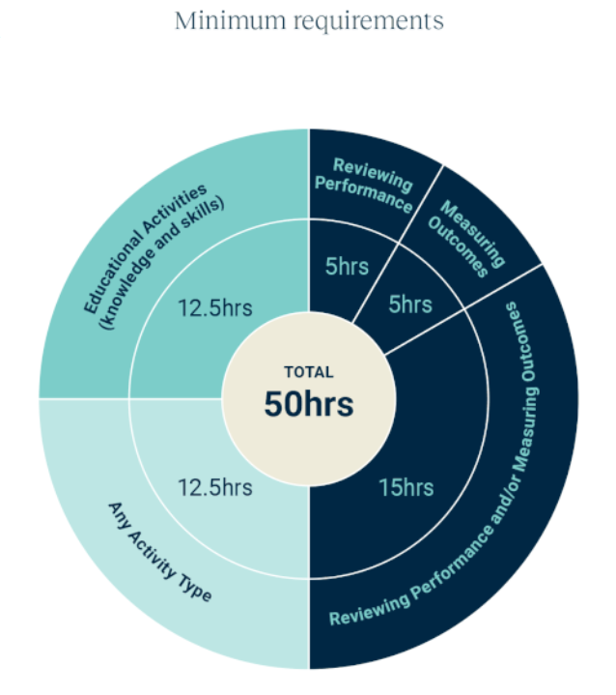
WVPHN – Your CPD Centre
Attend all 5 sessions in series
We are here to help you complete your CPD requirements for the 2023-25 Triennium
Project ECHO
accredited as a Peer Group Learning (PGL) Activity with RACGP and ACRRM
eligible for Reviewing Performance hours
If a GP attends
Each of the 5 ECHO sessions in a series
We upload 5 Reviewing Performance hours to your CPD Dashboard
Add in a QI activity
Related to the ECHO series
Developed and supported by PFs
5 Measuring Outcomes hours
Minimum Annual Requirements
Add in a 5hr QI activity

Slide 9


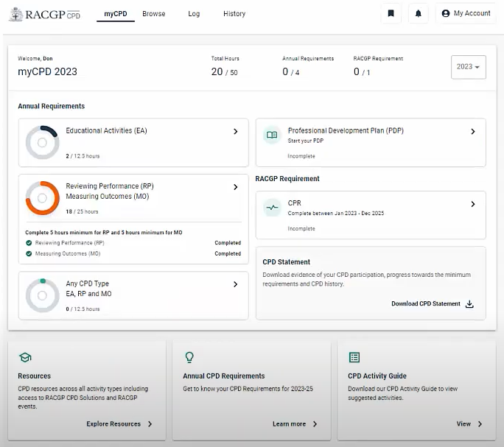
Self reporting CPD hours
WVPHN reports hours for:
GPs who attend all five 1-hour sessions
Self-reporting CPD hours:
GPs may self-record Reviewing Performance (RP) hours via MyCPD Quick Log or the RACGP app for the following:
  Attended less than 5 ECHO sessions
    1 RP hr / session, include date and session title
  Report RP hours for case preparation time
    State the session title and the date you presented the case.
    E.g. Presented a case presentation for Project ECHO Communicable Diseases Network: Sexually Transmitted Diseases 16/3/23. Preparation time 1.0 RP hours.

Slide 10

COVID-19 Booster doses in RACFs and disability
The Commonwealth have requested PHNs to make contact with all RACFs and Disability houses in our catchment and support where needed to connect to a vaccine provider.
Vaccination providers may receive a phone or email request to support a facility in your area.
As a last resort a VAPP referral can be made by WVPHN.
Notes:
With the scale back of services offered by the PHU's COVID boosters in RACFs will be relied upon by primary care providers.
It is encouraged that RACFs utilise their existing relationships with Primary care providers to obtain these vaccinations. Eg. Usual GP rounds undertaking vaccination on residents, existing relationships with vaccinating pharmacies.
In circumstances where RACFs are unable to source vaccines from their usual primary care providers, RACFs are encouraged to reach out to the WVPHN and we might be able to will assist with linking up a provider with a RACF. As a last resort a VAPP referral can be made by the PHN

Slide 11
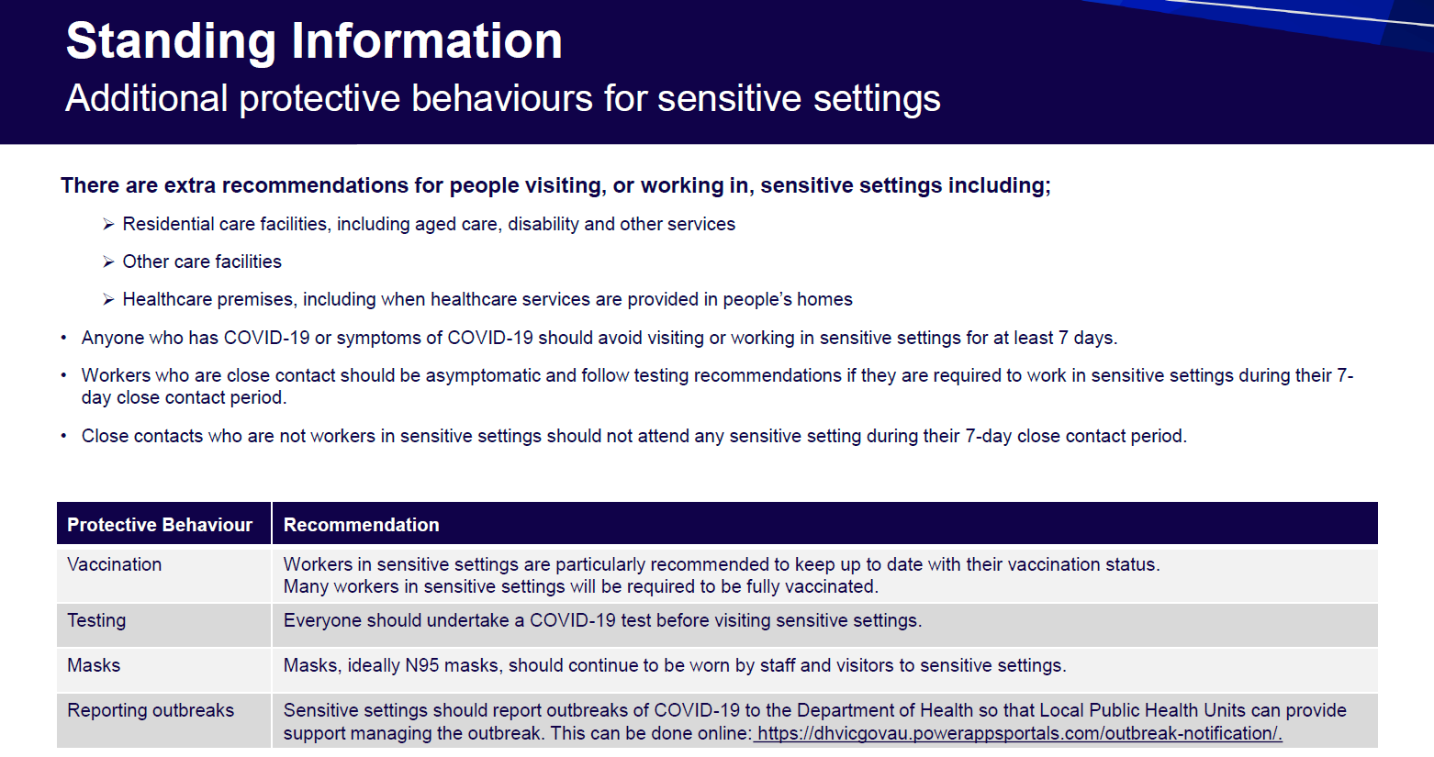
COVID-19 and Masks Guidance in Primary Care
Notes:
Testing Bulletin 03 February 2023 No. 4.pdf
There are currently no official requirements for masks in GP settings there are however recommendations to that effect. I have attached the most recent Testing bulletin from Vic DH which has advice for health premises on pages 10 and 11 related to mask wearing. I have screen shot the relevant points below.
I understand some health services in the last week have switched from pt facing staff requiring N95/P2 masks to surgical masks. I have not been able to find any specific advice on this change or if it was a recommendation. The mask wearing fatigue appears to be wide spread in the community. Best practice still recommends mask wearing particularly when working with vulnerable populations.
I hope this is help for you. Please reach out if there is anything else. Unfortunately the guidance isn’t as forthcoming and available as it used to be.

Slide 12
COVID vaccination Grant opportunity
Grants of $3000 to vaccinating clinics
Must either operate in MMM regions 4-7 or be MMM 1-3 planning to do a pop up in a 4-7 area to be eligible
Grants available for extending hours, increasing vaccination staff, pop up community clinics
A GEM Flyer has been sent to vaccinating clinics
  All responses via EOI document to tenders@westvicphn.comau
  If you can questions or request flyer resent please email covidenquiry@westvicphn.com.au

Slide 13
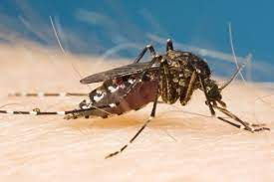
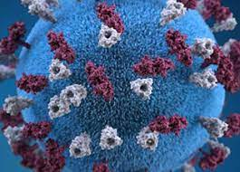
Health Alert
The risks for mosquito borne disease remains high.
Providers in eligible LGAs are encouraged to order and provide access to JEV vaccine to their communities.
Expansion of JEV vaccination eligibility in our northern LGAs. Buloke, Greater Bendigo, Hindmarsh, Horsham, Northern Grampians, West Wimmera and Yarriambiack
Update alert Strep A
Noting continued activity and producing severe illness particularly among children.
Japanese Encephalitis Vaccination | Western Victoria Primary Health Network (westvicphn.com.au)
Notes:
MVE - Murray Valley encephalitis (health.vic.gov.au)
JEV – Update on Japanese encephalitis and Murray Valley encephalitis in Victoria | health.vic.gov.au
Japanese encephalitis virus (JEV) | Australian Government Department of Health and Aged Care

Slide 14

Sexually Transmitted Infections
Dr Sarah Huffam
Infectious Diseases and Sexual Health Physician

Slide 15


Contents
Australasian STI Management Guidelines
Selected key points and updates (2022)
Asymptomatic check up

Slide 16
Emerging role of the BSW PHU in support for Sexual and Reproductive Healthcare
Notifiable Diseases
BRaSH Clinic - soon to be two!
HIV Outreach Nurse (formerly HARP)
SRHVH PHU Nurse – recruiting now
SRH working group (Clinical, Epi, Research etc)
Partnerships to support a SRH provider network in primary care

Slide 17
PARTNERSHIP OPPORTUNITY - Barwon South West Region
Summary
An exciting opportunity exists for a general practice to become a partner with Melbourne Sexual Health Centre (MSHC) to join the Victorian Sexual Health Network (VSHN). Through this partnership the GP practice will receive education and ongoing support from MSHC in relation to STI testing and management.
This document describes the VSHN and what the partnership entails.
If your practice is interested in joining us, please complete the expression of interest document below and return to lkennedy@mshc.org.au by COB 31st March 2023. We will contact your practice within seven days of the closing date to organise an interview before final selection.

Slide 18
https://sti.guidelines.org.au/

Slide 19
Asymptomatic check-up
To determine risk - take a sexual history.
Some subpopulations (e.g. men who have sex with men, sex workers, pregnant people, Aboriginal and Torres Strait Islander people, trans and gender diverse people) have special requirements for testing due to increased risk of infection, adverse health outcomes, community prevalence or other factors.
Perform asymptomatic STI check for people who:
  Request STI testing.
  Are at increased risk of STI: new sexual partner, living or travelling to areas of higher prevalence in Australia or in other countries.
  Have a known exposure to any STI or history of an STI within the past 12 months.
  Are a partner of special subpopulation (listed above) or any of above.

Slide 20
Standard asymptomatic check-up
Youth
“The 9th edition of the RACGP Guidelines for Preventive Activities in General Practice recommends opportunistic testing for chlamydia infection in all sexually active people aged 15-29 years. Currently, chlamydia is detected in approximately 1 in 20 young Australians who have screening tests in general practice.”
Testing advice:
  Opportunistically offer chlamydia and other STI screening to all young people at least annually.
  Testing for chlamydia, gonorrhoea, HBV, syphilis and (HIV) is recommended, as per the Standard Asymptomatic Check-up guideline.
  Confirm hepatitis B status and vaccinate if not immune.
  Discuss reproductive health including contraception.
  Discuss and prescribe PrEP if indicated according to guidelines

Slide 21
Selected key points and updates
HIV and syphilis testing should be included whenever STI testing is indicated.
Extra genital swabs (pharyngeal, anorectal) should be performed (self collect) for all men who have sex with men, and may be indicated in some women (eg CSW)
Vaginal swab (self collect) is more sensitive than FPU therefore is the specimen of choice.
Asymptomatic screening is not routinely recommended for; trichomonas, Mycoplasma genitalium, Bacterial vaginosis, HCV, HPV, or HSV
Trans and Gender Diverse - offer STI screening based on anatomy, sexual practices and patient preference

Slide 22
Standard Asymptomatic STI Screen |  |  | Asymptomatic sexual contacts of MG or TG: add
Population | Specimen (Self Collect) | Pathology request
MSM | FVU | N.gonorrhoeae + C. trachomatis | M.genitalium | T.vaginalis
 | Throat | N.gonorrhoeae + C. trachomatis
 | Rectal | N.gonorrhoeae + C. trachomatis | M.genitalium
MSW | FVU | N.gonorrhoeae + C. trachomatis | M.genitalium | T.vaginalis
Female | HVS (FVU) | N.gonorrhoeae + C. trachomatis | M.genitalium | T.vaginalis
CSW /contacts | Throat | N.gonorrhoeae + C. trachomatis
Offer to All | Serology | HIV and Syphilis Establish HBV status and immunise (HBsAg, HBV sAb, HBV cAb) HCV Ab if IVDU/PrEP/contact

Slide 23

Selected key points and updates
Chlamydia:
Doxycycline is the recommended treatment for Chlamydia trachomatis in all anatomical sites.
Immediate treatment is not recommended for all sexual contacts of chlamydia – instead, offer testing of exposed anatomical sites and await results.
Mycoplasma genitalium:
Special treatment situations when first-line therapy fails or is contraindicated have been updated in response to rising AMR
Sex-associated diarrhoea:
Increasing drug-resistant shigellosis in MSM, do a stool culture, seek expert local advice when treating diarrhoea in MSM.
Skin rash and lesions:
Think about STIs when examining, clients with rashes, lumps and lesions that might not be on the genital skin.
Genital dermatology:
Now includes causes and treatment options for non-STI related conditions of the anogenital skin, such as autoimmune disorders, malignancies, trauma, and inflammatory conditions like psoriasis and eczema.
Adult sexual assault:
A “time from assault” framework as the assessment, management, and ongoing support will differ depending on timing
Consideration for post-exposure prophylaxis (PEP) for STIs has been removed with the only PEP (after risk assessment) recommended for HIV, HBV + pregnancy.
A new entry regarding historical sexual assault as the primary care clinicians may be the first to hear about childhood abuse.
Trans and gender diverse people:
A major update to this section has incorporated current trans and gender diverse affirming language and addressed the deficiencies in published literature.

Slide 24

Resources
Australasian STI management guidelines https://sti.guidelines.org.au/
MSHC: history and examination, treatment guidelines partner notification, patient fact sheets, education modules + much more https://www.mshc.org.au/
Australasian contact tracing guidelines 2022 https://contacttracing.ashm.org.au/
Let Them Know https://letthemknow.org.au/
ASHM decision making tools for PrEP, Syphilis, HCV, HBV, Mpox, HIV, etc https://ashm.org.au/resources/
ASHM PrEP guidelines https://www.ashm.org.au/resources/the-ashm-national-prep-guidelines/
ASHM Post Exposure Prophylaxis for HIV – Australian National Guidelines https://www.ashm.org.au/resources/post-exposure-prophylaxis-for-hiv-australian-national-guidelines/
ASHM HIV guidelines https://www.ashm.org.au/resources/antiretroviral-guidelines/
Centre for Excellence in Rural Sexual Health (CERSH) 12 modules, free, online, Online Learning Modules (unimelb.edu.au) (RACGP and ACRRM accredited, CPD points)
Rainbow ready roadmap https://www.vic.gov.au/rainbow-ready-roadmap

Slide 25

Case Presentation: 23yo Female
Situation 23 yo female - presented 11/10/2022 worried. May have chlamydia - sore and itchy, but no discharge, different to previous thrush.
Background: 23 yo female, hairdresser, lives in share house with sister.
Assessment: Needs STI screen - urine PCR for chlamydia and gono. +ve chlamydia, and then treated with stat dose Azithromycin.
Re-presented end of December - ongoing itch and odour - further chlamydia test +ve, and also back vaginitis swabs (+ve for trichomonas and gardnerella on AFFIRM testing) - treated with doxycycline and metronidazole - 7 days of each
Recommendation: Sx now resolved, but patient requested test on 7/2/23 as confirmation of cure.
Should we include bacterial vaginitis screen with STI screen?
Did we really have a persisting +ve Chlamydia test, or was it too early to retest?
How to manage timely if needing swabs as well as urine PCR (Can request the urine from the lab, harder to do the swabs, and the affirm test is fiddly)

Slide 26
GPs needed for Survey
Seeking prescribing health care providers in Victoria for a brief online survey about patient delivered partner therapy (PDPT) for chlamydia.
You do not need to have any experience or knowledge of PDPT to participate.
You could win one of five $100 gift vouchers.
Take the survey here: https://go.unimelb.edu.au/n43e
Survey is open until 30th March 2023.
Questions: Contact jane.goller@unimelb.edu.au
Approved by University of Melbourne Human Research Ethics (ID: 24990).
Notes:
https://go.unimelb.edu.au/n43e

Slide 27

Upcoming webinar – Cervical Screening
How to optimise the use of self-collection and manage your patients’ follow-up
Speaker:
  Dr Alexis Butler - GP Liaison Physician, VCS Pathology, Australian Centre for the Prevention of Cervical Cancer
Learning Outcomes:
  Discuss the advantages and disadvantages of the HPV self-collection option to support your patient to make an informed choice
  Discuss the appropriate follow up for abnormal self-collection results
  Describe the different self-collection testing processes now available in primary care.
Thursday 4th May 7.00pm - 8.00pm
Webinar
Register here

Slide 28
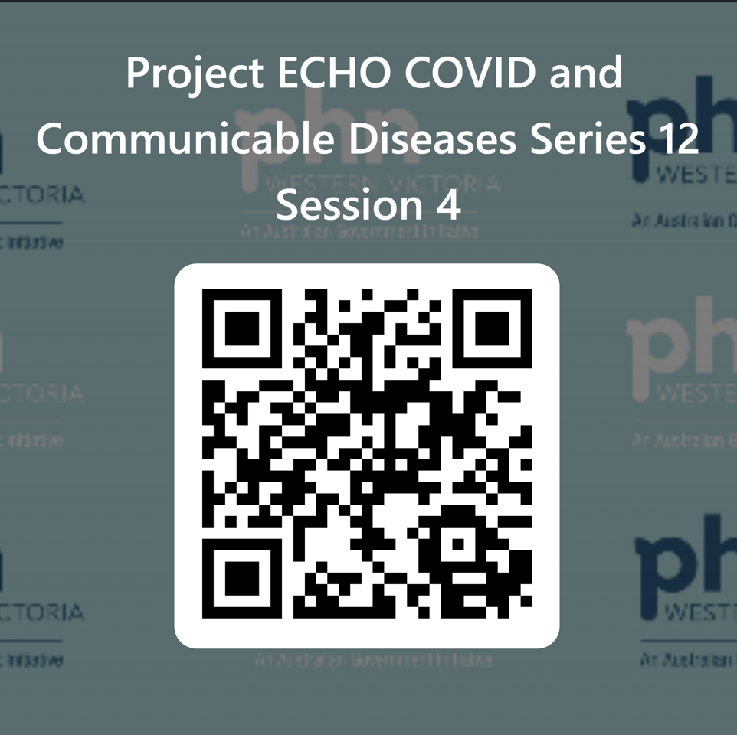


Evaluation
Session evaluation
Please take the time to evaluate this session
  Link pasted into the chat
Upcoming Sessions
6 April
If you have a case, you would like to discuss with the group:
Case template here
Email projectechocovid19@westvicphn.com.au
Use the comment box in the evaluation form
Notes:
Session evaluation link https://forms.office.com/r/ExRQiqM99i
Case template link https://forms.office.com/r/JGtcXzehKJ

