Slide 1
Welcome to Project ECHO COVID and Communicable Diseases Network
Series 12: Session 5
Responding to the common problem of Bacterial vaginosis

Slide 2
Acknowledgement of Countries
I’d like to begin by acknowledging the Traditional Owners and custodians of the lands and waterways from which we are all zooming in from today.
the Wadda Wurrung, Gulidjan, Gadubanud, Keeray Wurrung, Peek Wurrung, Gunditjmara, Djab Wurrung, Wotjobaluk, Dja Dja Wurrung, Jadawadjarli, Wergaia, Jaadwa and Jupagalk peoples
We recognise their diversity, resilience, and the ongoing place that First Peoples hold in our communities.
We pay our respects to the Elders, both past and present and commit to working together in the spirit of mutual understanding, respect and reconciliation.
We support self-determination for First Nations Peoples and organisations and will work together on Closing the Gap.
Ask the question. Do you identify as Aboriginal or Torres Strait Islander?

Slide 3
Etiquette/Zoom use
Clearly name yourself with first name and surname.
Introduce yourself / Role / Region / Organisation in “chat”
Use chat to ask questions
Please remain on ‘mute’ except when speaking
Please turn video on
In-session Evaluation at the end
These sessions will be recorded for ongoing training and quality improvement purposes.
The didactic presentations ONLY will be disseminated on our learning channel.
Discussions will be de-identified where used for QI or research purposes.
Please let us know if you would not like your comments recorded.

Slide 4
Learning outcomes
Series learning outcomes
Describe the prevalence of STIs in the Western Victoria region and the needs of people at risk of and living with STIs along the continuum
Describe the role of primary care in STI policy implementation and discuss service barriers and enablers in regional Victoria
Describe how to use the Polar GP data extraction tool to analyse routinely collected patient data
Contribute to the development of a quality improvement plan that could be used in primary care to bridge care gaps for people living with STIs
Opportunity to review and discuss emerging COVID-19 pandemic information relevant to general practice
Session 5 Learning outcomes
Discuss the treatment and care of the common presentation of bacterial vaginosis
Locate best practice resources, guidelines and decision support tools relevant to prevention, screening, treatment and care
Apply best practice approaches to a case based discussion

Slide 5
STI ECHO “Sprint”
Session 1-Policy/Problem ECHO
STI Strategy
Principles of prevention, testing, treatment and care
Session 2- Data ECHO
Routinely collected EMR data
POLAR walkthrough
Session 3-Knowledge ECHO
Common presentations- Infected IUDs
Best evidence and clinical guidelines
Session 4-Knowledge ECHO
Session 5-Change ECHO
Cascade of care- patient care continuum
Reviewing Performance
In practice
Changes in the STI guidelines in relation to STI testing, treatment care
Management of Chlamydia with Doxycycline v Azithromycin
Introduction of annual Syphilis and HIV testing
Review of STI sprint
Responding to common problems raised by cases
Demo outputs

Slide 6
Learning Health System Improvement cycle -A community of learning and change
CPD Mini audit Step 3:
Data Collection
External Evidence
CPD Measuring Outcomes
self directed activity
Data Analytic specs
Polar Walkthrough
<link>
Interpret results
Design Intervention
Take action
Assemble data
Analyse data
Capture Practice as data
Measuring Outcomes mini audit Template
<link>
CPD mini-audit Step 2
Audit criteria, data to be collected
Service gap analysis strategies
SE2- Data ECHO
Health Pathways review of relevant topics
Review of other “hot topics”
Guidelines-refresh for participants
Step 4: Data Analysis
and change implementation
Problem Statement
SE5- Change ECHO
CPD Mini-audit Step 1: Identification of need (what’s the subject of the study?)
SE3 and 4- Knowledge ECHO
SE1- Problem/Policy ECHO
Community comes together in pursuit of a Health Problem of interest
Sexually transmissible infections
If community decides that something of importance has been learned that points towards something that could be improved, then…..

Slide 7
POLAR Walkthrough
This video will show you how to use POLAR to identify patients who have had a certain test ordered in the last three months.
Once identified, a quality improvement activity could be conducted to increase the number of tests being ordered, and after three months this number could be reviewed to see if there has been an improvement.
This activity could be replicated with any test, cohort or time period.

Slide 11
Notes:
Download the QI activity template here: https://mcusercontent.com/b74b09ecd9126bb9cd61aa252/files/727a4ff8-6297-1cdb-ef9a-b71741c41f05/PDSA_GP_CPD_audit_2023_ECHO.docx
@Jemma Missbach I made some changes to the template to make the process a bit clearer. Part 1 - the thinking part, followed by part 2, the doing part (i.e. the PDSA)

Slide 14
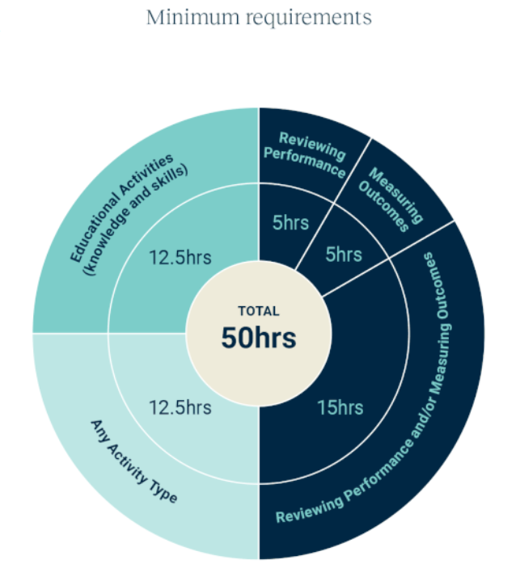
WVPHN – Your CPD Centre
Attend all 5 sessions in series
We are here to help you complete your CPD requirements for the 2023-25 Triennium
Project ECHO
accredited as a Peer Group Learning (PGL) Activity with RACGP and ACRRM
eligible for Reviewing Performance hours
If a GP attends
Each of the 5 ECHO sessions in a series
We upload 5 Reviewing Performance hours to your CPD Dashboard
Add in a QI activity
Related to the ECHO series
Developed and supported by PFs
5 Measuring Outcomes hours
Minimum Annual Requirements
Add in a 5hr QI activity

Slide 15
Agenda for COVID and Communicable Diseases Network Series 12: Session 5 Responding to the common problem of Bacterial vaginosis
Facilitator: Dr Bianca Forrester, Clinical Lead of Innovation and Learning, Western Victoria PHN
Naomi White, Senior Manager Regional Partnerships and Public Health, Western Victoria PHN
New announcements
Dr Kate Graham, GP and Clinical Editor – HealthPathways and COVID Clinical Advisor, Western Victoria PHN
STI swabs in primary care
Dr Sarah Huffam, Infectious Disease and Sexual Health Physician, Barwon Health and BSW PHU
Sexually Transmitted Infections – Bacterial Vaginosis
Case presentation: Dr Bianca Forrester
Network Co-ordinators: Whitney Flower and Jemma Missbach, Western Victoria PHN

Slide 16
COVID - Expanded access to subsidised Paxlovid
From 1 April 2023, patients may be eligible for a PBS-subsidised prescription of Paxlovid if they test positive to COVID-19, and are:
70 years of age or older,
60-69 years of age with one risk factor,
50‑59 years of age with two risk factors,
First Nations person 30 years of age or older and with one risk factor,
18 years of age or older
with moderate to severe immunocompromise, or
who have been previously hospitalised from COVID-19 disease, and subsequently reinfected.
Minister Butler announced on March 30th and live from April 1st. - Awaiting PBS updates
Notes:
Thursday 30 March, the Minister for Health and Aged Care announced a change to eligibility under the Pharmaceutical Benefits Scheme (PBS), for the COVID-19 oral treatment Paxlovid (nirmatrelvir and ritonavir), for individuals aged 60‑69 years with one risk factor. The change will ensure greater access to Paxlovid for people who are at risk of severe disease. The expansion means that if an individual is 60-69 years and has particular conditions, (for example, diabetes, obesity, moderate to severe asthma), they may be eligible for PBS‑subsidised Paxlovid.
Expanded access to subsidised oral antiviral Paxlovid and other COVID-19 supports | Health Portfolio Ministers and Aged Care

Slide 17
COVID Antivirals
The PBS eligibility criteria for molnupiravir (Lagevrio®) remain unchanged. Patients may be eligible for a PBS-subsidised prescription of Lagevrio if they test positive to COVID-19, and are:
70 years of age or older,
50‑69 years of age with two risk factors,
First Nations person 30 years of age or older and with one risk factor,
18 years of age or older
with moderate to severe immunocompromise, or
who have been previously hospitalised from COVID-19 disease, and subsequently reinfected.
The Pharmaceutical Benefits Advisory Committee recommend that Lagevrio should be considered for use only if Paxlovid is contraindicated or otherwise unsuitable.
Notes:
If you have a patient who is 60-69 years of age with one risk factor, but where contraindications have been carefully assessed and it is concluded that Paxlovid use is contraindicated, that patient would not be eligible for a PBS-subsidised prescription for the alternative oral COVID-19 antiviral Lagevrio, (assuming no other restriction, for example, moderate to severe immunocompromise, is relevant). However, if treatment with Lagevrio is deemed clinically necessary it is recommended prescribers consider contacting their relevant state or territory health department for supply of Lagevrio outside of the PBS.

Slide 18
COVID vaccination Grant opportunity
Grants of $3000 to vaccinating clinics
Must either operate in MMM regions 4-7 or be MMM 1-3 planning to do a pop up in a 4-7 area to be eligible
Grants available for extending hours, increasing vaccination staff, pop up community clinics
A GEM Flyer has been sent to vaccinating clinics
All responses via EOI document to tenders@westvicphn.comau
If you can questions or request flyer resent please email covidenquiry@westvicphn.com.au
STILL OPEN!
Grants available!!

Slide 19
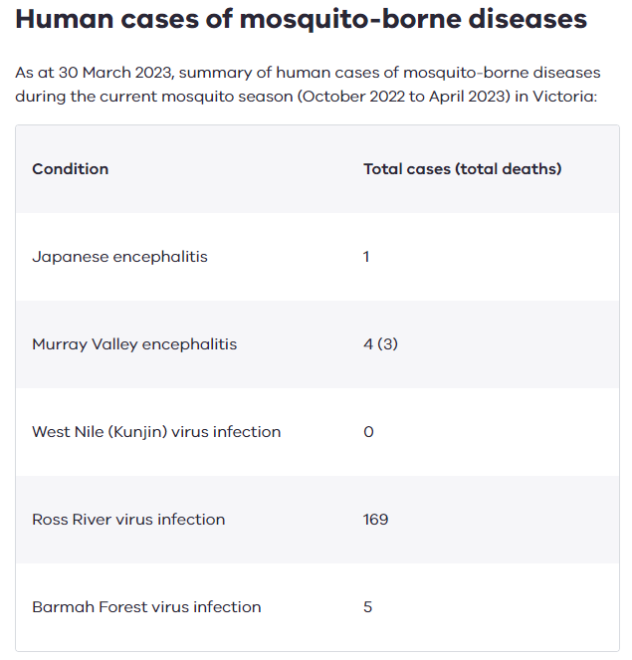
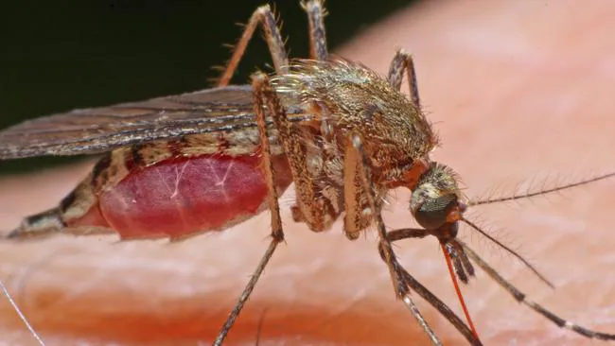
Health Alert
For more information see the Mosquito surveillance report.
Beat-the-bite-brochure.pdf (betterhealth.vic.gov.au)
Protect yourself from mosquito-borne disease - Better Health Channel
Notes:
MVE - Murray Valley encephalitis (health.vic.gov.au)
JEV – Update on Japanese encephalitis and Murray Valley encephalitis in Victoria | health.vic.gov.au
Japanese encephalitis virus (JEV) | Australian Government Department of Health and Aged Care
Mosquito borne diseases Mosquito-borne diseases (health.vic.gov.au)

Slide 20
STI swabs in primary care
Follow HP
Symptomatic vs asymptomatic
Think about which sites to swab – risk and best capture rate

Slide 21
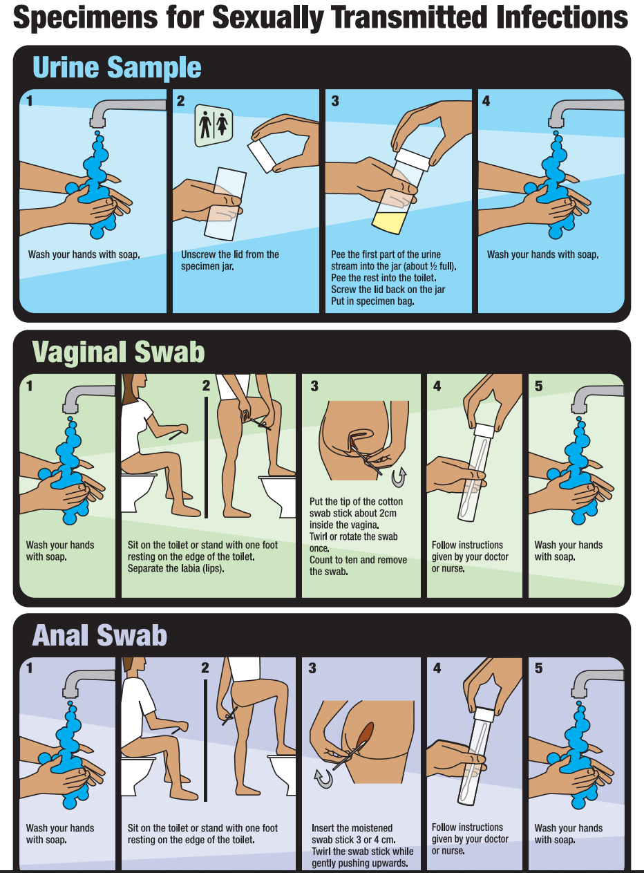
SELF_TESTING_CARD.pdf (nsw.gov.au)

Slide 22
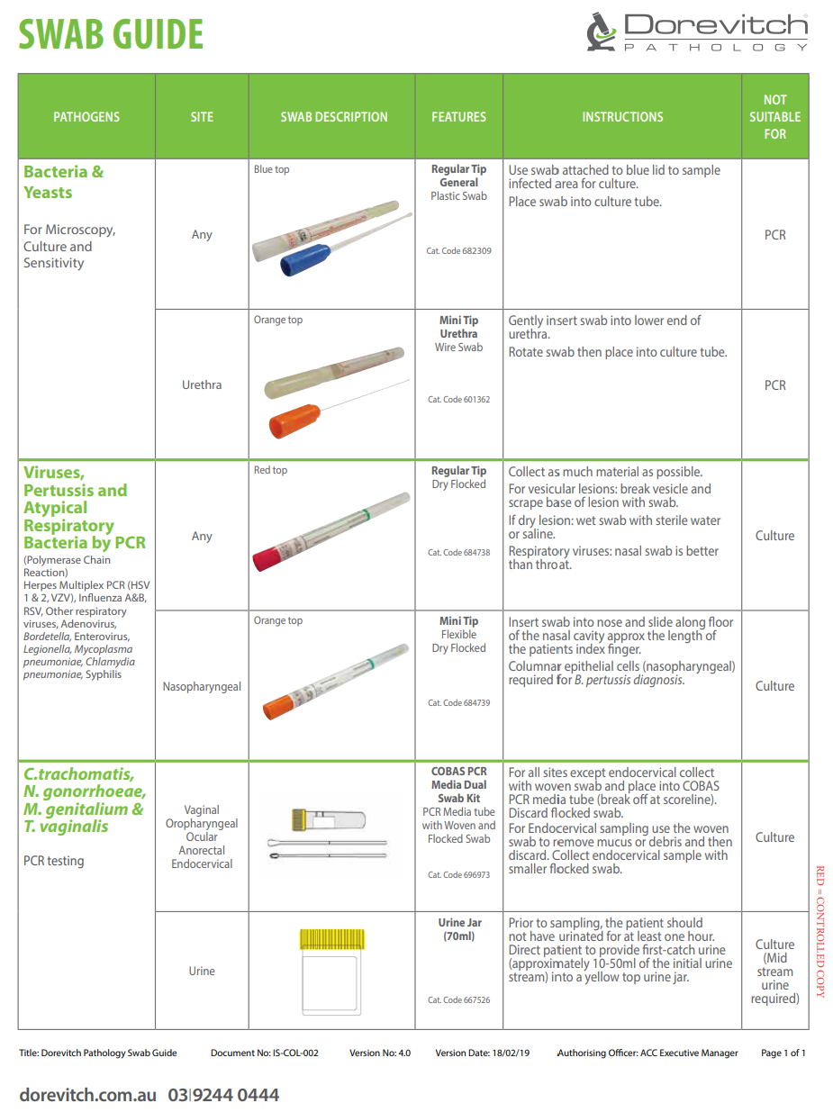
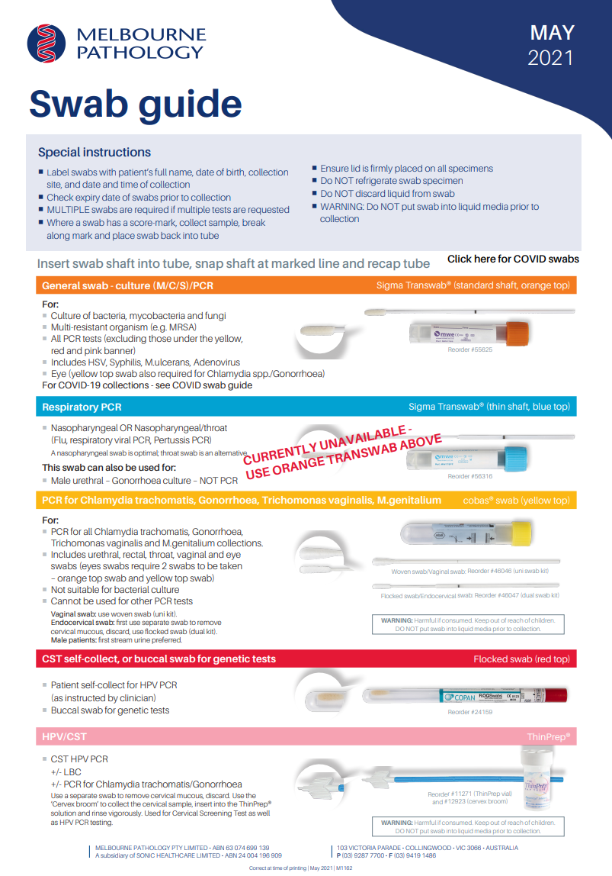
e6a0cef0-4422-43b9-8d36-921572b4900b.pdf (healius.com.au) swab-guide-vic-sa-aclmar-bf-vicsa-00154-pms.pdf (clinicallabs.com.au) swab-guide-may2021-final-with-link-to-covid-swabs_new-oct21-link.pdf (mps.com.au)

Slide 23
Sexually Transmitted Infections
Dr Sarah Huffam
Infectious Diseases and Sexual Health Physician

Slide 24
Contents
Bacterial Vaginosis

Slide 25
Bacterial Vaginosis
Most common cause of abnormal vaginal discharge in people of childbearing age.
Cause:
A polymicrobial dysbiosis characterised by a change from a Lactobacillus dominant state to one with high diversity and quantities of anaerobic bacteria including Gardnerella vaginalis, Atopobium vaginae, Mobiluncus spp, Prevotella spp, and other BV-associated bacteria. A polymicrobial biofilm adherent to vaginal epithelial cells has been identified of people with BV.
Sexual transmission of BV has not been established however there is a strong association between acquisition of BV and young age of first sex, increased numbers of sex partners, exposure to new sex partners and lack of condom use for penile-vaginal sex.
BV-associated bacteria are present in the urethra and penile skin in partners of people with BV and women who have sex with women show very high concordance for bacterial vaginosis within partnerships.
Post-treatment recurrence of BV is associated with exposure to an ongoing sex partner and lack of condom use for penile-vaginal sex.

Slide 26
Clinical presentation
Symptoms
Malodorous vaginal discharge Thin white or greyish homogenous vaginal discharge Commonly asymptomatic (up to 50%)
Complications
Increased risk of: spontaneous abortion premature labour chorioamnionitis postpartum endometritis pelvic inflammatory disease (including after surgical termination of pregnancy, intra-uterine device (IUD) insertion or other gynaecological instrumentation) acquisition of chlamydia, gonorrhoea, herpes simplex type 2 acquisition and transmission of human immunodeficiency virus (HIV) infection.

Slide 27
Clinical Indications for testing
Symptoms of bacterial vaginosis: abnormal vaginal discharge and/or malodour
Test for STIs at time of diagnosis, or particularly if symptoms persist despite treatment
Evidence does not support routine screening for bacterial vaginosis in low risk pregnancies, before surgical termination of pregnancy or insertion of an IUD in asymptomatic people.

Slide 28
Diagnosis
Clinical diagnosis is made using Amsel criteria;
If 3 or 4 of 4 criteria are present, presumptive treatment can be offered.
Specimen collection:
Clinician collection ensures visualisation of secretions and measurement of vaginal pH; microscopy can be performed on self-collected or clinician collected swabs smeared on a slide.
Special considerations
Isolation of Gardnerella vaginalis (by NAAT) is reported by some laboratories but cannot be used to diagnose bacterial vaginosis as this organism can also be isolated in people with an optimal vaginal microbiota and no bacterial vaginosis.
If your laboratory uses NAAT testing, speak to your pathology provider about its comparative performance..

Slide 29
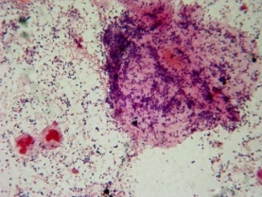
BV diagnostic methods
Amsel criteria; (Amsel Am J Med 1983)
Requires speculum examination
BV requires 3 or 4 Amsel criteria
thin watery homogenous discharge
elevated vaginal pH (≥4.5)
a fishy odour (10% potassium hydroxide liberates volatile amines from vaginal secretions); if you can smell it is a positive “whiff test”
the presence of more than 20% of clue cells (vaginal epithelial cells studded with GV/GN coccobacilli)
Slide courtesy of Dr Catriona Bradshaw MSHC

Slide 30
Nugent Method
“Gold standard” widely used in clinical trials
20 years old, rarely used by private labs
Scores vaginal bacterial morphotypes on Gram stained vaginal smear
Loss of lactobacilli (0-4)
Increasing GN/GV rods (0-4)
Presence of mobiluncus spp.(0-2)
Nugent Scores
0-3: Normal flora
4-6: Intermediate flora
7-10: Bacterial vaginosis
Slide courtesy of Dr Catriona Bradshaw MSHC
Notes:
The Nugent method is a more objective method with less inter and intra-observer variability
It scores bacterial morphotypes according to loss of LB, increasing GV/GNR & presence of MOB spp.
0-3 = normal flora, 4-6 intermediate and 7-10 = BV
However the Nugent method is time-consuming, requires significant experience, & while it is the standard for clinical trials is rarely used in clinical practice
In addition the significance of the category “intermediate flora” is unclear. It is thought that this group may represent a state of transition to or from BV, and we do know that they are at increased risk of obstetric complications and HIV acquisition when compared to women with normal flora. Intermediate flora often causes diagnostic and management dilemmas in clinical practice and in studies.

Slide 31
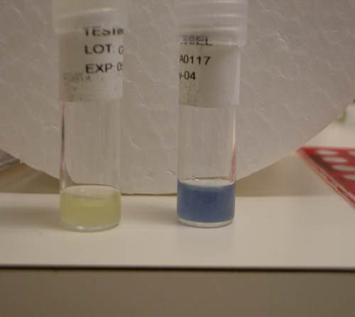
Other BV diagnostic methods
Molecular based diagnostic assays:
NAAT tests i.e. BD Max™, NuSwab® and SureSwab™
identify and quantify multiple organisms associated with nonoptimal/optimal VM (i.e. Gardnerella vaginalis, Atopobium vaginae, Megasphaera, BVAB2, L. crispatus)
Point of Care tests:
chromogenic tests i.e. OSOM®, BVBlue® detect elevated levels of the sialidase enzyme
The VGTest™ determines the levels of the malodorous biogenic amines associated with BV
Slide courtesy of Dr Catriona Bradshaw MSHC

Slide 32
Management
Principal treatment option
Situation | Recommended | Alternative
Symptomatic bacterial vaginosis NB intravaginal preps may affect condom integrity | Metronidazole 400 mg PO, BD with food for 7 days. OR Metronidazole 0.75% gel 5 g, intravaginally nocte for 5 nights (not on PBS). OR Clindamycin 2% vaginal cream 5 g, one applicator intravaginally nocte for 7 days (not on PBS). | Clindamycin 300 mg PO, BD for 7 days. OR Metronidazole 2 g PO, stat.
Treatment advice
Treatment is aimed at alleviating symptoms or offered to asymptomatic people requesting treatment.
Stat. dose and short-duration regimens are associated with higher rates of recurrence.
Patients should refrain from vaginal penetrative sexual practices or use condoms consistently during treatment.
Douching and intravaginal cleaning practices should be avoided

Slide 33
Treatment considerations
BV diagnosed or suspected at the time of IUD insertion should be treated with no need to delay the procedure; for surgical abortion antibiotic prophylaxis refer to Therapeutic Guidelines (eTG ) and local guidelines.
Copper IUDs have been associated with increased risk of BV acquisition and recurrence. If the patient experiences recurrent bacterial vaginosis with a copper IUD consider switching to an alternative method.
> 50% of people experience post-treatment recurrence within 3-12 months.
There is currently insufficient evidence to recommend the use of intravaginal lactic acid or vaginal probiotics.
Treatment is not currently recommended in partners but trials are ongoing.

Slide 34
Special situations
Situation | Recommended
Breastfeeding | Consider intravaginal treatment. Metronidazole may affect taste of breast milk; avoid high doses in breastfeeding.
Pregnancy | Standard treatment is recommended if symptomatic. There is no clinical benefit of treatment for asymptomatic patients in low-risk pregnancies.
Recurrent infection | Intravaginal metronidazole 0.75% gel 5 g twice per week for 4 months reduces recurrence during treatment, although this benefit does not persist when discontinued. Intravaginal boric acid regimens (via compounding pharmacy) have also been used but have not shown sustained benefit on discontinuation. Seek specialist advice if required.
Allergy to principal treatment choice | If allergic to nitroimidazoles, use clindamycin.

Slide 35
Contact tracing
Contact tracing is not indicated
There are insufficient data to recommend treatment of partners with a penis
Assessment of partner(s) with a vagina is recommended as concordance is high (see women who have sex with women).

Slide 36
Resources
Australasian STI management guidelines https://sti.guidelines.org.au/
MSHC: history and examination, treatment guidelines partner notification, patient fact sheets, education modules + much more https://www.mshc.org.au/
Australasian contact tracing guidelines 2022 https://contacttracing.ashm.org.au/
Let Them Know https://letthemknow.org.au/
ASHM decision making tools for PrEP, Syphilis, HCV, HBV, Mpox, HIV, etc https://ashm.org.au/resources/
ASHM PrEP guidelines https://www.ashm.org.au/resources/the-ashm-national-prep-guidelines/
ASHM Post Exposure Prophylaxis for HIV – Australian National Guidelines https://www.ashm.org.au/resources/post-exposure-prophylaxis-for-hiv-australian-national-guidelines/
ASHM HIV guidelines https://www.ashm.org.au/resources/antiretroviral-guidelines/
Centre for Excellence in Rural Sexual Health (CERSH) 12 modules, free, online, Online Learning Modules (unimelb.edu.au) (RACGP and ACRRM accredited, CPD points)
Rainbow ready roadmap https://www.vic.gov.au/rainbow-ready-roadmap

Slide 37
Case Presentation: 34 YO Female with postcoital bleeding
Situation: 34 YO F with postcoital bleeding for 1 month.
New male sexual partner 12/12
Implanon 24/12.
No vaginal discharge, intermenstrual bleeding, pelvic discomfort or urinary complaints.
UTD with CST (NAD).
Recently started anal sex as worried about getting PCB.
Background: PMH ADHD current meds: Ritalin
Assessment: Post coital bleeding STI check Safe sex and Anal sex safety Partner's history and testing
Recommendation:
Examination and investigation: cervical exam (normal),
Co HPV test, High vaginal swabs for MCS, endocervical swabs for chlamydia and gonorrhoea performed.
Swabs grow bacterial vaginosis. all other test negative.
Discussed can be implanon related bleed, need to monitor for next few months, if still there will consider early replacement of implanon or alternate contraception. Plan to see partner in next consult.
Question: 1. Can bacterial vaginosis present with bleed?
2. Does it require treatment even if asymptomatic? 3. Is pelvic US recommended in this scenario? 4. How to approach PCB in general?
Notes:
Case template link https://forms.office.com/r/JGtcXzehKJ

Slide 38
Next Series: Reproductive Health- 2 “Sprint” in Term 2 and 3 Knowledge ECHOs, Regional change project - service access
Early Medical abortion access
Early Medical abortion management of complications
LARC contraception- your questions answered
Heavy menstrual bleeding and pain management in primary care
Chronic Pelvic pain assessment and management
ECHO “Season” 5 x consecutive weeks
From late May/early June
Community activities May:
Mini audit
Submit cases
Work with Prac fac to improve data quality
CoP improvement interviews
Project activities in May:
Building partnerships between LPHU and women’s health promotion
O&G specialist services
Other key stakeholders
Service mapping
Reviewing your cases and designing the series
Building “Data club” for term 3
Topics

Slide 39
Upcoming webinar – Cervical Screening
How to optimise the use of self-collection and manage your patients’ follow-up
Speaker:
Dr Alexis Butler - GP Liaison Physician, VCS Pathology, Australian Centre for the Prevention of Cervical Cancer
Learning Outcomes:
Discuss the advantages and disadvantages of the HPV self-collection option to support your patient to make an informed choice
Discuss the appropriate follow up for abnormal self-collection results
Describe the different self-collection testing processes now available in primary care.
Thursday 4th May 7.00pm - 8.00pm
Webinar
Register here

Slide 40
The Primary Care Conference 2023 will again be a hybrid event
attend virtually, or
face-to-face across four locations in western Victoria - Geelong, Ballarat, Horsham, Warrnambool
Face-to-face venues also offer optional:
social networking events on Saturday afternoon
emergency medicine skills training on Sunday afternoon
The program offers a dynamic combination:
Plenary Sessions: Keynote speakers, panel discussions
GP Stream: will cover topics relating to GPs
Primary Care Stream: topics relating to GPs, practice managers, practice nurses, practice staff and allied health professionals
Conference Registration
Register here
FREE (may be a cost for clinical skills)
Via WVPHN website or subscribe to WestVic News
Notes:
A special mention for our upcoming Primary Care Conference. This is a hybrid conference where you can attend from Geelong, Horsham, Warrnambool or Geelong venues, or dial in remotely. The theme for 2023 is Toddler to Teen Health. Registrations open on 3 April so keep an eye out for that.
For chat:
Follow this link to register: Primary Care Conference | Western Victoria Primary Health Network (westvicphn.com.au)

Slide 41
Upcoming Intellectual Disability Project ECHO series
Commencing Tues 9 May, 7pm – 8pm
Register here
Date/Time | Session Topic
Tues 9 May, 7 - 8pm | A Deep Dive into Positive Behaviour Supports
Tues 23 May, 7 - 8pm | Things health professionals must consider before prescribing or increasing psychotropic medication
Tues 6 June, 7 - 8pm | The Impact of Diet (Part 1)
Tues 20 June, 7 - 8pm | The Impact of Diet (Part 2)
Notes:
Click here to register: Project ECHO - Intellectual Disability Information and Education Series | Western Victoria Primary Health Network (westvicphn.com.au)

Slide 42
Notes:
https://ashm.eventsair.com/QuickEventWebsitePortal/cersh-sexrurality-2022/home

Slide 43
Evaluation
Session evaluation
Please take the time to evaluate this session
Link pasted into the chat
Upcoming Sessions
Series 13 commencing in May
If you have a case, you would like to discuss with the group:
Case template here
Email projectechocovid19@westvicphn.com.au
Use the comment box in the evaluation form
Notes:
Session evaluation link https://forms.office.com/r/cqYkZh1gUQ
Case template link https://forms.office.com/r/JGtcXzehKJ

