Slide 1
Primary care, unintended pregnancy, LARC and medical abortion
Professor Danielle Mazza AM
MD, MBBS, FRACGP, DRANZCOG, Grad Dip Women’s Health, GAICD, CF
Head, Department of General Practice, Monash University
Director, NHMRC SPHERE Centre of Research Excellence

Slide 2
Perspectives I bring
Practicing GP
Churchill Fellow – integrating medical abortion into primary care
Former:
  Medical Director of Family Planning Victoria
  Board member of South-East Melbourne Primary Health Network (2016-2022)
Currently:
  Professor of General Practice, Monash University
  Director of the NHMRC funded SPHERE Centre of Research Excellence in in Women's Sexual and Reproductive Health in Primary Care
  Chair of the Royal Australian College of General Practitioner’s preventive care guideline group
  Member, National Women’s Health Advisory Council
  Member of the:
    National Endometriosis advisory group
    TGA women’s health product advisory group

Slide 3
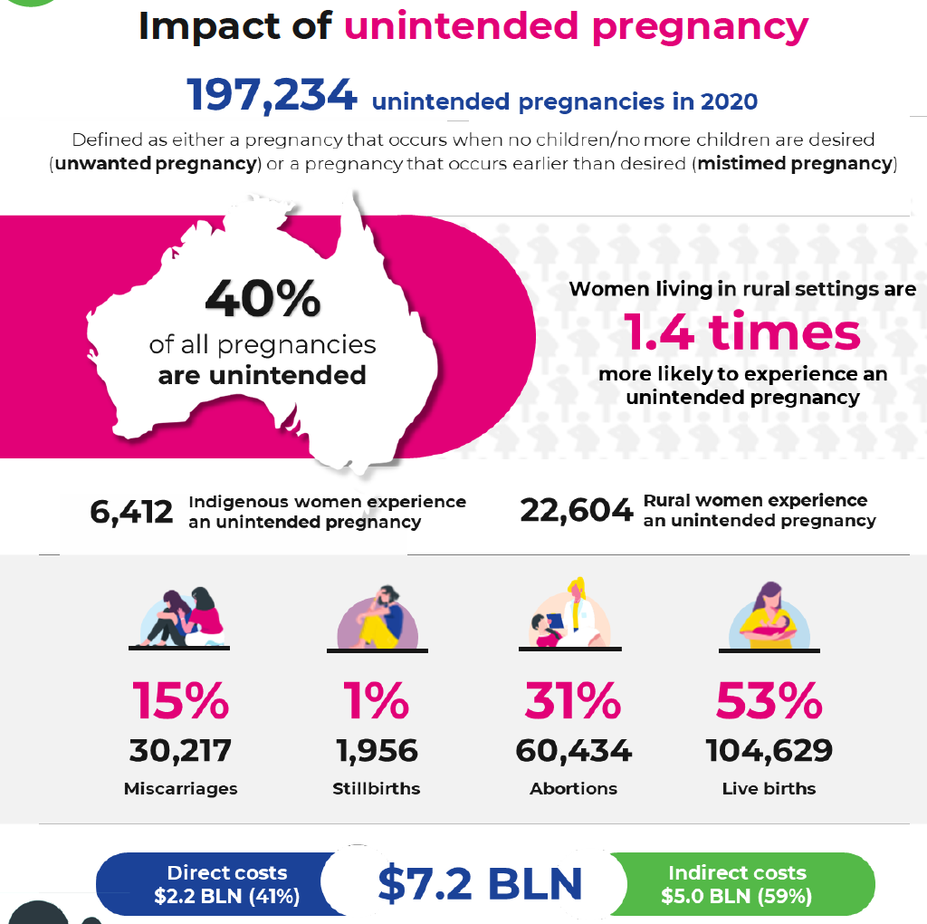
The burden of unintended pregnancy in Australia
Organon Report into Unintended Pregnancy in Australia Sept 2022.
Rowe H, Holton S, Kirkman M, Bayly C, Jordan L, McNamee K, McBain J, Sinnott V, Fisher J. Prevalence and distribution of unintended pregnancy: the Understanding Fertility Management in Australia National Survey. Aust N Z J Public Health. 2016 Apr;40(2):104-9.

Slide 4
What do we need to do to reduce unintended pregnancy?
Improve access to effective forms of contraception to prevent pregnancy
Improve access to safe abortion when required for unintended pregnancy

Slide 5
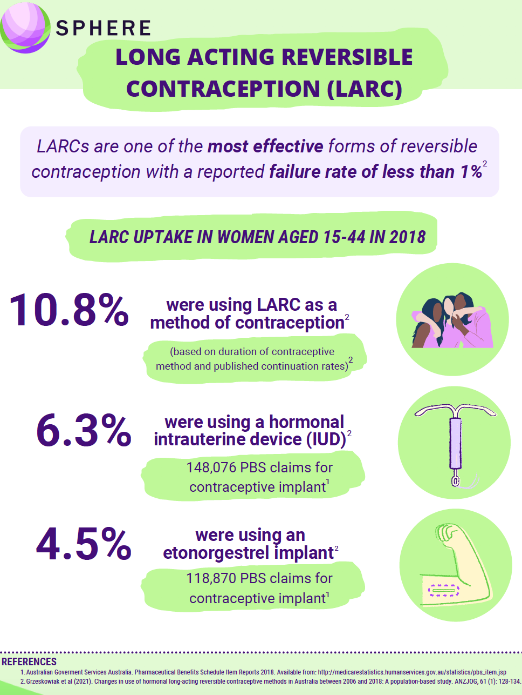
International benchmark:
20-25%
LARC use
Sweden = 31% in 2019 majority IUDs

Slide 6

Best Practice = Access to and choice of either a surgical or a medical method of abortion
Less time sensitive
Most are undertaken <12 weeks but can be done later in pregnancy
Performed under sedation in a private day surgery or public hospital facility
Supervised by medical staff
Involves less bleeding and cramping
Highly time sensitive (<9 weeks in Australia)
High level of personal autonomy
Undertaken at home with support of friends +/or family
Can feel more “natural” like a very heavy period or miscarriage
Can be delivered by telehealth

Slide 7
What is our current workforce?
10% of GPs nationally
No formal GP trainee training
70-80% of GPs nationally
All GP trainees are being trained
Unknown number of GPs nationally
No formal GP trainees training
Following training low number commence and not all sustain practice

Slide 8

Accessible high quality comprehensive women’s sexual and reproductive health services delivered in primary care
5.57 million women of reproductive age in Australia
General practice and primary care
Preconception Care
Contraception
Abortion

Slide 9
A new vision for general practice and primary care women’s sexual and reproductive health service provision
x
a paradigm shift in the way general practitioners and other primary care providers provide care
transforming a siloed style of practice into one that recognises the interconnectedness of contraception, abortion and pregnancy planning for individual women
using an integrated life course approach to help women achieve their own reproductive goals.

Slide 10

SPHERE Partners
Department of Health and Aged Care
Royal Australian College of General Practitioners (RACGP)
Australian College of Rural and Remote Medicine (ACRRM)
Royal Australian & New Zealand College of Obstetrics and Gynaecology (RANZCOG)
Pharmaceutical Society of Australia (PSA)
Australian Practice Nurse Association (APNA)
Australian Women’s Health Nurse Association (AWHNA)
Australian Sexual Health Nurse Association(ASHNA)
Australian Commission on Safety and Quality in Health Care (ACSQHC)
Family Planning Organisations from Vic, NSW, Tas, the NT, SA and WA
Children by Choice from QLD
Jean Hailes For Women’s Health
Marie Stopes Australia
Bayer Healthcare
Organon

Slide 11




SPHERE strategies to improve access and equity
Promoting evidence-based practice
Workforce support
New models of care, rural health & workforce solutions
The ACCORd Trial to improve LARC uptake

Slide 12

https://www.spherecre.org/coalition

Slide 13
ACCORd: Increasing LARC uptake through general practice
Cluster RCT undertaken in general practices in metropolitan Melbourne
Resulted in greater LARC uptake and reduced unintended pregnancies and abortions in women attending intervention GPs
Intervention consisted of a combination of:
Online GP training on effectiveness based contraceptive counselling and
Rapid access to LARC insertion clinics
 | intervention | control | significance
4 weeks | 19.3% | 12.9% | RR 2.0; 95% CI 1.1-3.9; P=0.033
6 months | 44.4% | 29.3% | RR 1.6; 95% CI 1.2-2.17; P=0.001
12 months | 46.6% | 32.8% | RR 1.5; 95% CI 1.2-2.0; P=0.0015
3 years | 41% | 28% | P=0.019
Intervention versus control participants had significantly fewer:
unintended pregnancies (3.1% and 6.3%; odds ratio (95% CI)=0.38 (0.16, 0.86), P=0.021) and
abortions (0.9% and 3.6%; odds ratio (95% CI)=0.10 (0.02, 0.50), P=0.0051).
Mazza D, Watson CJ, Taft A, Lucke J, McGeechan K, Haas M, McNamee K, Peipert JF, Black KI. Increasing long-acting reversible contraceptives: the Australian Contraceptive ChOice pRoject (ACCORd) cluster randomized trial. Am J Obstet Gynecol. 2020 Apr;222(4S):S921.e1-S921.e13.

Slide 14
Abortion “deserts” in Australia
about 30% of women in Australia lived in SA3s in which MS-2 Step had not been prescribed by a GP during 2019, including about 50% of those in remote Australia
MS-2 Step prescribing and dispensing during 2019, by level 3 statistical area (SA3)
Subasinghe AK, McGeechan K, Moulton JE, Grzeskowiak LE, Mazza D. Early medical abortion services provided in Australian primary care. Med J Aust. 2021 Oct 18;215(8):366-370. doi: 10.5694/mja2.51275. Epub 2021 Sep 22. PMID: 34553385.

Slide 15
MBS Item Numbers for Telehealth Sexual and Reproductive Health Care Consultations
Introduced July 1st 2021
No patient restrictions
Time based phone and video consultations
Cover any aspect of Sexual and Reproductive Health and Blood Borne Virus care eg contraception, abortion, menopause
Service | Telehealth items via video-conference | Telephone items
Professional attendance for the provision of services related to blood borne viruses, sexual or reproductive health by a general practitioner of not more than 5 minutes | 92715 | 92731
Professional attendance for the provision of services related to blood borne viruses, sexual or reproductive health by a general practitioner of more than 5 minutes in duration but not more than 20 minutes | 92718 | 92734
Professional attendance for the provision of services related to blood borne viruses, sexual or reproductive health by a general practitioner of more than 20 minutes in duration but not more than 40 minutes | 92721 | 92737
Professional attendance for the provision of services related to blood borne viruses, sexual or reproductive health by a general practitioner lasting at least 40 minutes in duration | 92724 | 92740

Slide 16
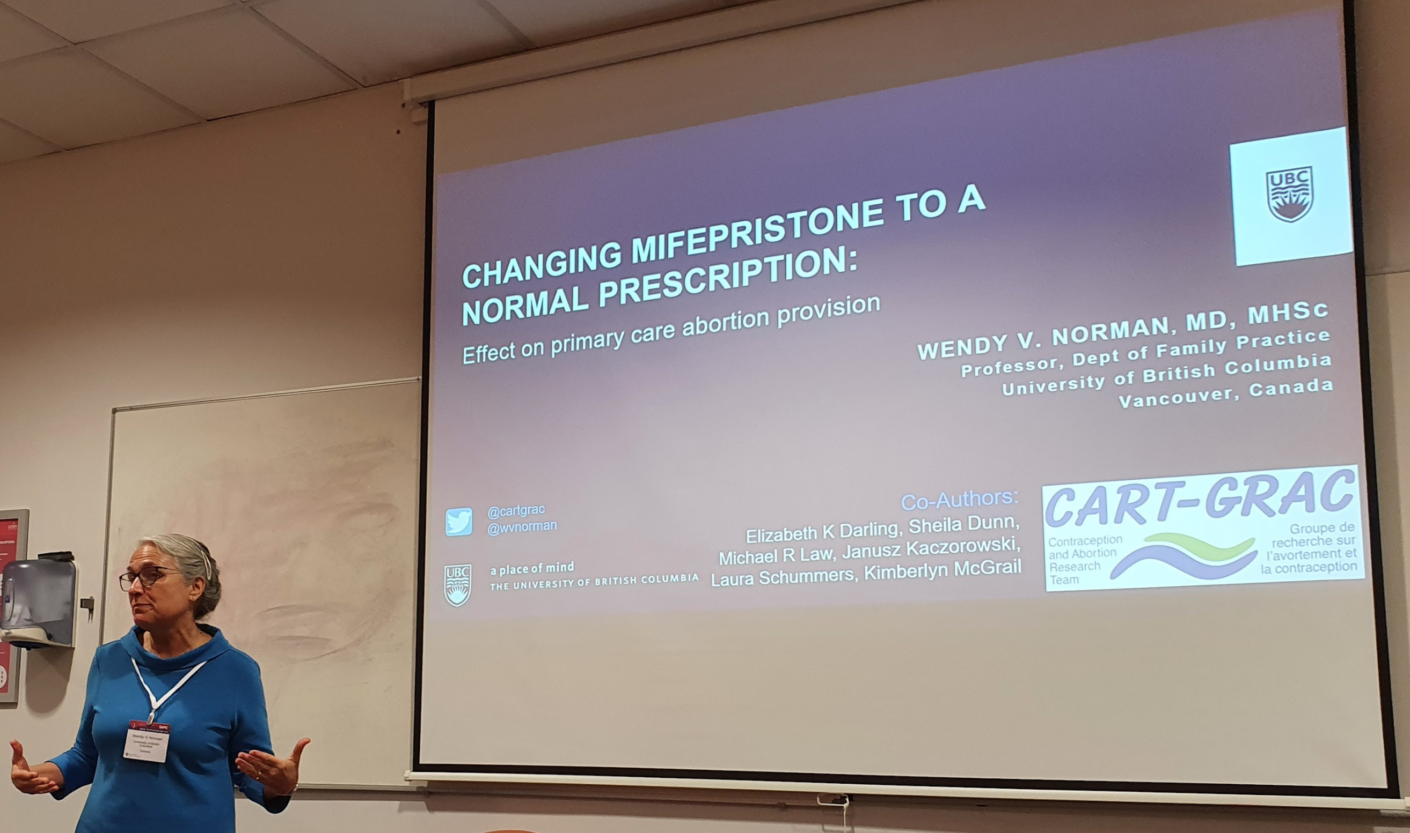

When medical abortion is available as a normal prescription:
abortion rate & safety did not change
The number of providers of abortion tripled
Rural areas had a twelve-fold increase in providers
Nine percent of abortions providers are Nurse Practitioners (providing nearly 1% of abortions)
New England Journal of Medicine. 2022;386(1):57-67.
@wvnorman @cartgrac @ubc
Notes:
Here, we se the abortion rate
Where see a pre-mifepristone decline in the abortion rate, followed by a small increase in the number of abortions per 1,000 reproductive aged females after mifepristone was available and unrestricted

Slide 17
TGA and PBAC regulatory reform re MS2Step
Up till August 1st | From August 1st
GPs had to undertake mandatory training in order to register to prescribe | No requirement for mandatory training or certification
GP prescribers had to reregister every 3 years
Individual pharmacists needed to register to dispense MS2Step | All pharmacies can dispense
Prescription restricted to medical practitioners | Nurse practitioners and endorsed midwives can prescribe (subject to state legislation)
MS Health needed to provide a 24/24 helpline for patients | Patients can utilize healthdirect
Gestational limit of 9 weeks | Gestational limit of 9 weeks continues

Slide 18


Slide 19

Funding and Partners
This project is funded through an NHMRC Partnership Grant
Notes:
Sharon
We would like to acknowledge that this research is funded by an NHMRC partnership grant and the role of our partners in the development of the AusCAPPS network.

Slide 20
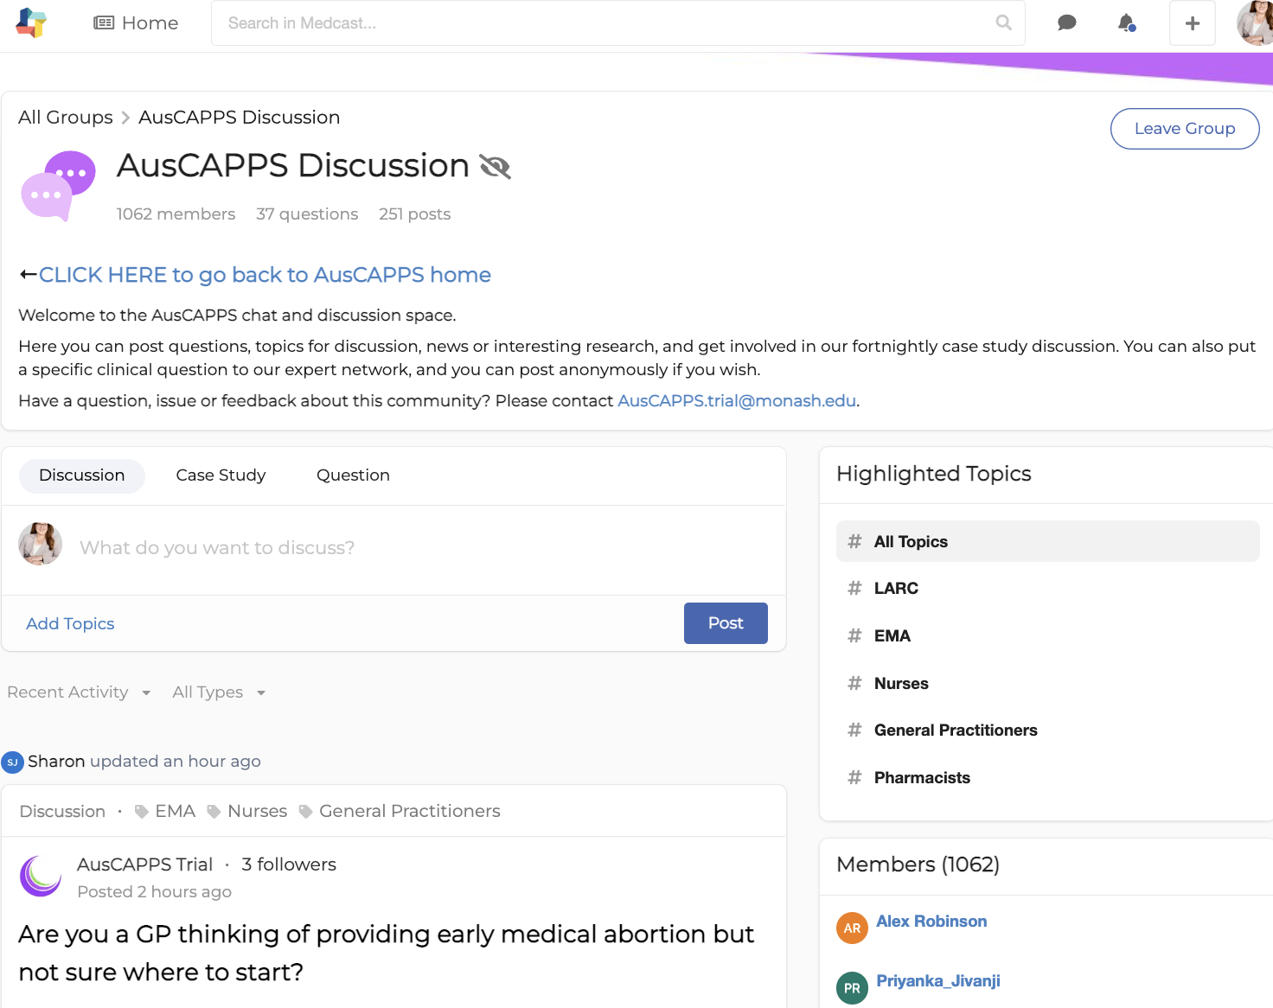
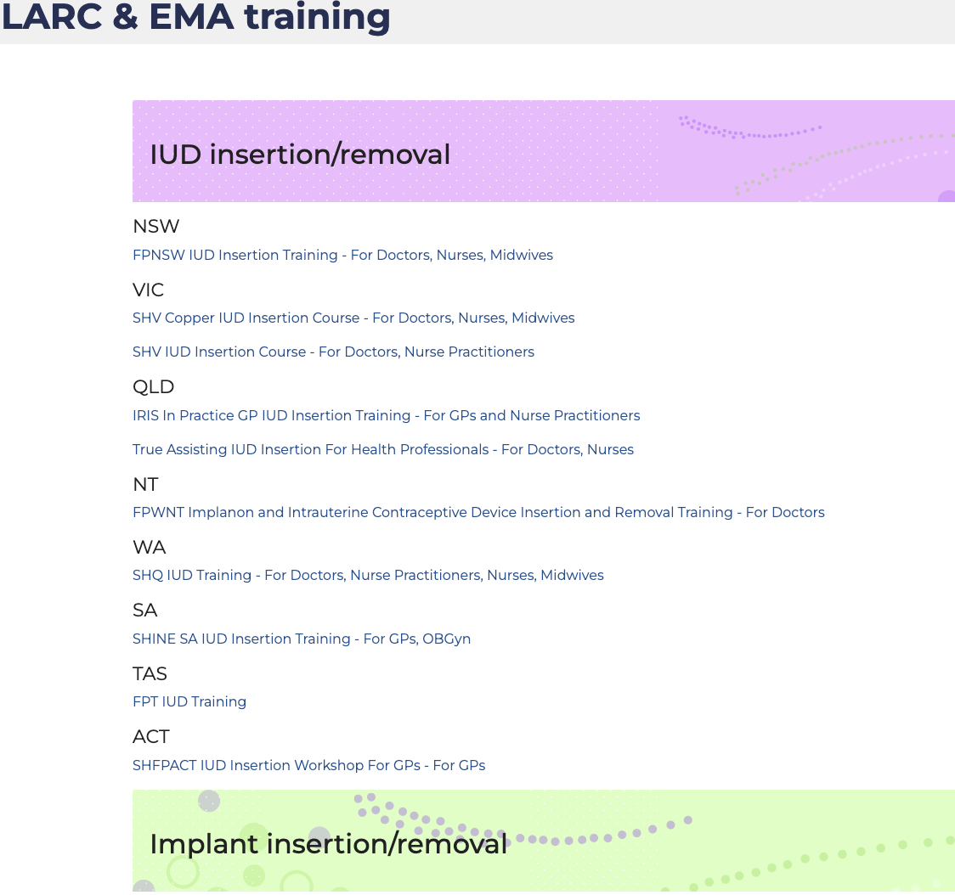
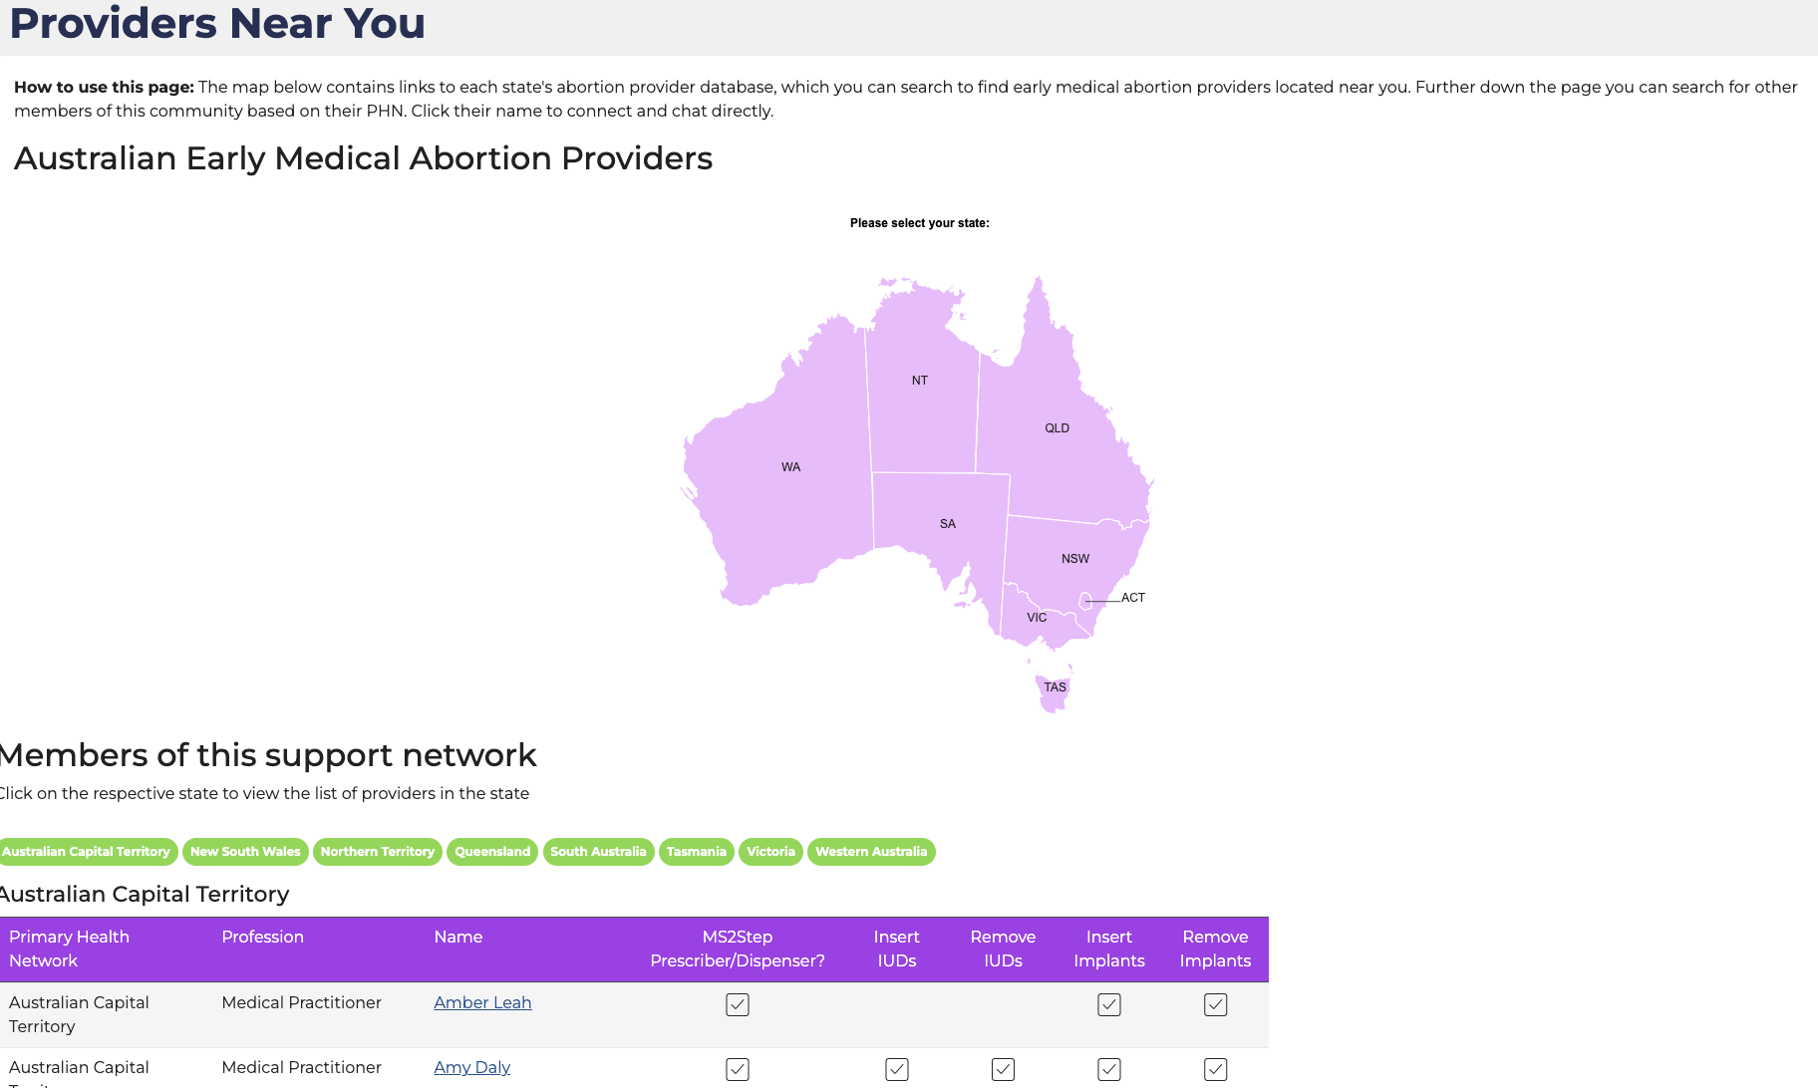
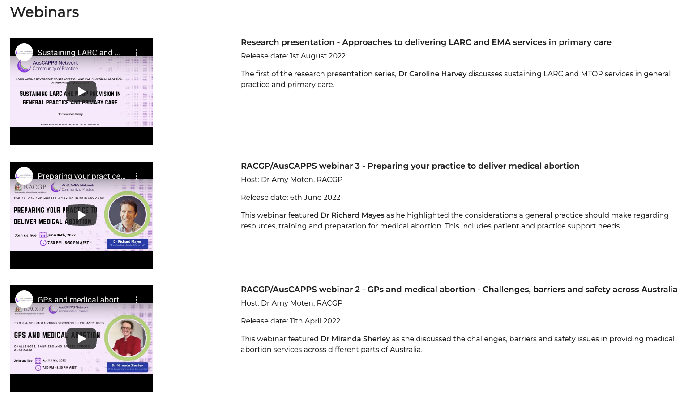
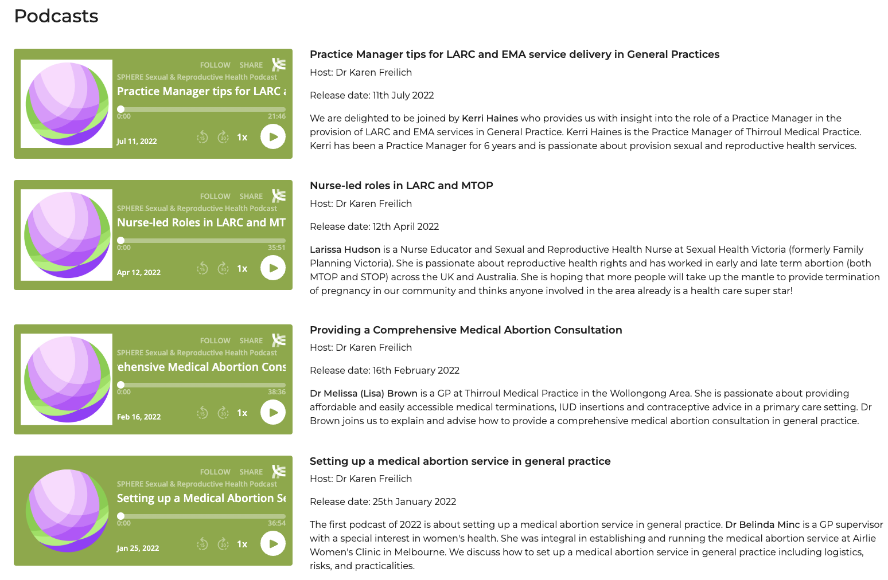
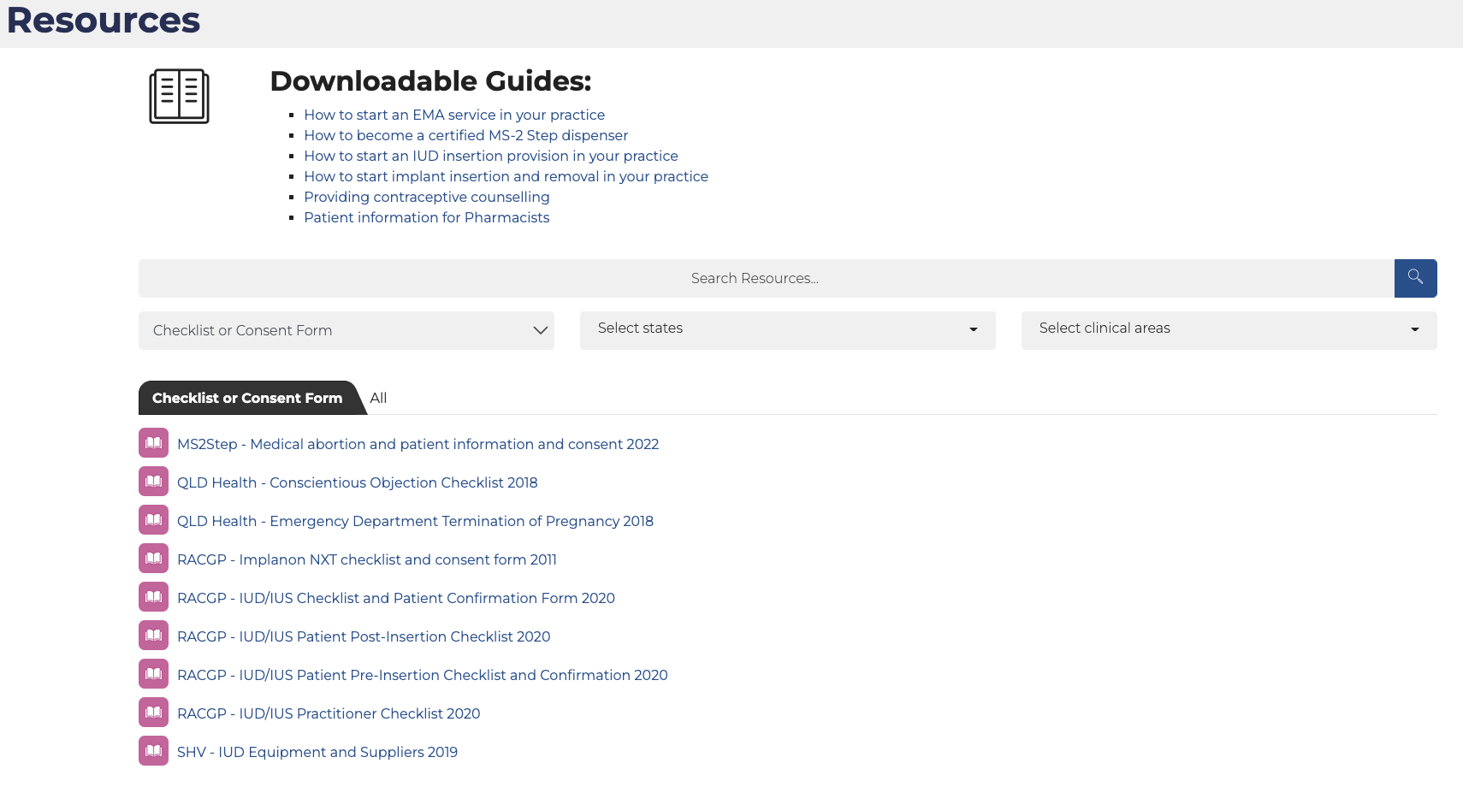

Slide 21
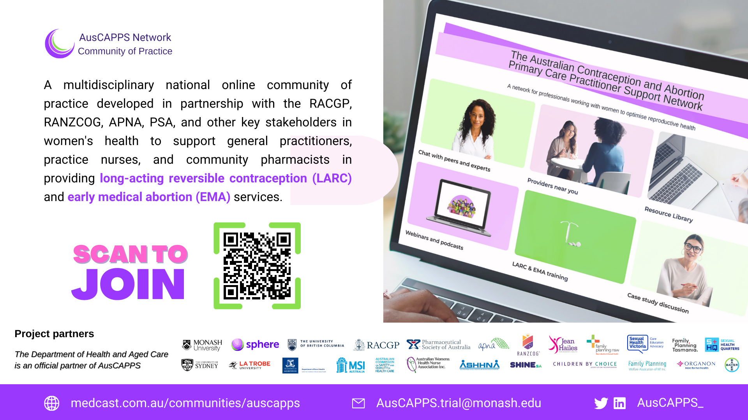

Slide 22

Aim: To assess the effectiveness of a nurse-led model of care (involving task-sharing, and where appropriate implant insertion by nurses and telehealth) in general practice for improving women’s uptake of LARC and access to medical abortion in rural and regional areas
Design: a five-year pragmatic cluster RCT with a stepped-wedge approach in 32 rural and regional practices
Implementation Support:
  Training in implant insertion and removal
  Online education
  Academic Detailing
  Support through the AusCAPPs online Community of Practice

Slide 23

The ALLIANCE community pharmacy intervention
Builds on ACCORd and Bridge-IT
Aim: To assess the effectiveness of a pharmacy based intervention at increasing uptake of effective (hormonal or intrauterine) contraception post ECP or medical abortion
Design: Four year step wedge trial involving 21 pharmacies in rural and regional areas
Comprehensive contraceptive counselling to women presenting for EC or EMA
Billed consultation in a private room within pharmacy
Referral to local hormonal contraception provider/prescriber using a referral template, if appropriate
Implementation support for pharmacies
Online education
Academic detailing delivered to pharmacists
Access to the AusCAPPS online community of practice
Identification of referral pathways to LARC insertion

Slide 24
Conclusions
Many access options outlined already in senate inquiry
Interactions with primary care strategy
Need big emphasis on regional level planning
Workforce capacity building and sustainability

